Slide 1
Exercise Strategy
Carol Wolfinger
Director of Emergency Management
February 12, 2024

Slide 2
Exercise Strategy Outline
What is your exercise based on?
Do your Homework
Be Systematic
Be Creative
Wrap up & Follow up

Slide 3
I. Do your homework
Before you exercise:
Support from leadership
Ask for input from stakeholders and invite them to the table if possible
Assess your risks

Slide 4


Support
From
Leadership!!
Notes:
1. Met with ~30+ Leaders in the organization to understand their priorities related to Emergency Preparedness
2. After 6 months, quarterly briefing to executive leadership for the first year to rely progress and ensure continued support

Slide 5

Invite stakeholders to participate in the planning & the exercise
Notes:
Include employees and students from every area when possible
1. First all college evacuations (5 campuses, 3 counties, several cities, townships, etc.) invited all emergency services and EM’s to attend
2. Some attend, some do not
3. Goes both ways, We often participate in county, regional, and state exercises when asked

Slide 6
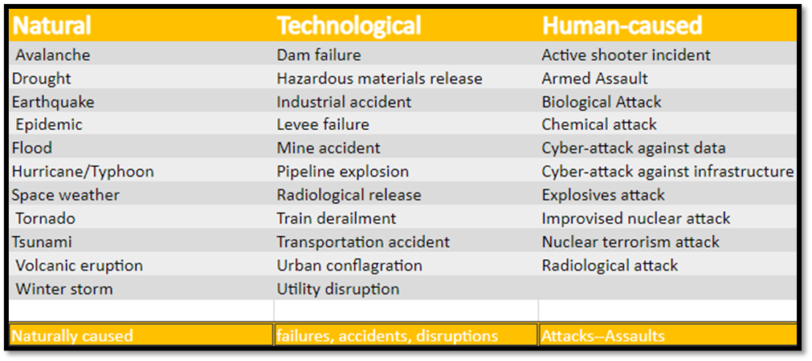
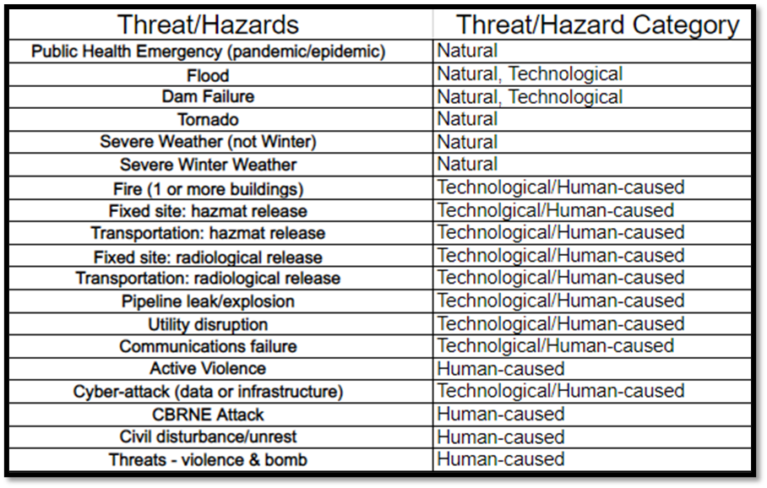
ASSESS Your Threats & Hazards
U.S.DHS CPG 201: THIRA/SPR Guide—3rd edition (p. 11)
LCC subset
Decided by a cross-organizational team from every campus and division
https://www.fema.gov/sites/default/files/2020-04/CPG201Final20180525.pdf
Listed in no particular order

Slide 7
ASSESS Your Vulnerabilities
Vulnerabilities
Threats
Hazards
Utility dependencies
Transportation (highways, railroad tracks, airports)
Communication (internal, depth, warning strategy, agreements)
Nearby fixed hazards (warehouses – chemicals, etc.)
Geographic (nearby rivers, lakes, oceans, mountains, etc.)
Common and Possible Local Weather Conditions

Slide 8
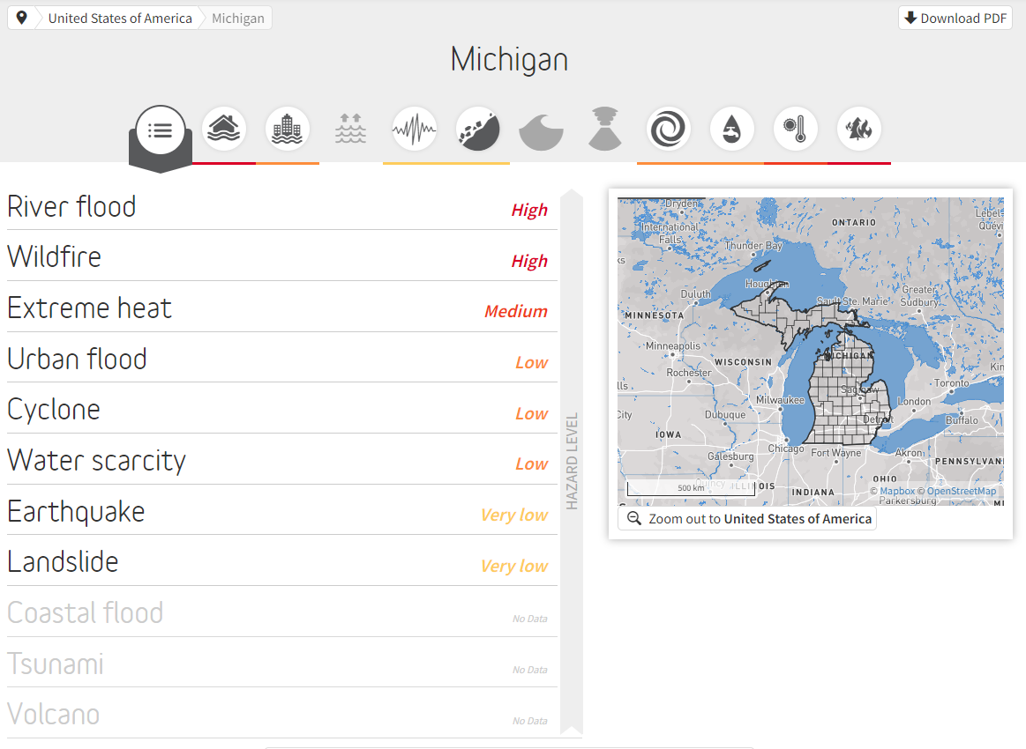
ASSESS Using Available Tools
thinkhazard.org
Focuses on natural hazards
ALSO:
Climate Risk and Resilience Portal (ClimRR)
https://climrr.anl.gov/
Notes:
Add the Climate Risk and Resilience portal

Slide 9
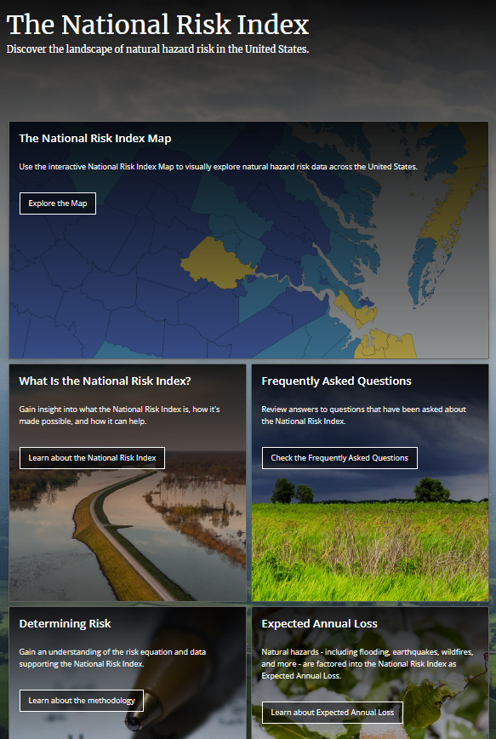
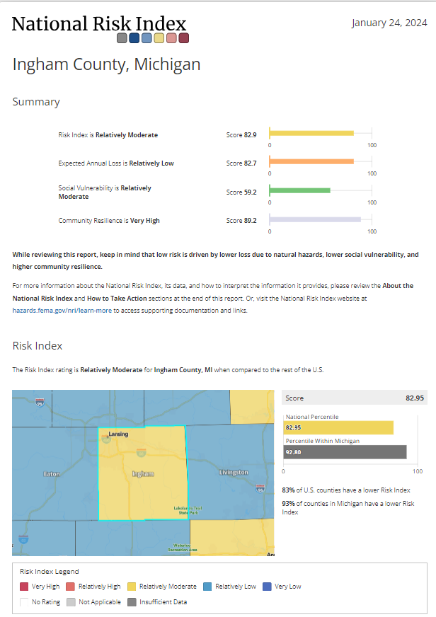
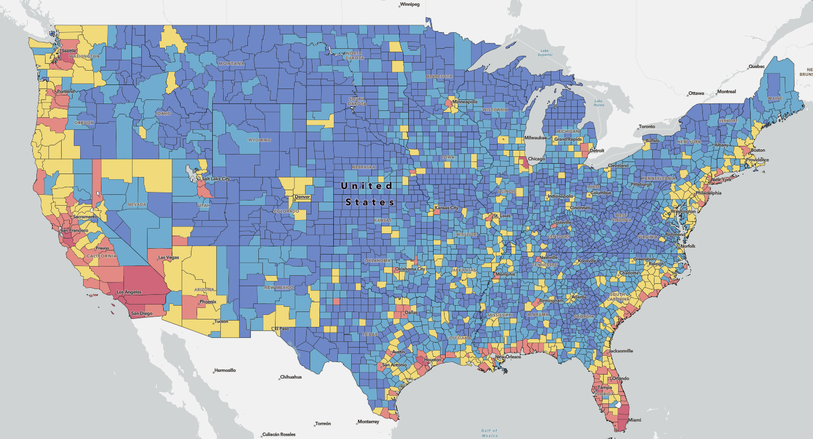
hazards.fema.gov/nri/
Step 2. Zero in to click on your city or county
Step 1.
Step 3. Click on
“create a report”
Report also includes details
of the summary data and
Recommendation of actions

Slide 10
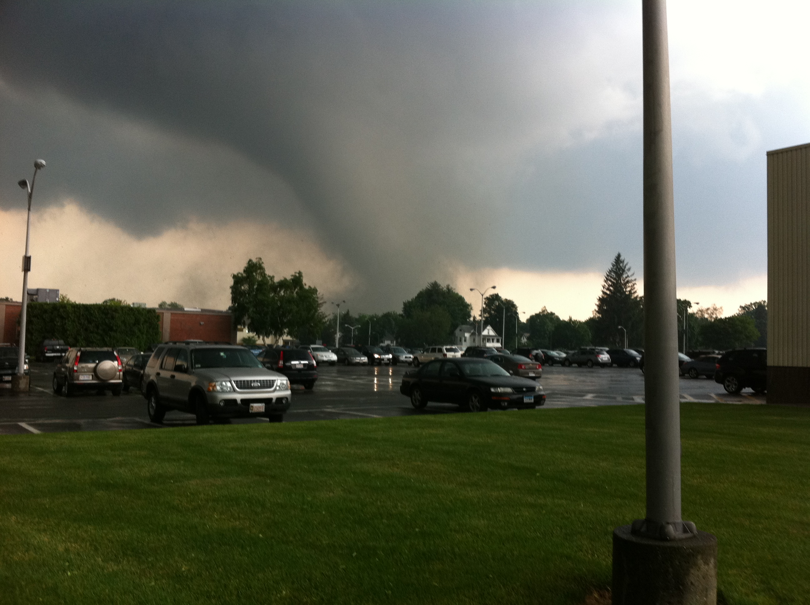
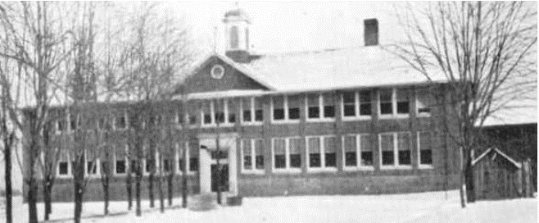
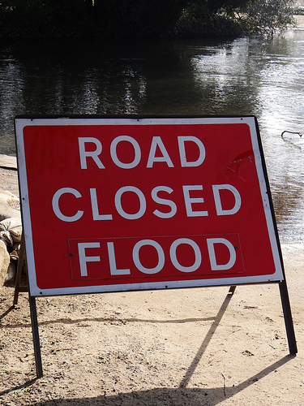
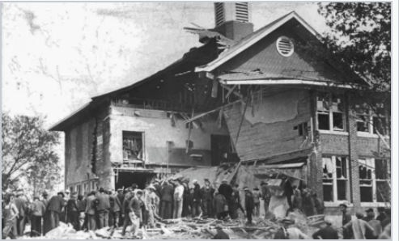
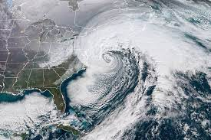
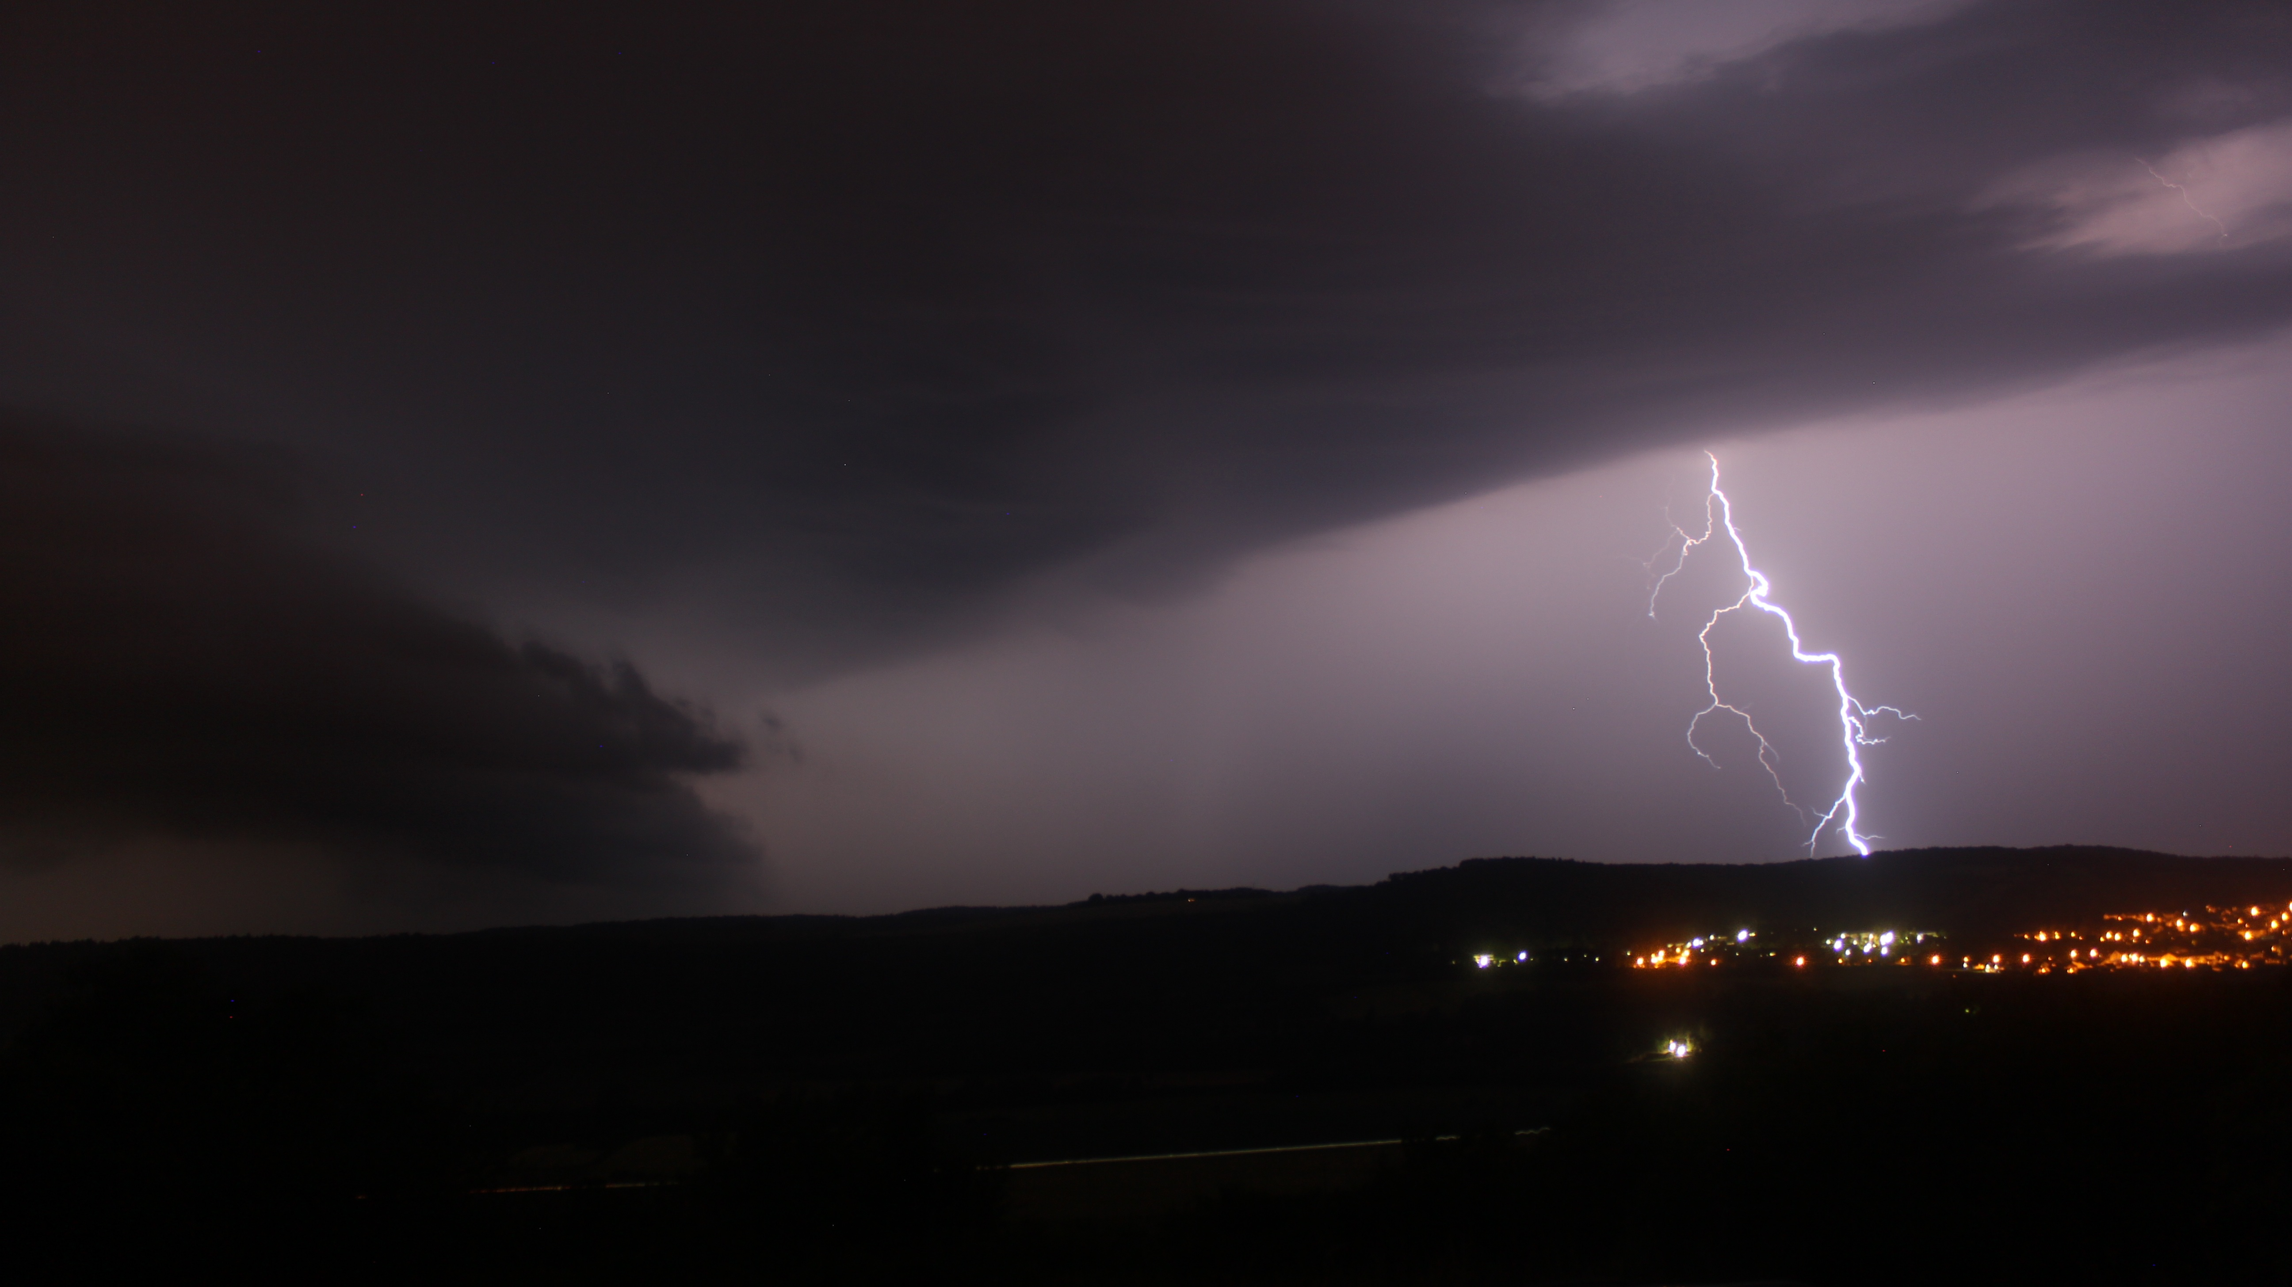
Hazard
Mitigation
Plans
Local
Regional
State
Hazard Mitigation Plans required by FEMA grants usually contain a thorough discussion of area hazards

Slide 11
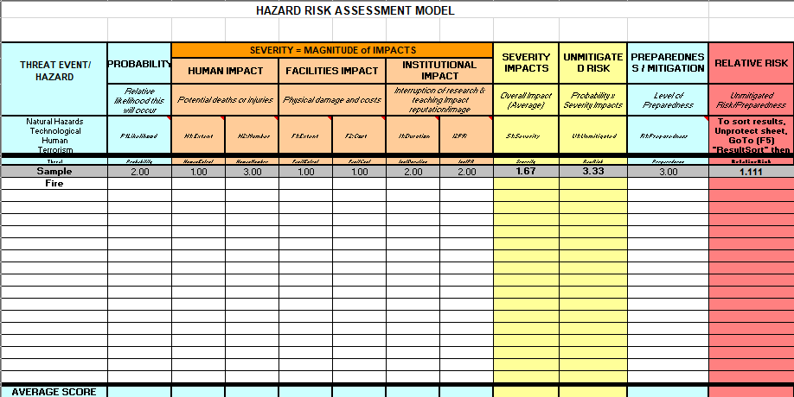
Understand your:
TOOL from FEMA/EMI Course G0363
threats,
hazards, and
vulnerabilities
Notes:
Use for collaborative input from multiple stakeholders

Slide 12
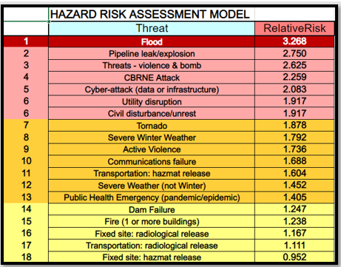
LCC Example – Aggregate of 5 campuses

Slide 13
II. Be Systematic
Helpful Hints:
Plan well and thoroughly
You exercise CAPABILITIES and PLANS, NOT a SCENARIO
Focus on Learning Objectives
Notes:
Core Capabilities
You are testing Plans/procedures/processes/organization/equipment/training (not people)
Objectives are key

Slide 14
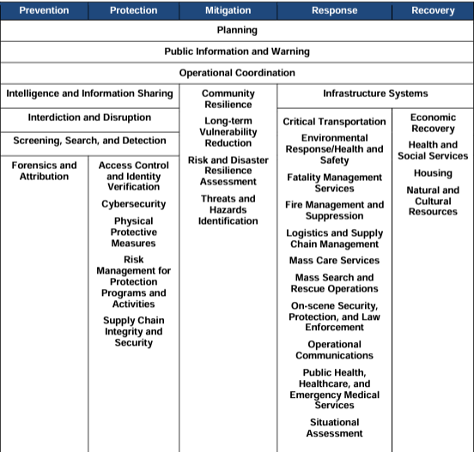
National Preparedness Goal – Core Capabilities
National Preparedness Goal, second edition, p. 3
https://www.fema.gov/sites/default/files/2020-06/national_preparedness_goal_2nd_edition.pdf

Slide 15
Core Capabilities Chosen for our ELT/IMT TTX in 2023
Operational Coordination
Operational Communication
Public Information and Warning
Situational Assessment
Intelligence Sharing and Dissemination

Slide 16
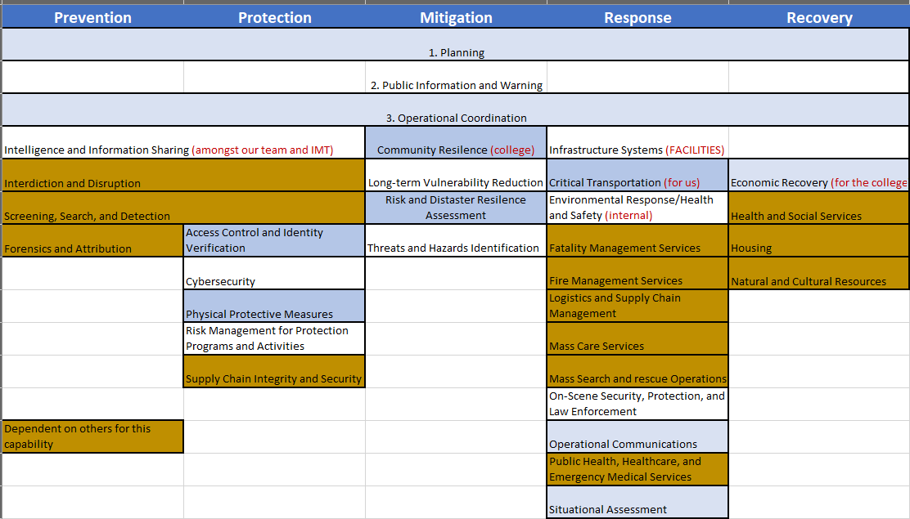





CORE CAPABILITIES – LCC specific
National Preparedness Goal, second edition, p. 3
https://www.fema.gov/sites/default/files/2020-06/national_preparedness_goal_2nd_edition.pdf

Slide 17
Plan A
processes
procedures
Plan B
processes
procedures
Plan C
processes
procedures
What are you Testing?
LCC TTX Examples
Crisis Communications Plan Emergency Operation Plan
-LCC Alerting Process -Severe Weather Response Procedure
EOC Activation Process -Threat Response Procedure
-IMT/EOC Activation Procedure -Hazardous Material Response Procedure
-EOC Reporting & Incident Action Planning -Civil Disturbance Response Procedure (past TTX)

Slide 18
Exercise Learning Objectives (LCC example)
. . .focused on improving understanding of a prevention, protection, mitigation, and response concepts, identifying opportunities or challenges, and/or achieving a change in attitude.
This exercise will focus on the following learning objectives selected by the Exercise Planning Team:
Identify and discuss roles and responsibilities as defined by the LCC Incident Management Team (IMT) structure and to effectively coordinate among the IMT.
Discuss and evaluate the ability of LCC to make effective and timely decisions during initial phases of incident response.
Demonstrate the ability to effectively assess the situation and communicate emergency alerts in a timely manner.
Review and assess the process to provide incident command and policy group with timely and relevant incident situational awareness and status updates.
Notes:
1. (to help to develop position-specific task books)

Slide 19
III. Be Creative
Think outside the box!!
Add bits of realism to capture the attention of participants

Slide 20
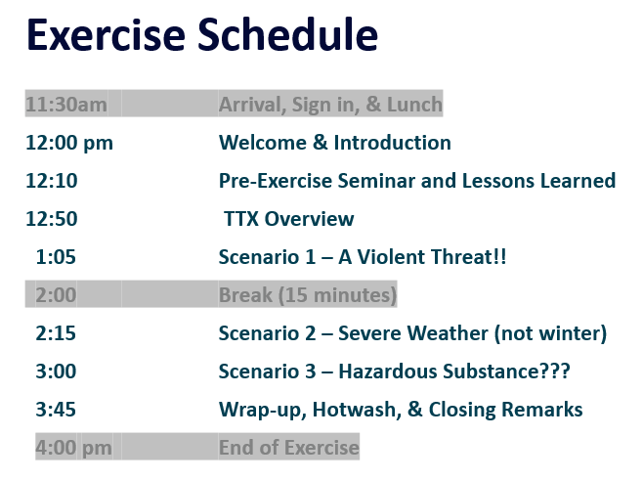




Critical Incident(s) “First Steps” TTX – ELT/IMT
Notes:
Note the Pre-exercise seminar and any other relevant information to help participants succeed in their exercie

Slide 21




Scenario 1
VM#1
VM#2
Call to Dispatch #3
Notes:
Speak to synthesized voice threats

Slide 22
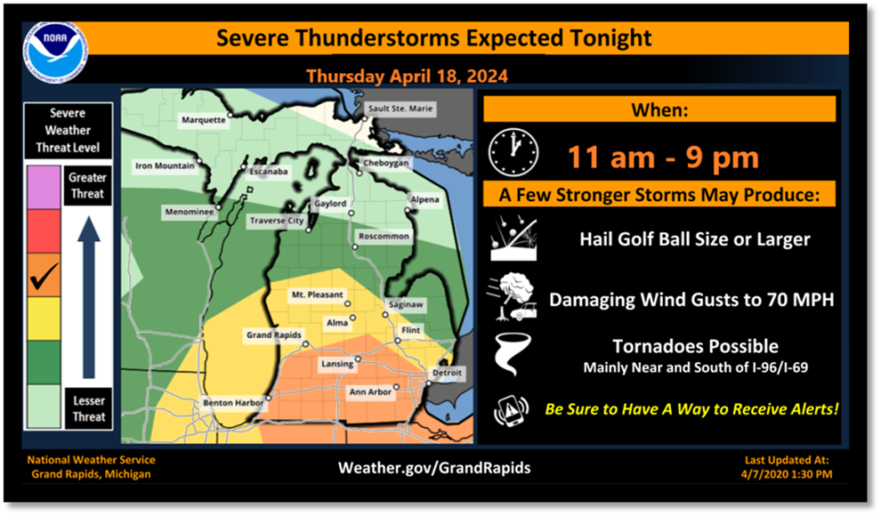
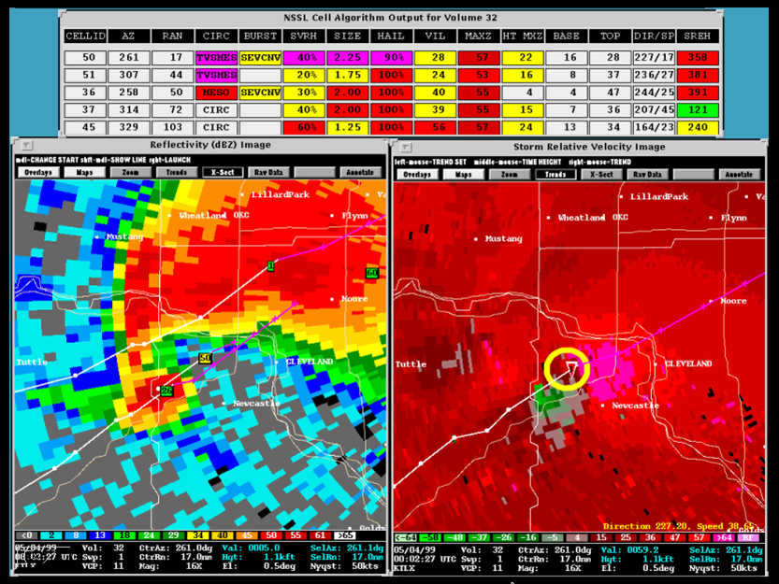
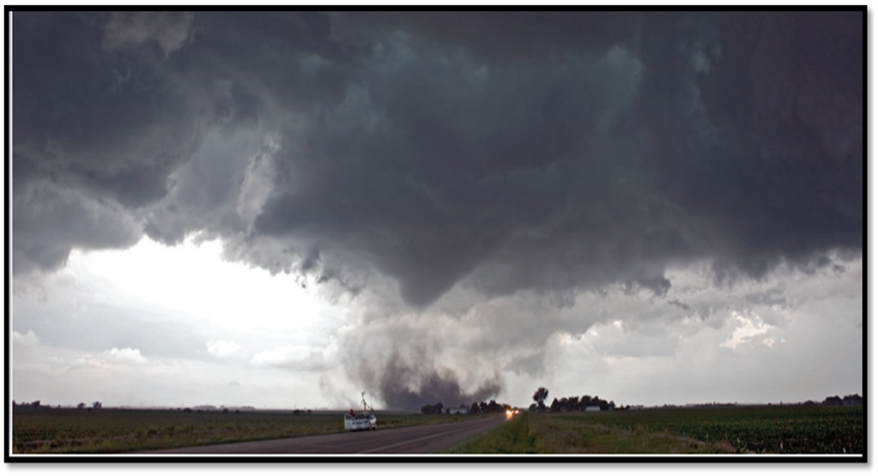


Scenario 2
Progressive Scenario
#1
#2
#3
Notes:
Speak to progression

Slide 23
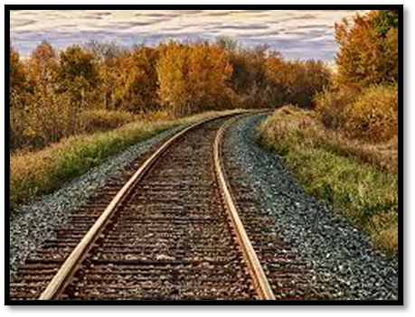
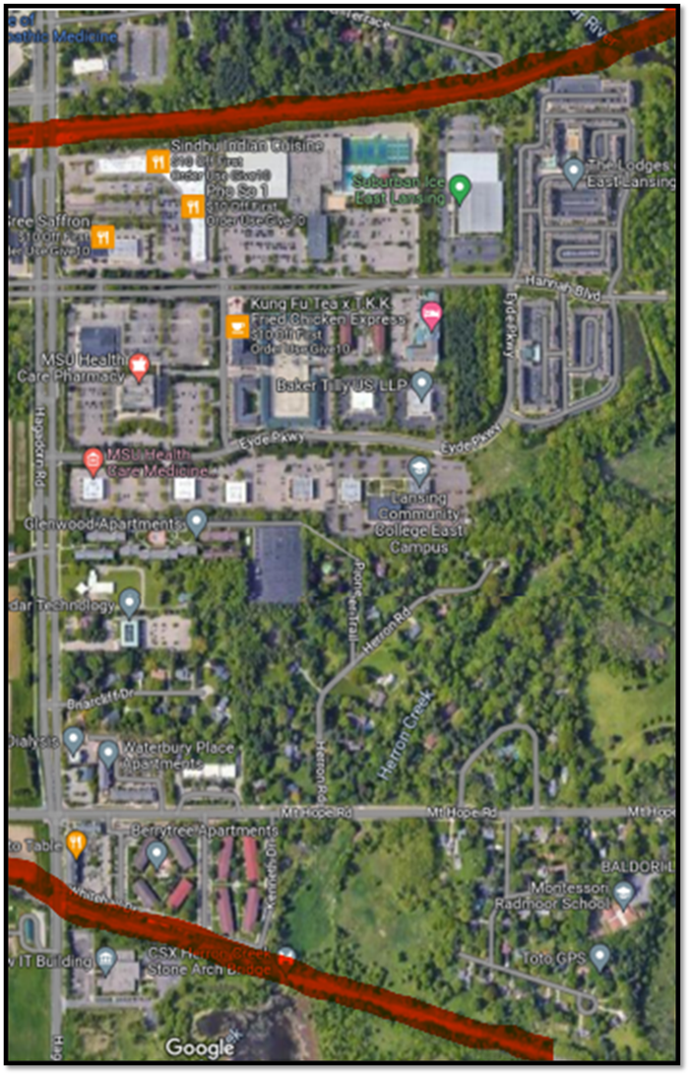
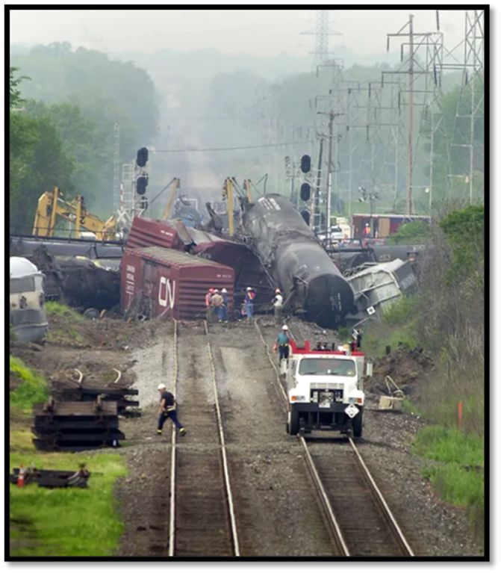

Scenario 3

Slide 24
Seat in logical groupings
Arrange participants into (incident response) groups
Discuss key Issues of scenario module
Questions should be developed related to each scenario to push the group toward meeting the exercise objectives
Ask questions along the way of key participants related to their role and responsibilities for such and incident.
Use break-out sessions for more in depth discussions. Have the group report out. Questions can vary for those logical groupings.
IC
PIO
OPS
PLN
LOG
FIN
Notes:
Emphasize point #5

Slide 25
Impromptu Drills
Create a virtual group or team, examples:
  Severe winter weather
  Virtual EOC activation - ELT/IMT
Periodically (monthly or so) present a situation and ask everyone “what would or should you do next?”
The information provided by participants can be used to build or refine plans and to teach the group by coaching and developing a common understanding.

Slide 26
IV. Wrap up & Follow up
Hotwash & After-Action & Corrective Actions --- Oh my!
Never let the outcomes of a good exercise go to waste

Slide 27

Lions &
Tigers &
Bears
Oh My!

Slide 28
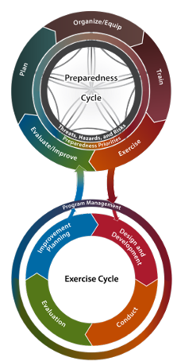
HSEEP
Homeland Security Exercise & Evaluation Program
FEMA GUIDELINES which sometimes become REQUIREMENTS if you are using GRANT-funding for the exercise. A few tips:
Use HSEEP if you have to
Take the pieces and parts that work best for you if you don’t have to
Operational Exercises tend to be more costly
Discussion-based exercises help you better work through thoughts and improvements (less stressed / less costly environment.)
https://www.fema.gov/sites/default/files/2020-04/Homeland-Security-Exercise-and-Evaluation-Program-Doctrine-2020-Revision-2-2-25.pdf
Notes:
I recently attended a presentation which said – “throw out HSEEP” – “don’t even look at it.” “Don’t even try”

Slide 29
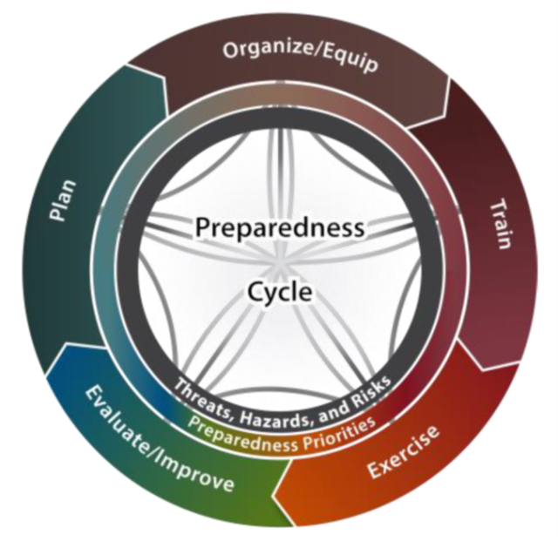
HOTWASH
Wrap up - HOTWASH
A HOTWASH should be held immediately after the exercise ends. It should focuses on two main points:
What went well?
What are opportunities for improvement?
TIPS
Never focus on the individual
Focus on plans, organization, equipment/tools, training & exercise (POETE)
Provide feedback forms to those who are unable to meet for the hotwash
Always Keep POETE in mind

Slide 30
After Action Meetings & Reports (AAM & AAR)
Follow up – AAM
The After Action meeting helps you to focus on corrective actions or solutions (never mistakes)
  Did we meet our objectives?
  What needs to be documented that has never been written down or plan updated? (How to improve the plan, process, or procedure)
  Are organizational revisions or new equipment /tools needed?
  What training & exercise would be helpful?
  KEY: Who is responsible for the corrective actions and what is the target date to completion?
  Do you have a Corrective Action Program (CAP)?
  Don’t forget to follow up on progress!

Slide 31
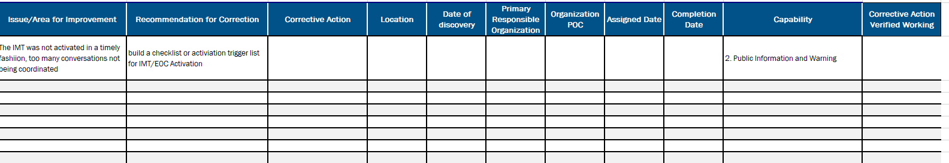
Corrective Action Program - Documentation and Tracking
An Example:
Follow up – CAP
Never let the outcomes of a good exercise go to waste

Slide 32
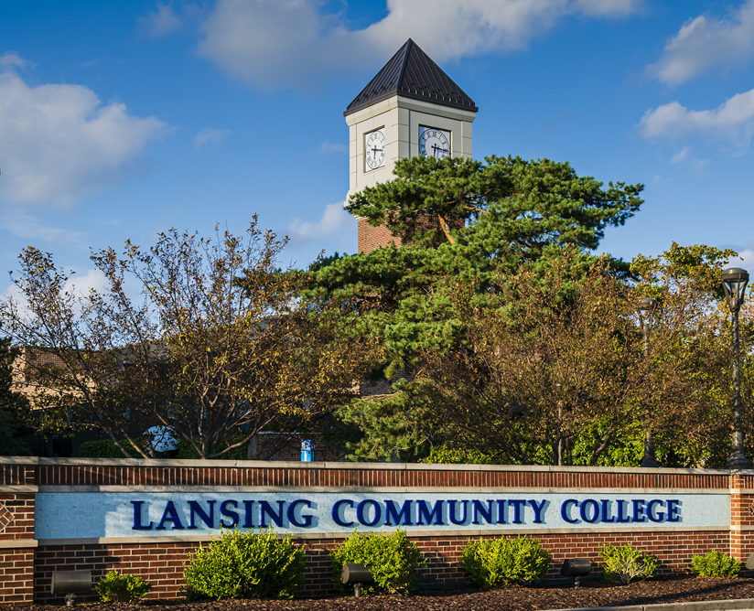
In Conclusion
Exercises need to work for you and your situation!
Do What Works Best for You and Your Organization.
Remember:
Do your homework
Be systematic
Be creative!
Don’t forget to wrap up and follow up

Slide 33
Resource Link Summary
National Preparedness Goal, https://www.fema.gov/sites/default/files/2020-06/national_preparedness_goal_2nd_edition.pdf
Comprehensive Preparedness Guide (CPG) 201, 2018 (3rd edition), aka Threat and Hazard Identification and Risk Assessment (THIRA) and Stakeholder Preparedness (SPR) Review Guide, https://www.fema.gov/sites/default/files/2020-04/CPG201Final20180525.pdf
FEMA’s National Risk Index, https://hazards.fema.gov/nri/
Natural Hazards, thinkhazard.org
Climate Risk and Resilience Portal, https://climrr.anl.gov
FEMA Flood Map Service Center, https://msc.fema.gov/portal/home
Homeland Security Exercise & Evaluation Program (HSEEP) https://www.fema.gov/sites/default/files/2020-04/Homeland-Security-Exercise-and-Evaluation-Program-Doctrine-2020-Revision-2-2-25.pdf

Slide 34
