Slide 1
Active Shooter Training Approaches
2-minute Stop & Think Drill
Tabletop Departmental Exercises with 2-minute timed discussions (Example from 11 Jan 2024)
ASU Office of Environmental Health, Safety, and Risk Management

Slide 2
2-Minute Stop and Think Drill
Governed by Operating Policy 34.30 Active Shooter Incident
  Appendices
    Active Shooter Response Personal Considerations for Any Location
    How to Respond if an Active Shooter Event Occurs – Plan Ahead

Slide 3
2-Minute Stop and Think Drill
Per Operating Policy 34.30, please discuss your run, hide, fight strategy for the next 2 minutes at your location with those around you. Please record any positive and negative findings and identify shortfalls or areas for improvement for your Run, Hide, Fight plan. The attached appendix provides an example of how to record on page 3.

Slide 4
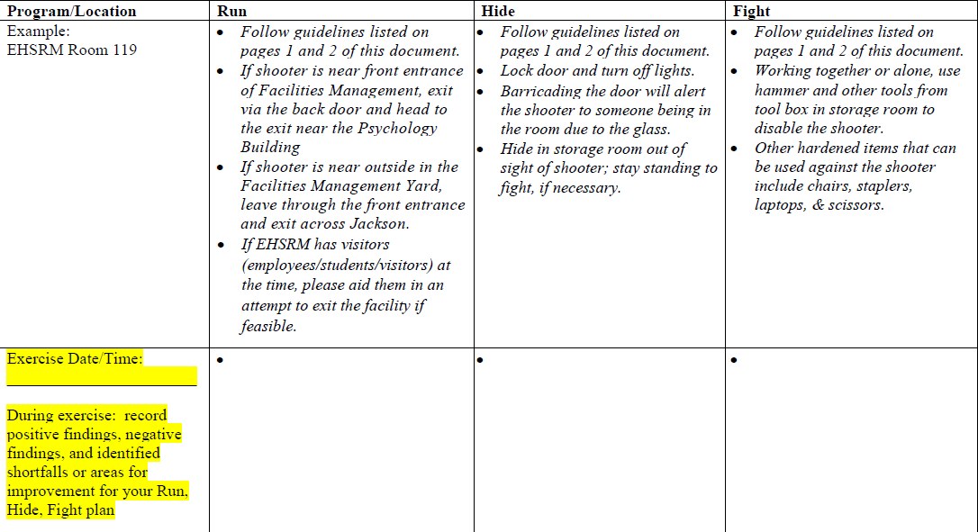
2-Minute Stop and Think Drill

Slide 5
Active Shooter Tabletop Exercise With
Timed 2-Minute Discussions
Presented by ASU’s Office of Environmental Health, Safety, & Risk Management
Notes:
POLL QUESTION
Does your institution conduct hands-on active shooter drills with faculty, student, and staff members? [open ended]

Slide 6
Objectives
CAF members who successfully complete this training will be able to:
Understand the importance of See Something Say Something Campaign and apply concepts to create a safer ASU campus.
Apply communication skills and peer interaction in a realistic exercise scenario.

Slide 7
See Something Say Something
Department of Homeland Security Initiative - https://www.dhs.gov/see-something-say-something
Emphasis on noticing surroundings & changes in behavior
Partnered with Student Government Association
The Challenge: https://www.dhs.gov/see-something-say-something/take-challenge
Video: https://www.youtube.com/watch?v=9qyD7vjVfLI&feature=youtu.be

Slide 8
Discussion Items
Safety & Emergency Situations
Location of nearest building exit(s)
Not necessarily the route you came to class
Location of life safety equipment, as applicable
Fire extinguisher, AED, first-aid kit, eye wash, and/or shower station
Severe weather shelter-in-place location
Fire evacuation muster point

Slide 9
Discussion Items
Active Shooter Situation
See something, say something; report suspicious activity to UPD: 942-2071
Denial
Do not deny you possibly heard gun shots.
Interrupt the lesson.
Deliberation
Avoid: Can I flee the situation?
Deny: Lock and barricade doors, silence phones, close blinds, and prepare to defend.
Defend: Position people on either side of door, attack shooter with any means possible.

Slide 10
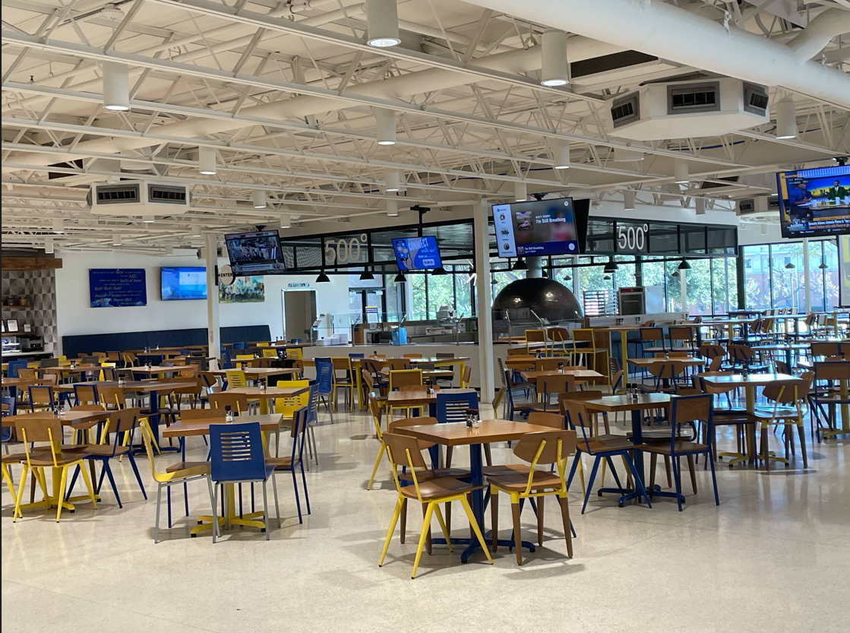
Module 1
Tuesday, January 16, 2024, at 11:00 AM
Many students are entering the CAF for lunch
First day of the Spring semester

Slide 11
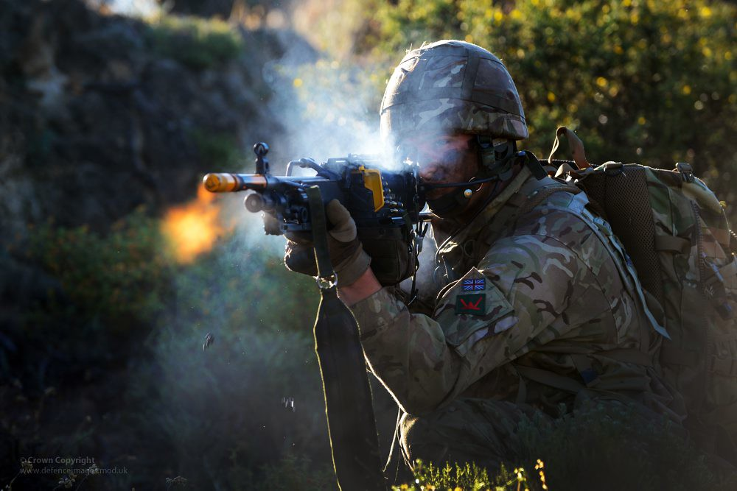
Module 1
At 11:15 AM…
ASU (@angelostate) is tagged in a Snapchat post by @Zachtheundead.
The post contains a picture of a man holding a gun.
“Lunch is going to be to die for today.”
This Photo by Unknown Author is licensed under CC BY-NC

Slide 12

Module 1
At 11:16 AM, a student in the CAF sees the post.
UPD is contacted immediately after the student sees the post.

Slide 13
Module 1
The Snapchat account includes no personal information about the account owner except a name, which is Zach.
Some students in the CAF are confused and alarmed because a fellow student named Zach took his own life last semester after finals.
A couple of students noticed that Zachary’s best friend Nate is sitting alone in the CAF and had been hash-tagging longlivezach on Instagram for the past couple of days.

Slide 14
Module 1
At 11:17 AM, Some students outside the CAF hear gun shots coming from the CAF.
Several students, faculty, and staff are seen running from the CAF.
Some individuals currently in the CAF take cover in the restrooms, kitchen storage rooms, and freezers.
The CAF has approximately 80 students and 20 workers present.

Slide 15

Module 1
Discussion
What are your objectives/priorities at this point based on your choice?
What should you do as faculty, staff, and students if taking refuge and hiding in the CAF?
Do you evacuate, hide, or fight back? If so, explain your choice or choices.
2 minutes

Slide 16
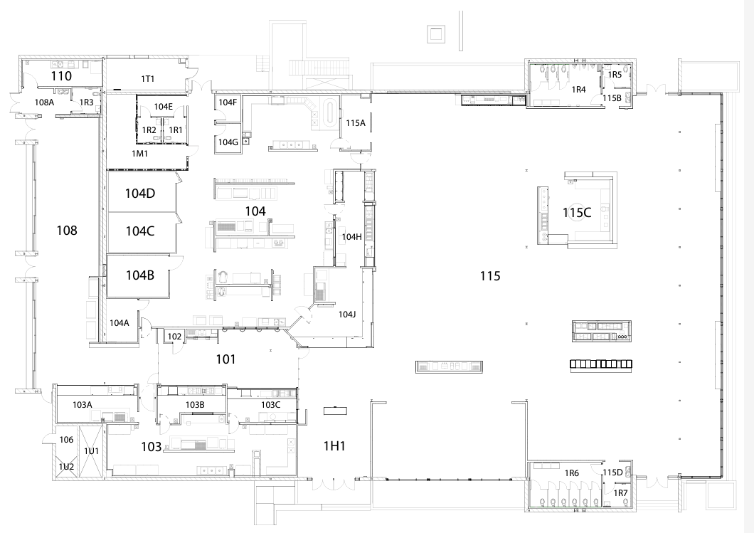
Module 2
At 11:17 AM and 45 seconds, the shooter makes his way back to the kitchen area to continue the rampage.
UPD and SAPD are now arriving to the CAF but are unaware of the shooter’s location within the building.
Individuals are still in rooms spread out throughout the CAF.

Slide 17
Module 2
As the shooter fires rounds randomly, he yells “long live Zach.”
A student provides the following information about Nate by texting 911 while hiding from the shooter in the CAF:
Name: Nate Smith
Age: 22
Major: Biology
Degree building: Cavness
Students and faculty in the kitchen storage room prepare to fight back with any weapons possible (i.e., vegetable cans, shelves, etc.).
One worker in the storage room has a license to carry and is armed with a handgun.

Slide 18
Module 2
Students hiding in the various CAF rooms begin posting on social media platforms.
Students are posting weapons and location and about the situation, and some students are even saying their goodbyes in a worse-case scenario attempt through Twitter/Snapchat/Instagram/Facebook.

Slide 19
Module 2
Discussion
If you were in the storage room, how would you position yourself, the worker with the gun, and what is your plan if the shooter enters?
Should the student with the handgun pursue the shooter or stay in the storage room?
2 minutes

Slide 20
Module 3
At 11:18 AM, the shooter overhears cell phones and talking coming from the CAF kitchen storage room.
The shooter then proceeds to open the storage room door and invade the room.
Upon entering the room, the armed worker surprises the shooter, shoots, and kills Nate Smith.
In addition to the shooter, 22 students were injured, and one worker and three students were killed.

Slide 21
Module 3
National news stations begin to cover the story.
Many families and friends are concerned for their loved ones.
Calls to campus are extremely high.
Many parents and friends are coming to campus to check on loved ones.
Ambulances have taken the students who have been wounded for treatment.
Campus closure has been declared.
The CAF will be out of operation for further investigation for an unknown time frame.

Slide 22
Module 3
Many reporters and family members are on campus questioning staff, police, and students.
All current activities have been disrupted.

Slide 23
Module 3
Discussion
What are the priorities and objectives now?
Should any warnings, notices, or alerts be sent out?
How should the media be handled?
How should family members and friends be handled?
2 minutes

Slide 24
UPD Feedback
Actions:
ASU Alert
Campus Shelter In Place; campus to avoid east side of campus
Follow-up messages as required
Restrict access around CAF
Expectations:
Assist in helping evacuate the building.
Assist in searching common areas for anything that might seem suspicious.
Provide support for evacuees during the event.
Be patient for building-by-building all-clear actions by UPD.

Slide 25
Communications & Marketing Feedback
Enact Crisis Communications Plan.
Post instructions through ASU Alert, which will populate university website and official university Facebook and Twitter feeds.
Request media stay clear of incident.
Provide situational updates to media, as appropriate.
Let Communications & Marketing be ASU spokesperson.
Do not post to social media other than to share official university posts.
Publicize family unification center location.

Slide 26
You can create a “safer” workplace
Exercise situational awareness.
If you see something, say something!
Conduct assessment.
Program local PD Dispatch (942-2071) into your cell phone or be ready to call/text 9-1-1.
Train.

Slide 27
Active Shooter: Top Themes
An active shooter (AS) situation can develop anytime, any place.
Expect the unexpected. Look at people’s behavior critically.
If you see something, say something!
Police cannot prevent an AS while the incident is ongoing.
You can play a role in reducing the risk of an AS on campus.
Time is critical. You must act decisively.

Slide 28
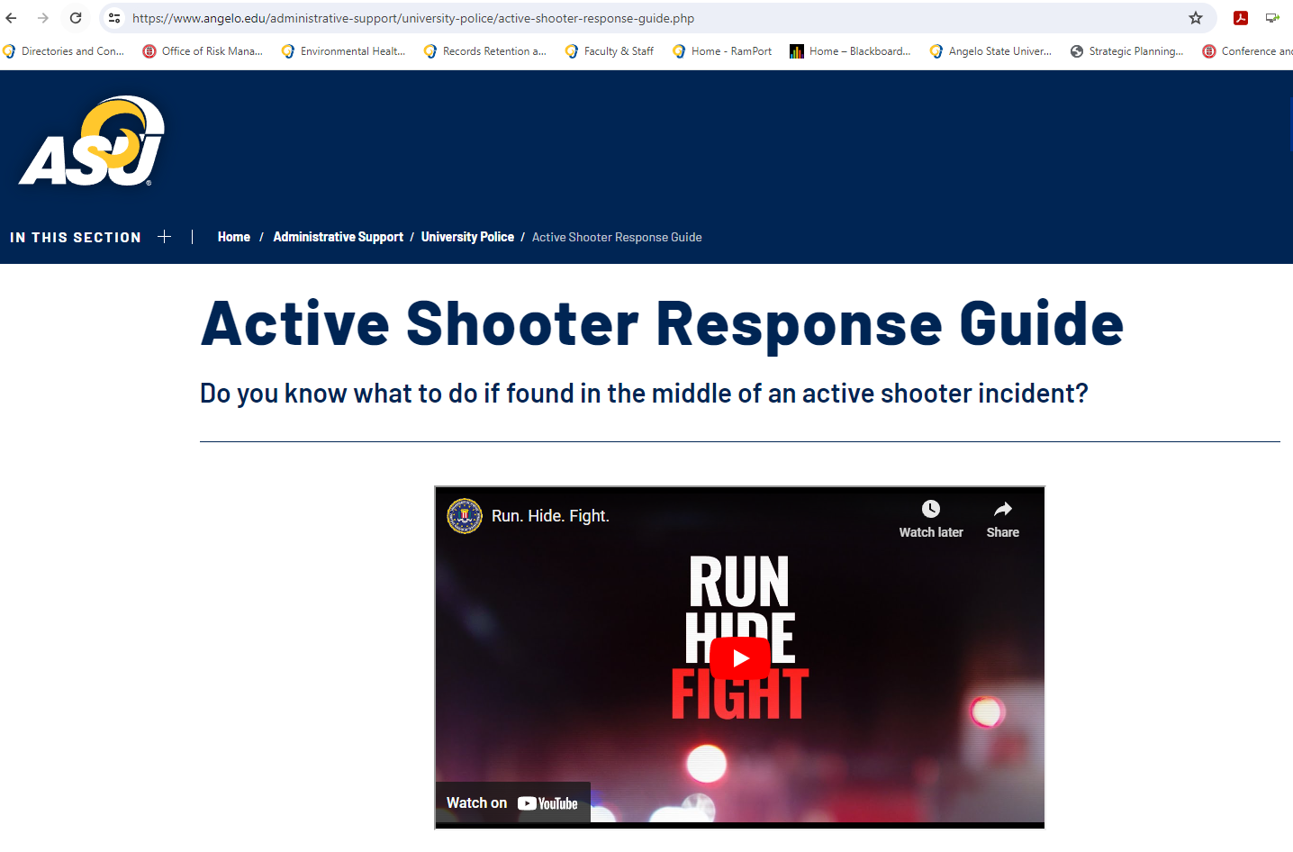
Thank you!
Sam Spooner, Director, EHSRM
James Spencer, EHS Specialist

Slide 29
2 minutes

