Slide 1
Business Continuity —
Best Practices and Lessons Learned
Notes:
Ali –
Acknowledge the Uvalde incident. Stress mental health (especially self-care).
COVID mitigation grant is available to use for mitigation efforts outside of covid including hardening of schools. Deadline June 30th .

Slide 2
Definition
As defined in the National Continuity Policy Implementation Plan (NCPIP) and the National Security Presidential Directive 51/Homeland Security Presidential Directive 20 (NSPD-51/HSPD-20), is an effort within individual executive departments and agencies to ensure that Primary Mission Essential Functions (PMEFs) continue to be performed during a wide range of emergencies, including localized acts of nature, accidents, and technological or attack-related emergencies.
Notes:
Ali

Slide 3
What Does That Really Mean?
Continuity is how we keep the things going that make us the institution, organization, or business unit we are.
Notes:
Ali
Jim
Thank you UC System
Poll: Does your institution have a policy/procedure at the institutional level that addresses continuity of operations/instruction?

Slide 4
Incident Management
Continuity of Operations
Notes:
Ali

Slide 5
Incident Management vs. Continuity
Incident focused
Survival mode
  Saving lives
  Stabilizing the incident
  Protecting property and the environment
Service delivery is a low priority
Function focused
Incident independent*
Service delivery is the priority
Notes:
Jim
Poll question: Do you have your EMP and BCOOP as separate and independently functioning plans?

Slide 6
Business Unit Essential Functions
Department Essential Functions
Campus Essential Functions
Institutional Essential Functions
Notes:
Jim

Slide 7
Core Tenets of a Continuity Plan
Identification of critical functions
Succession of leadership
Delegation of authorities
Communication plan
Vital data, systems, and equipment
Upstream and downstream dependencies
Key resources
Notes:
Jim
Poll question: Do you have your critical functions outlined by hierarchical levels (campus -> department -> business unit)?

Slide 8
Institutional Essential Functions
These are the philosophical core functions of your institution as defined by your executive leadership.
Different for every institution.
Must come from the board and/or executive level.
Drive all lower levels of functions.
Can be a useful filter.
Notes:
Ali

Slide 9
Campus Essential Functions
Continue visible leadership.
Continue teaching.
Continue research.
Maintain critical infrastructure.
Maintain the reputation of campus.
Maintain relationships with stakeholders.
Maintain safety & security.
Provide emergency services.
Maintain financial stability.
Maintain basic campus services.
Notes:
Jim

Slide 10
Department Essential Functions
Sensitive to downtime.
Fulfill legal or financial obligations.
Play a key role in maintaining your departments and campus reputation.
Safeguard an irreplaceable asset(s).
Is there a potential for mission loss if this function is not completed?
What campus objective/goal does this function support?
Does the successful completion of this function depend on any other functions?
Notes:
Ali

Slide 11
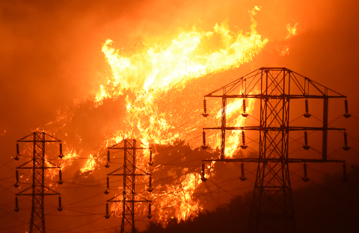
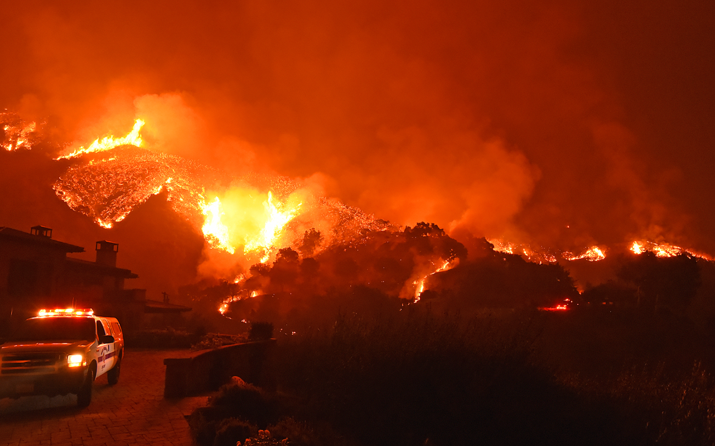
Case Study — Thomas Fire
Notes:
Jim

Slide 12
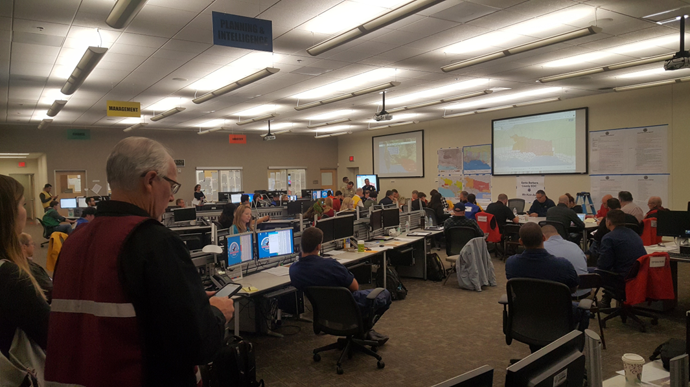
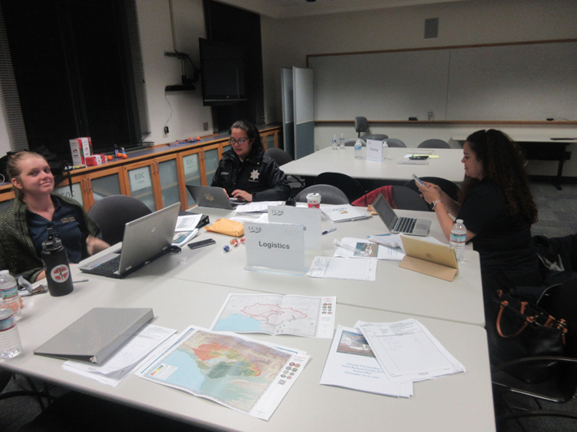
Case Study — Thomas Fire
Notes:
Jim

Slide 13
Case Study — Thomas Fire
Rolling power disruptions during the Thomas Fire during “Dead Week”
Power disruptions lasting for minutes to hours at a time
Effects
  Limited power source for students studying
  Rolling blackouts during the final week of instruction
  Information technology servers overheating due to cooling systems not functioning
  Threats to vital research being done on campus
Notes:
Jim

Slide 14
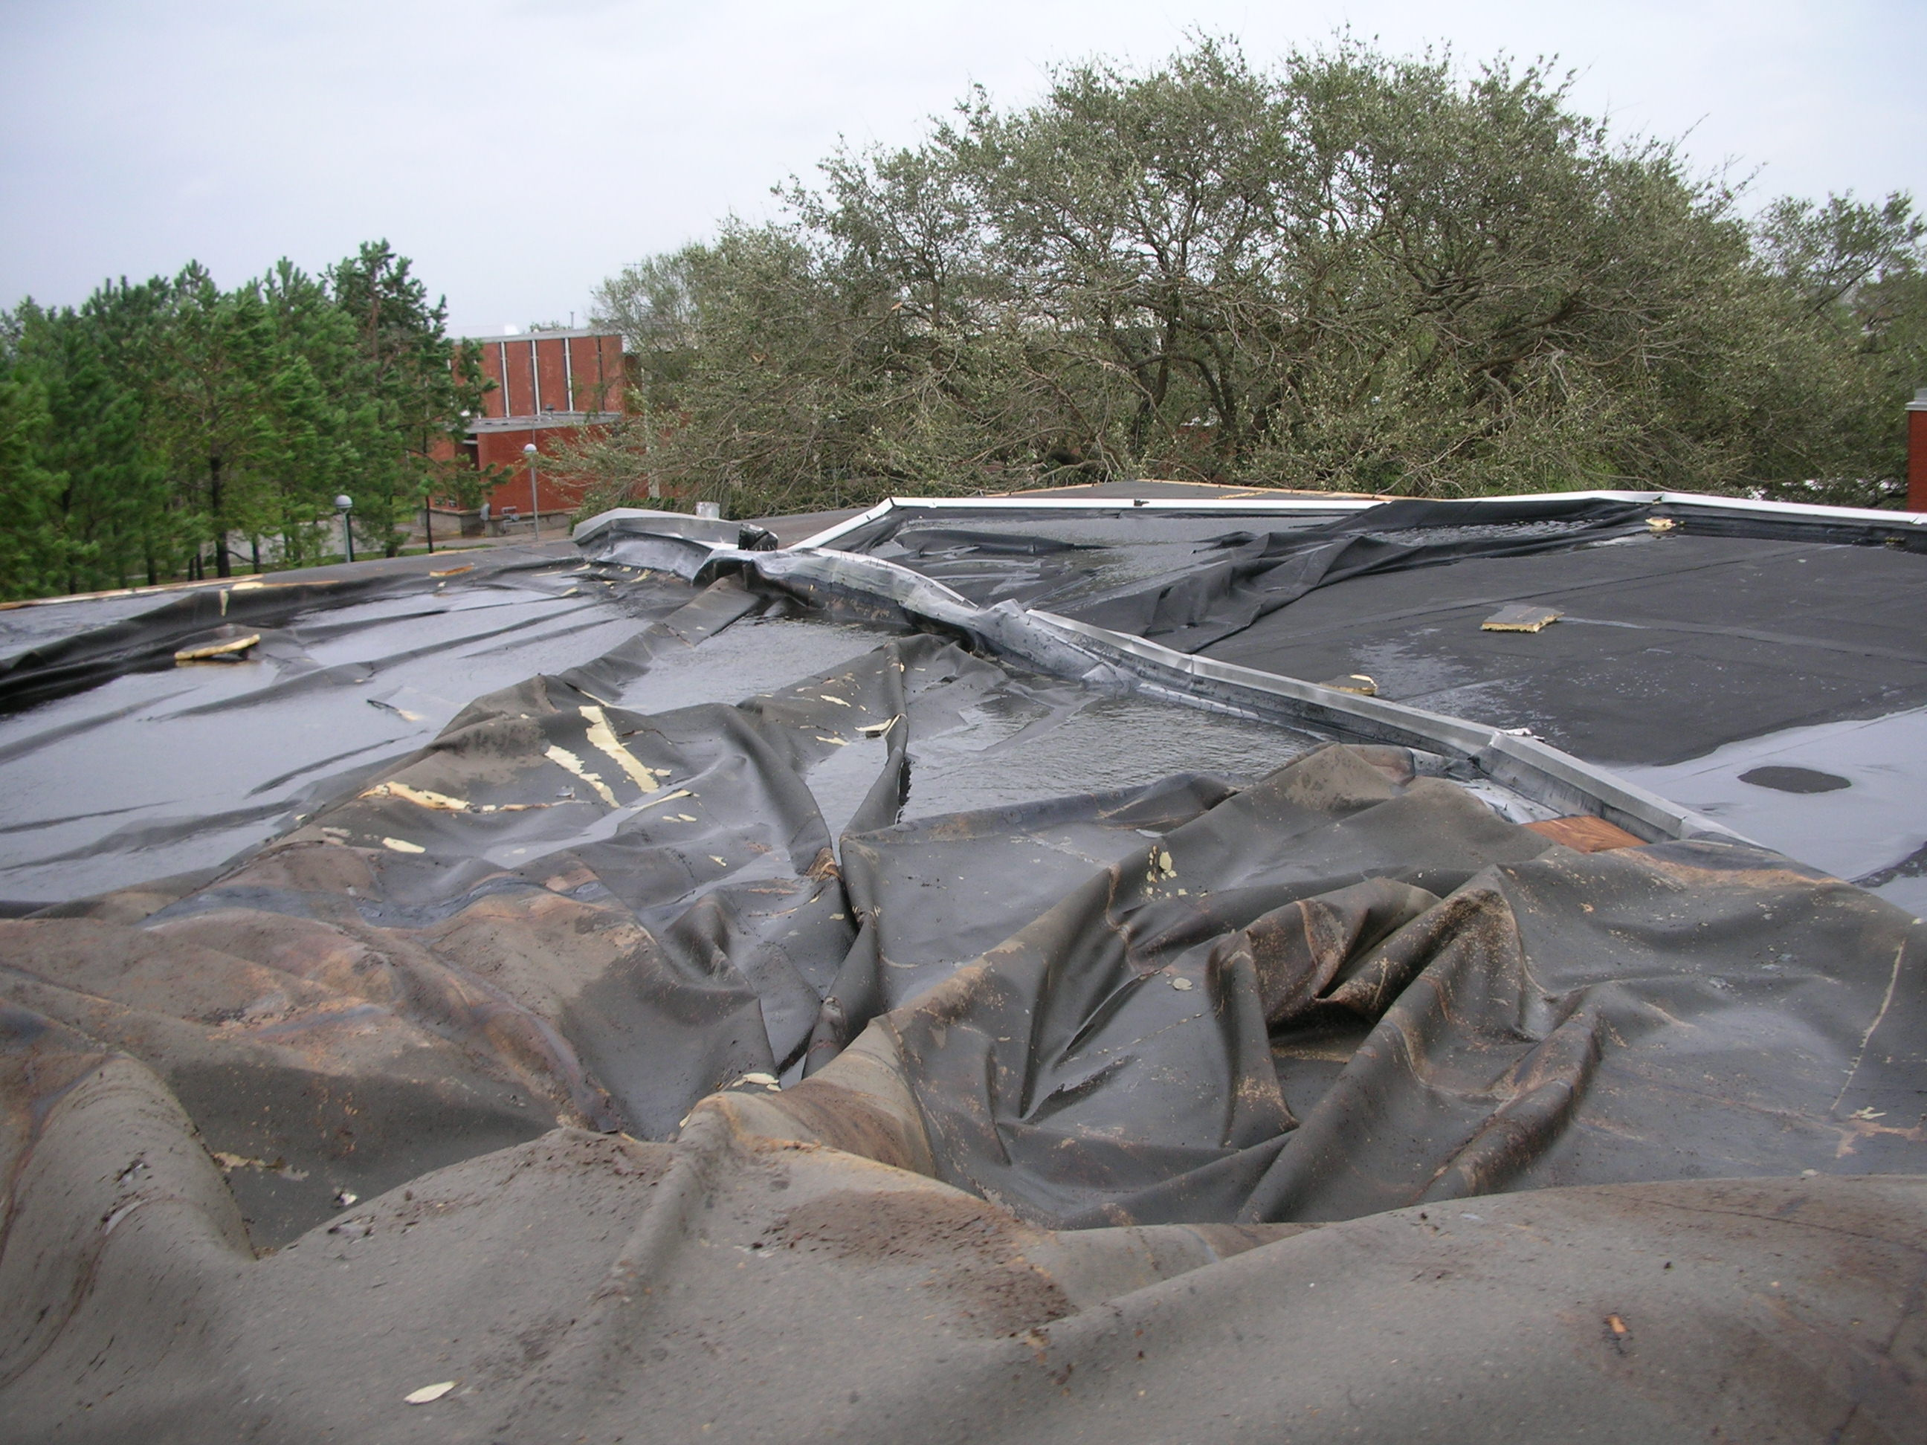
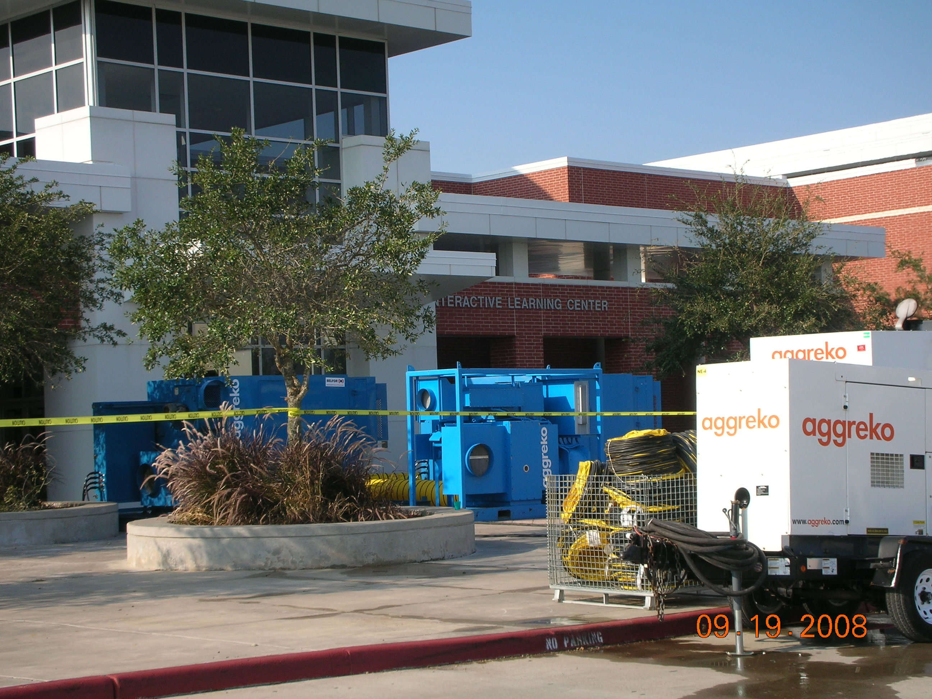
Case Study — Winter Storm Uri
Notes:
Ali

Slide 15
Case Study — Winter Storm Uri
Significant damage done to one building, with an estimated repair time of 6 months.
Building houses science and health professions classrooms and labs.
Relocated all programs to other buildings to include
  Labs
  Simulation equipment
  Special classroom setups
Notes:
Ali

Slide 16
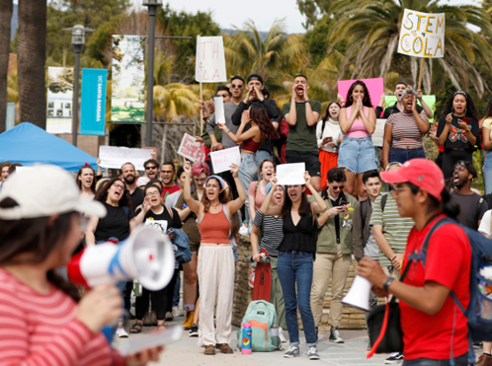
Case Study — Graduate Assistant Strike
Policy group activated, not EOC
Impacted the mission of the campus similarly as the Thomas Fire did
Continuity plans enacted for the Academic and Research Mission
Notes:
Jim

Slide 17
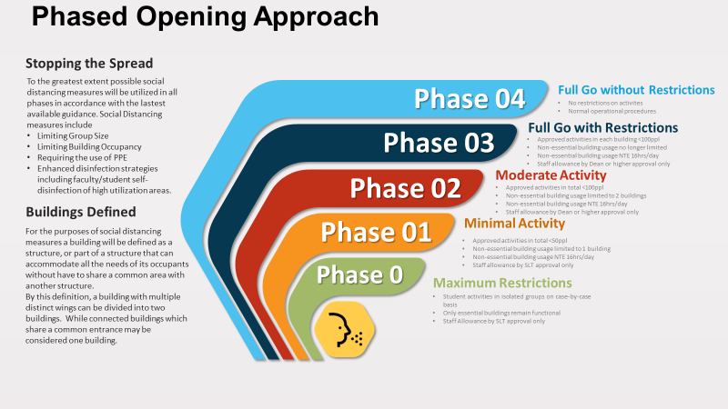
Rolling power disruptions during the Thomas Fire during “Dead Week”
Power disruptions lasting for minutes to hours at a time
Effects
  Limited power source for students studying
  Rolling blackouts during the final week of instruction
  IT Servers overheating due to cooling systems not functioning
  Threats to vital research being done on campus
Notes:
Ali & Jim

Slide 18
Resources
Federal Emergency Management Agency Continuity Resource Toolkit
  https://www.fema.gov/emergency-managers/national-preparedness/continuity/toolkit
REMS TA Center Continuity Resources
  https://rems.ed.gov/Resources/Specific?Topic=COOP
Texas State Office of Risk Management Continuity of Operations Planning
  https://www.sorm.state.tx.us/coop/
Notes:
Ali

