Slide 1

Information and Notification Center/ Reunification
Planning for the needs of survivors and loved ones after a disaster or mass casualty incident

Slide 2
Universities and Colleges Caucus (UCC)
Reunification Working Group Members
Name | Institution
Vanessa Flores | University of California, Irvine
Eric Hodges | Illinois State University
Kristen Mruk | Buffalo State University
Tara Thomas | Virginia Commonwealth University
David Barber | Massachusetts Institute of Technology
Grant Burnett | Cypress-Fairbanks Independent School District
Emily Kies | Elgin Community College
Ricardo Gonzalez | The University of Texas at El Paso
Krista Flannigan | Office for Victims of Crime
Donna Dougherty | “I Love U Guys” Foundation

Slide 3
Background Information
UCC Hot Topics—February 28, 2023
“I Love U Guys” Foundation
Reunification and Family Assistance Center Briefing
Engaged in fact-finding with the “I Love U Guys” Foundation to audit the reunification framework for institutions of higher education (IHEs)
Established the UCC Reunification Working Group—June 8, 2023
Partnered with the Office for Victims of Crime (Krista Flannigan, J.D.)—August 3, 2023
Moved from biweekly meetings to weekly meetings—September 14, 2023

Slide 4
Moving Forward
Two products that were developed could be used for
  Developing a plan
  Appointing members to fill the necessary roles
First draft products
Feedback is very much welcomed and encouraged
  Disseminating plan template through UCC
Presentation at the Higher Education Leadership Group in December
  Developing training
  Developing channels for dissemination
Phase 2—Develop a new working group to focus on the Family Assistance Center planning/template

Slide 5
Words Matter
USE … | INSTEAD OF …
Information and notification | Reunification
Acknowledgment, accommodation, adaptation | Closure
Remembrance, observance | Anniversary
Incident, crime, murder | Event
Activator, cue | Trigger

Slide 6
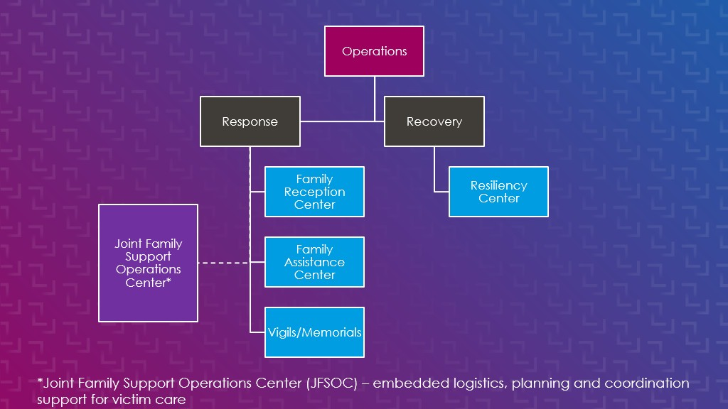
Integration Into External Agency Structure

Slide 7
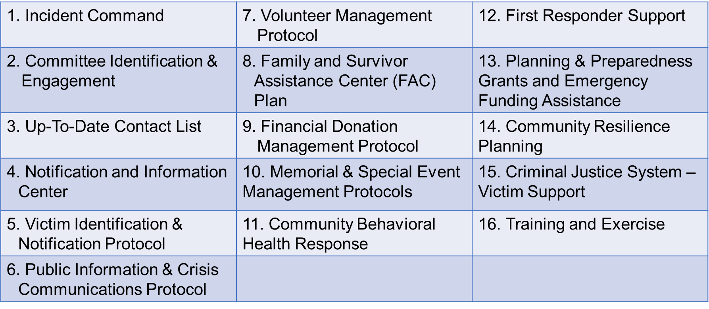
16 Best Practices in Planning for
Mass Casualty Incidents

Slide 8
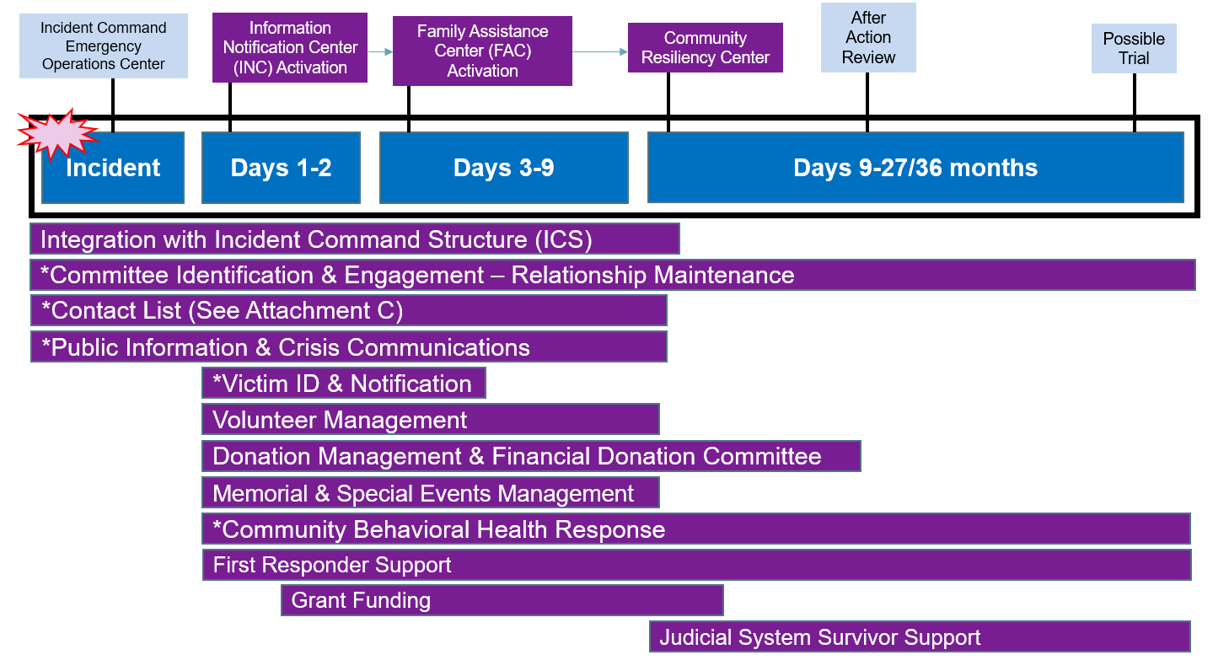
Defining the Scope
* Topics discussed in the template

Slide 9
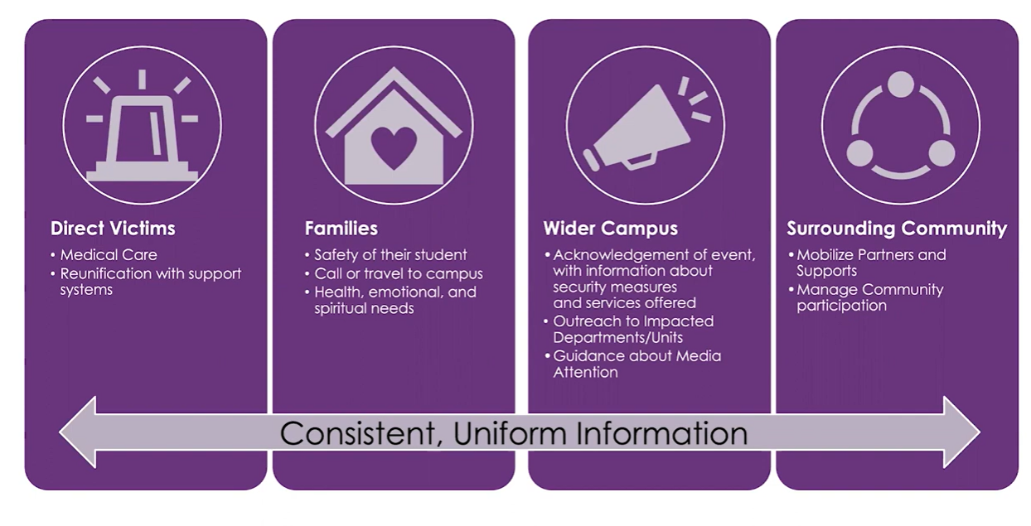
Who Are We Servicing?

Slide 10
Information and Notification Center (INC) Functions
Registration
Mental/
Behavioral Health
Spiritual Care
Reunification/ Notification Team
Victim ID/ Tracking
Safety/ Security
Transportation
Comms/
Information
Technology (IT)
Public
Information
Officer/Media
Limited Food/ Beverage

Slide 11
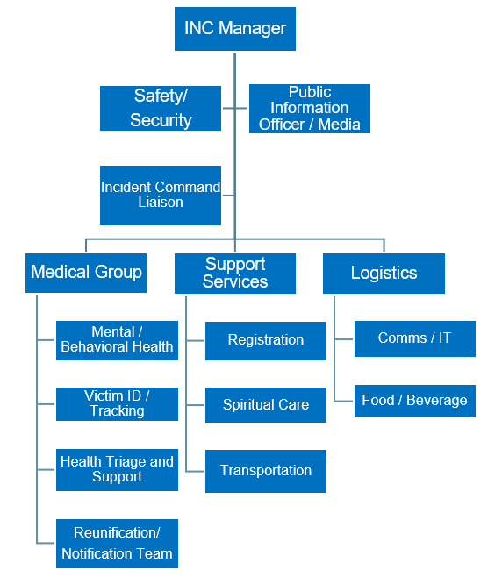
Sample Organizational Chart

Slide 12
Identifying Who Will Provide These Services at the INC

Slide 13
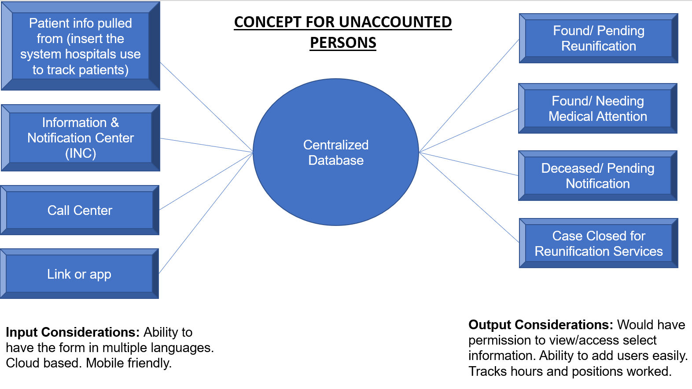
Developing a Framework for Reunification

Slide 14
Developing the Plan
Campuses are going to be at different starting points
Plan template is structured to either help build your plan from scratch or tailor your current plan with additional considerations
Formatted into two sections:
  Section 1: Table with planning considerations that reflect lessons learned and questions needing to be answered and included in the plan
  Section 2: Written as an actual annex/appendix for the respective chapter and incorporates the answers from Section 1

Slide 15
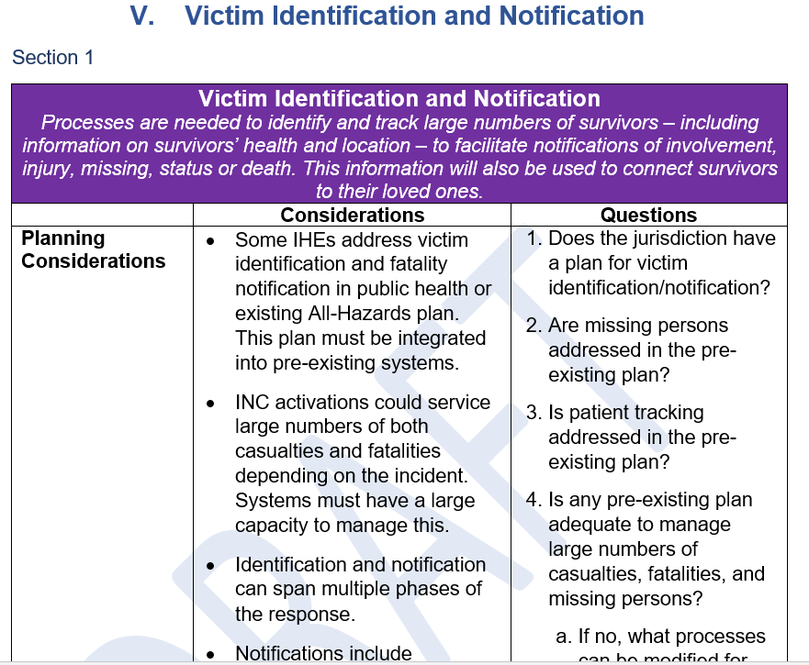
Example of Section 1 in Chapter V

Slide 16
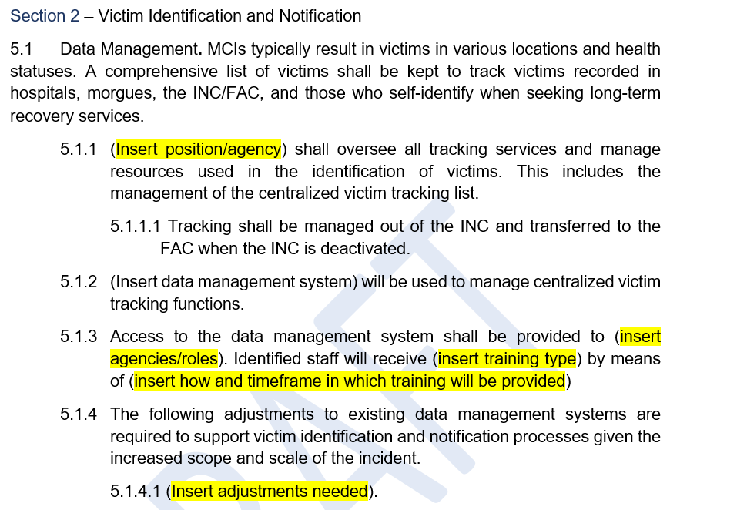
Example of Section 2 in Chapter V

Slide 17
Table of Contents
Purpose
Scope
Committee Identification and Engagement
Information and Notification Center
Victim Identification and Notification
Public Information and Crisis Communication
Community Behavioral Health
Training and Exercises
Attachments:
  List of Potential Internal and External Partners
  INC Fillable Contact List
  Potential Methods for Missing Persons
  Sample Missing Persons Form

Slide 18
Way Forward
Materials disseminated through UCC distro (456 IHE personnel) for feedback
  Suspense December 8
Target date to finalize documents is end of this year
Documents will be housed on the UCC Basecamp and possibly the “I Love U Guys” Foundation website
  Working with the National Mass Violence Victimization Resource Center to house on its website, as well
Goal is to make this accessible for all IHEs even via a Google search
Looking to have these documents approved by the Federal Emergency Management Agency as the standard, and then following that up with developing training in these areas

Slide 19
Thank You!

