Slide 1
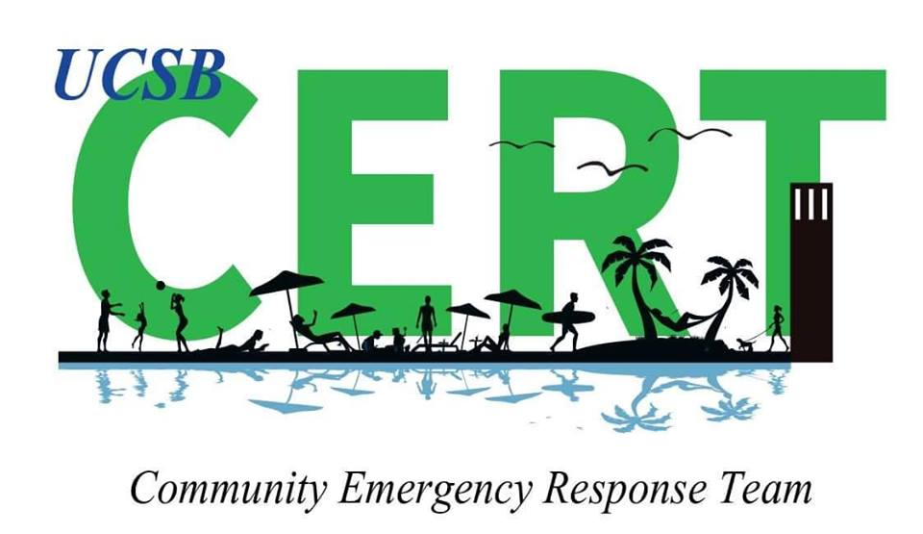
Campus CERT

Slide 2
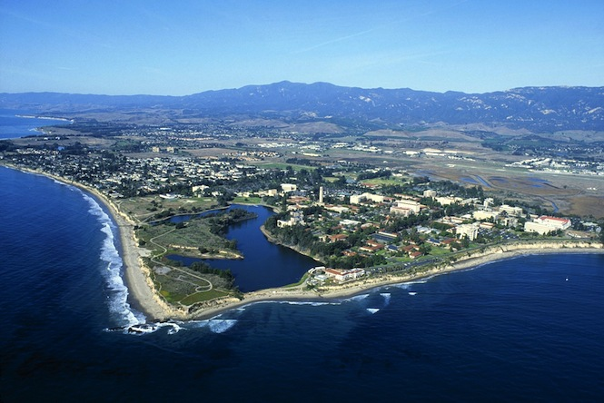

Slide 3
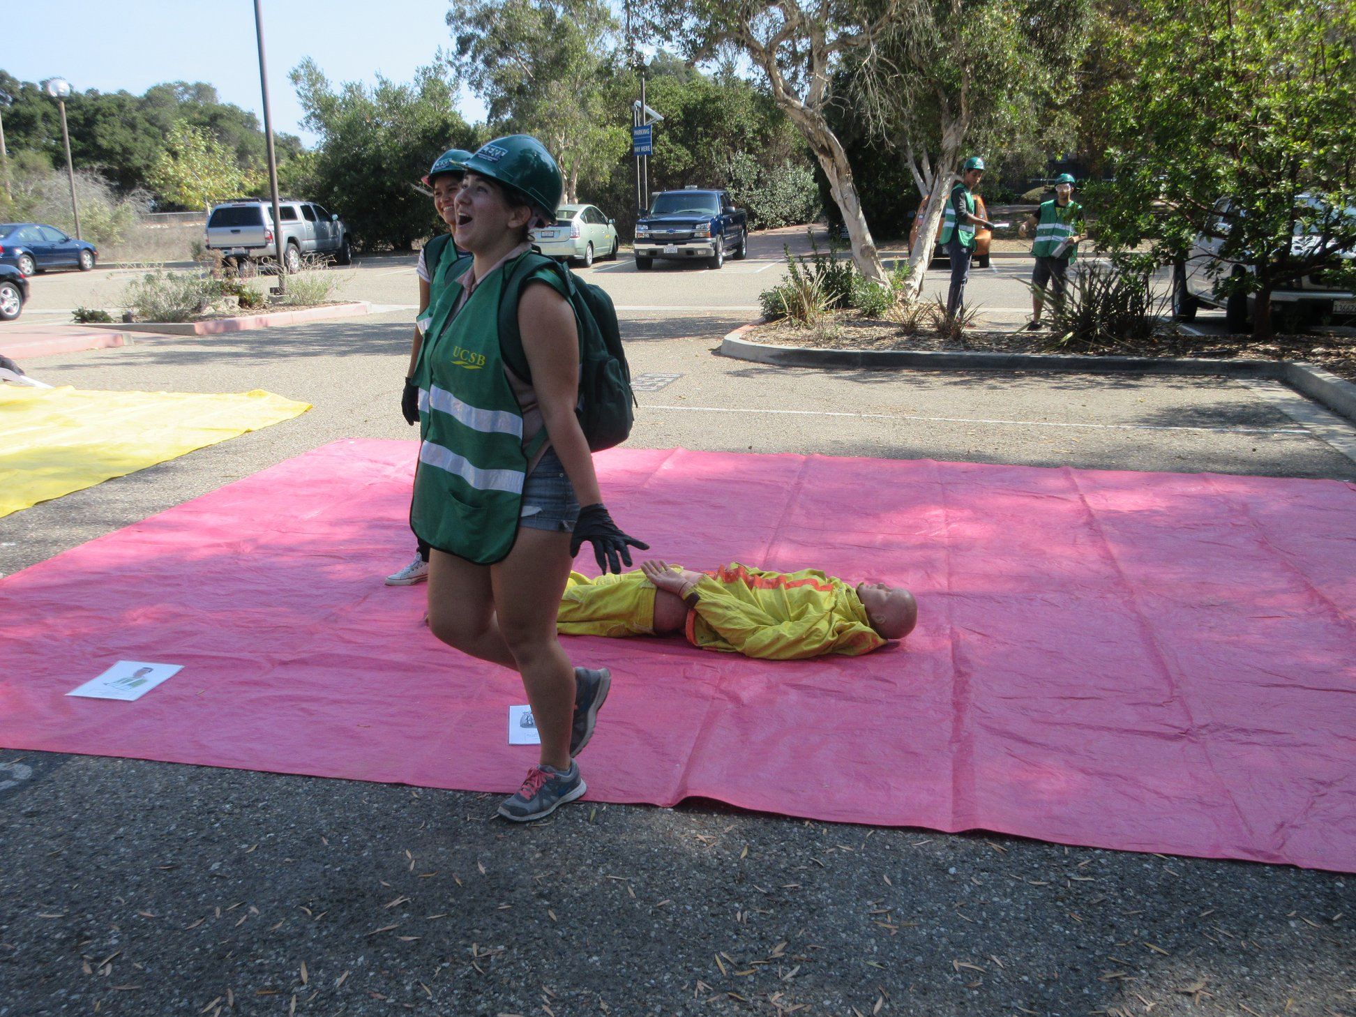

Slide 4
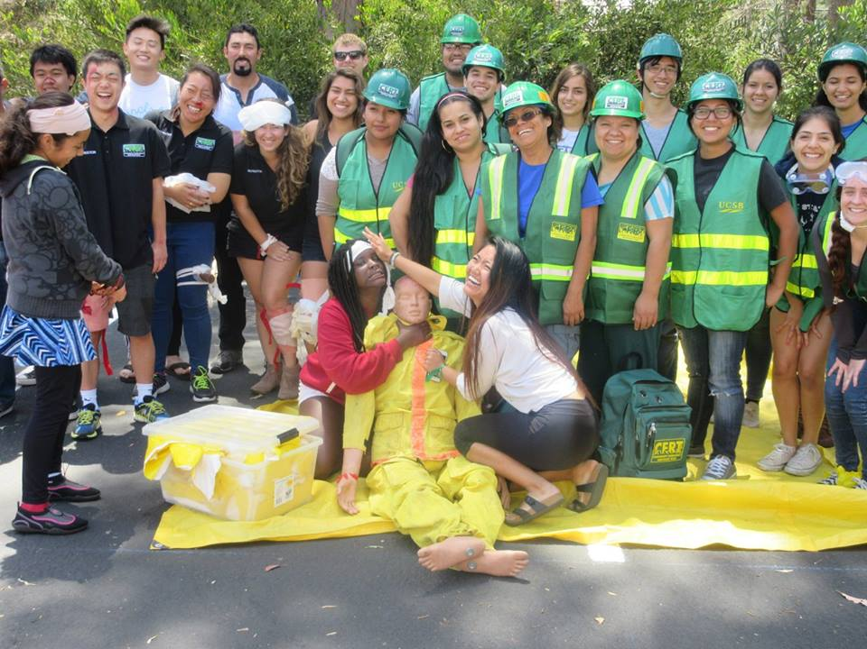

Slide 5
Overview of the UC Santa Barbara Campus CERT Program
  Started in 2010
  Classes Completed — 57
  Students Trained — 998
  Student CERT “Train the Trainer” — 28
  Outreach into the Isla Vista Community — Teen CERT/Spanish CERT

Slide 6

Campus and Community Partners
Facilities Management
Student Health
Environmental Health and Safety
Student Affairs
American Red Cross Club
Associated Students (A.S.)
Human Resources
Parking and Transportation
The Library
California Volunteers
Santa Barbara County Fire
Santa Barbara City Office of Emergency Services
American Red Cross
Fire Extinguisher Vendors
YMCA
Foundations
Elected Officials

Slide 7
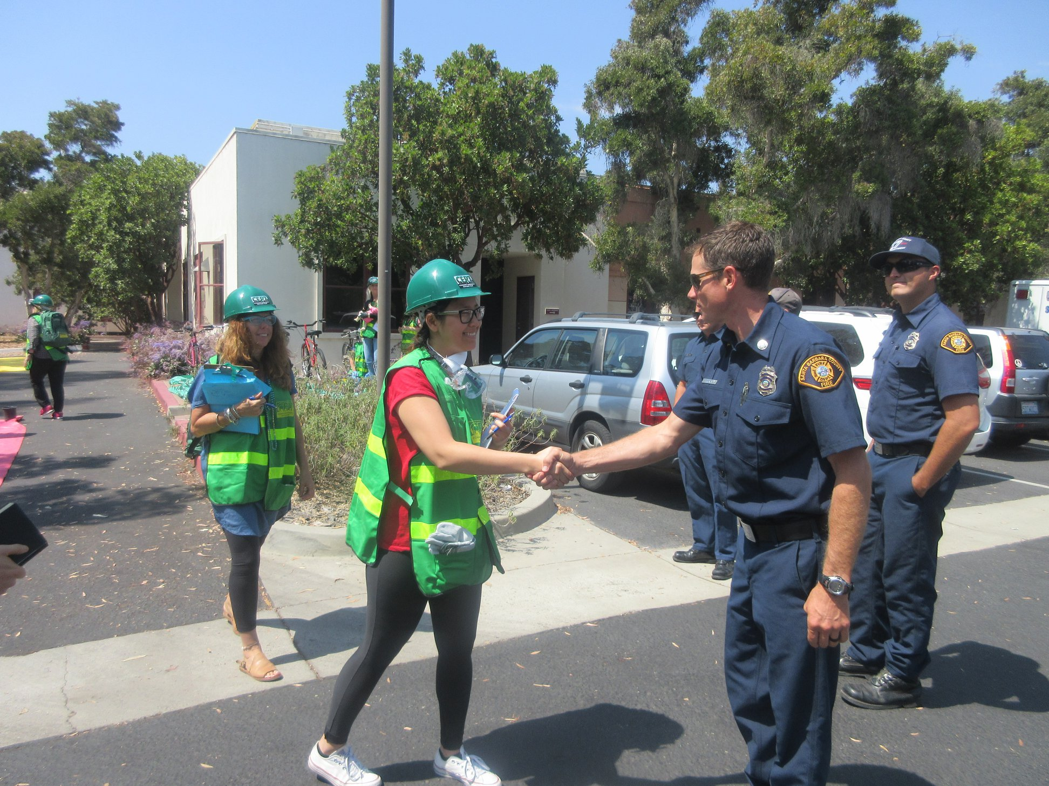

Slide 8
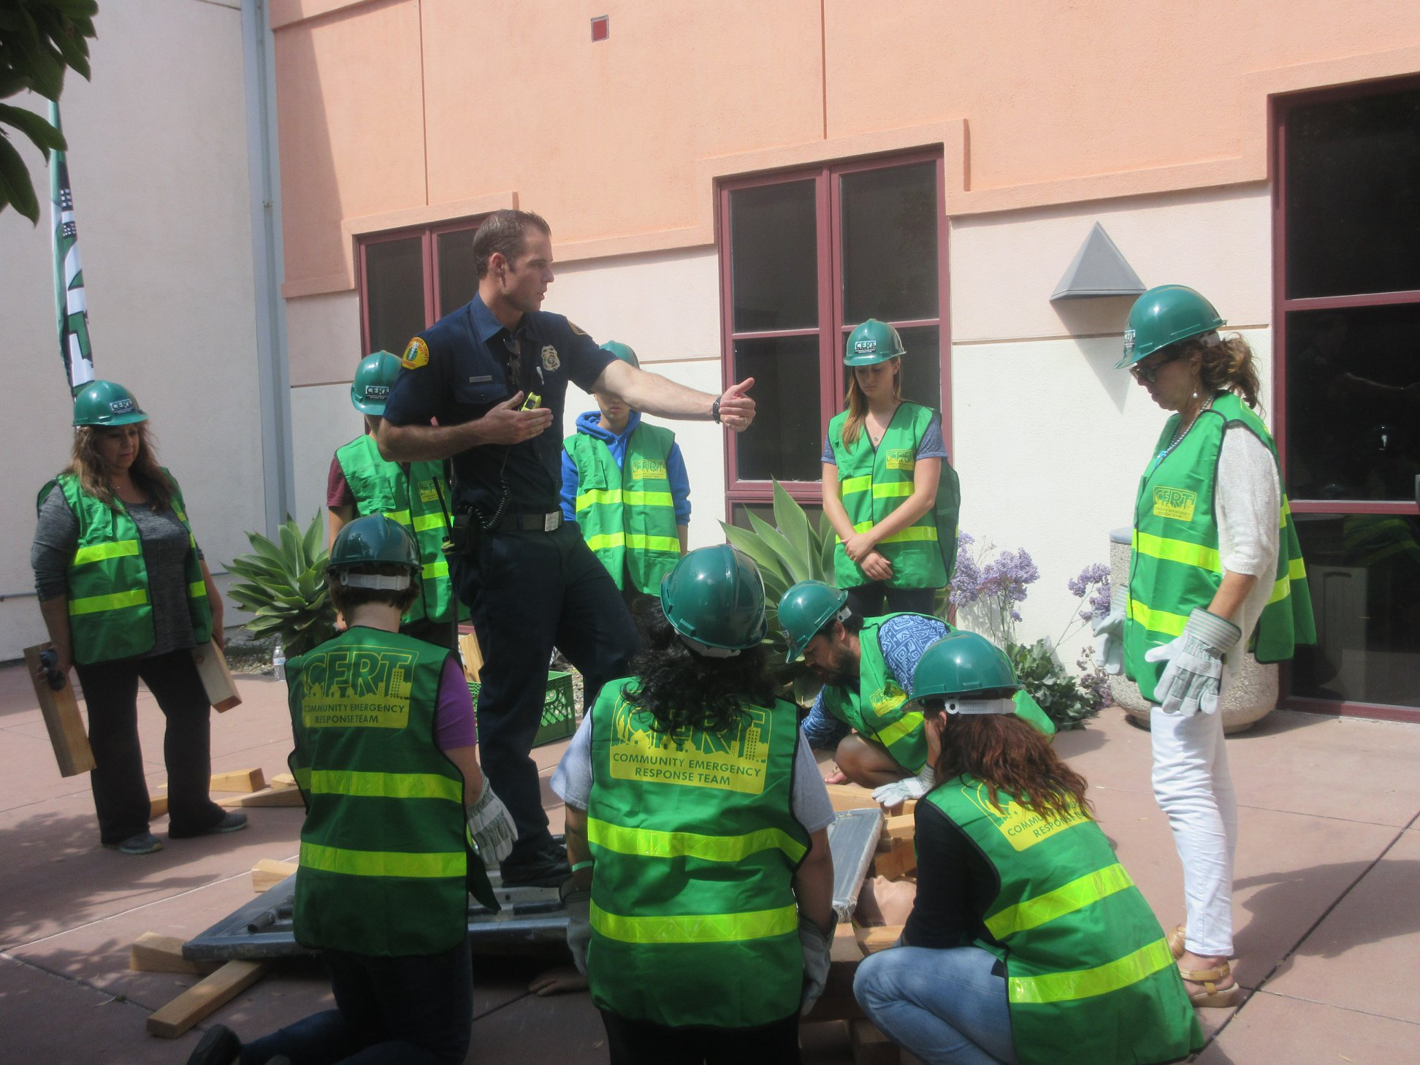

Slide 9
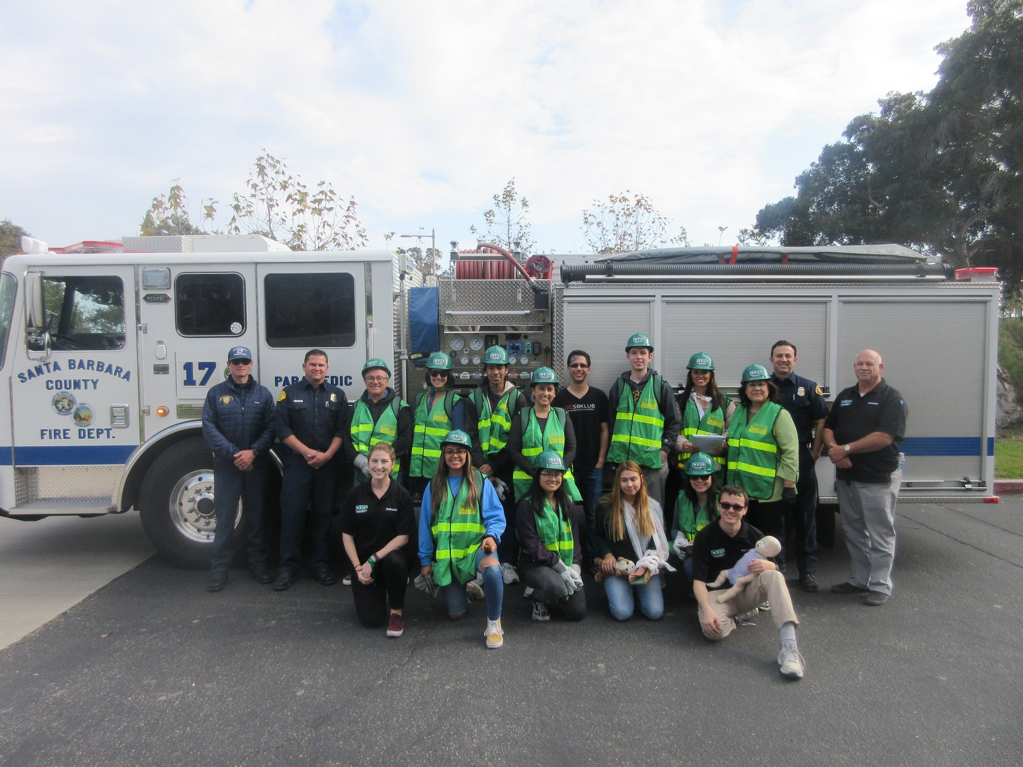

Slide 10
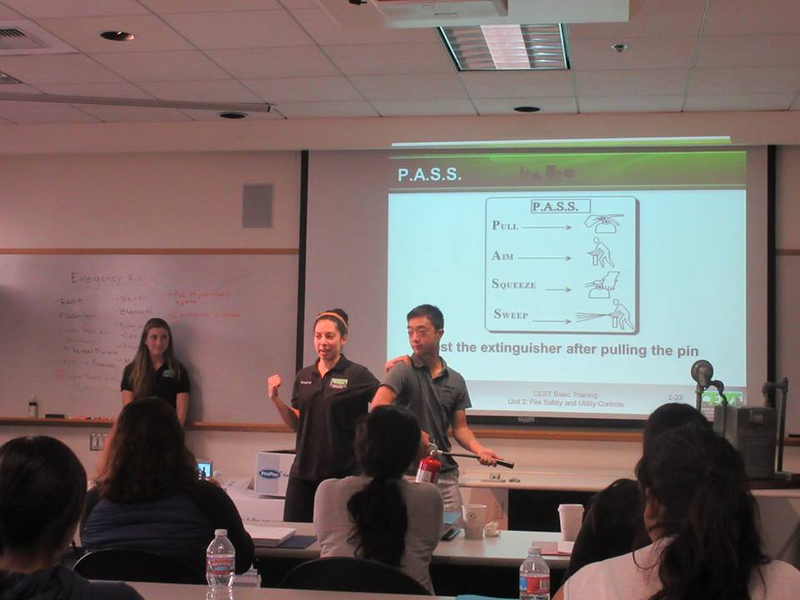
Student CERT
One Class per Quarter – Three Sundays
  Day 1 – Units 1, 2, 3, and Part of 4
  Day 2 – Units 4, 5, and 6
  Day 3 – Units 8, 6, and Final Exercise
Students Teaching Students CERT
Campus CERT Club

Slide 11
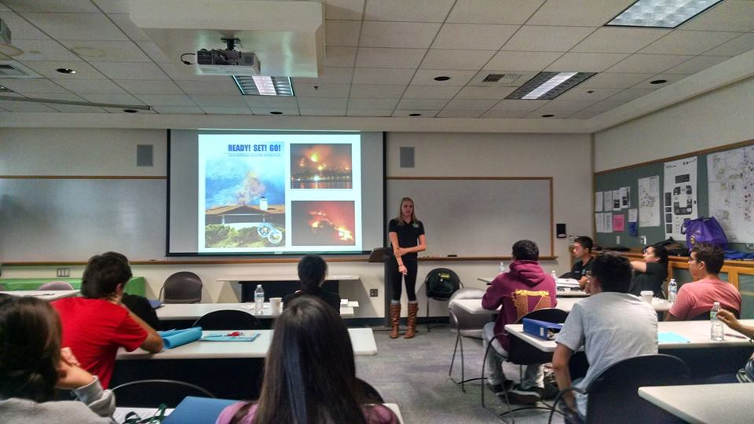

Slide 12
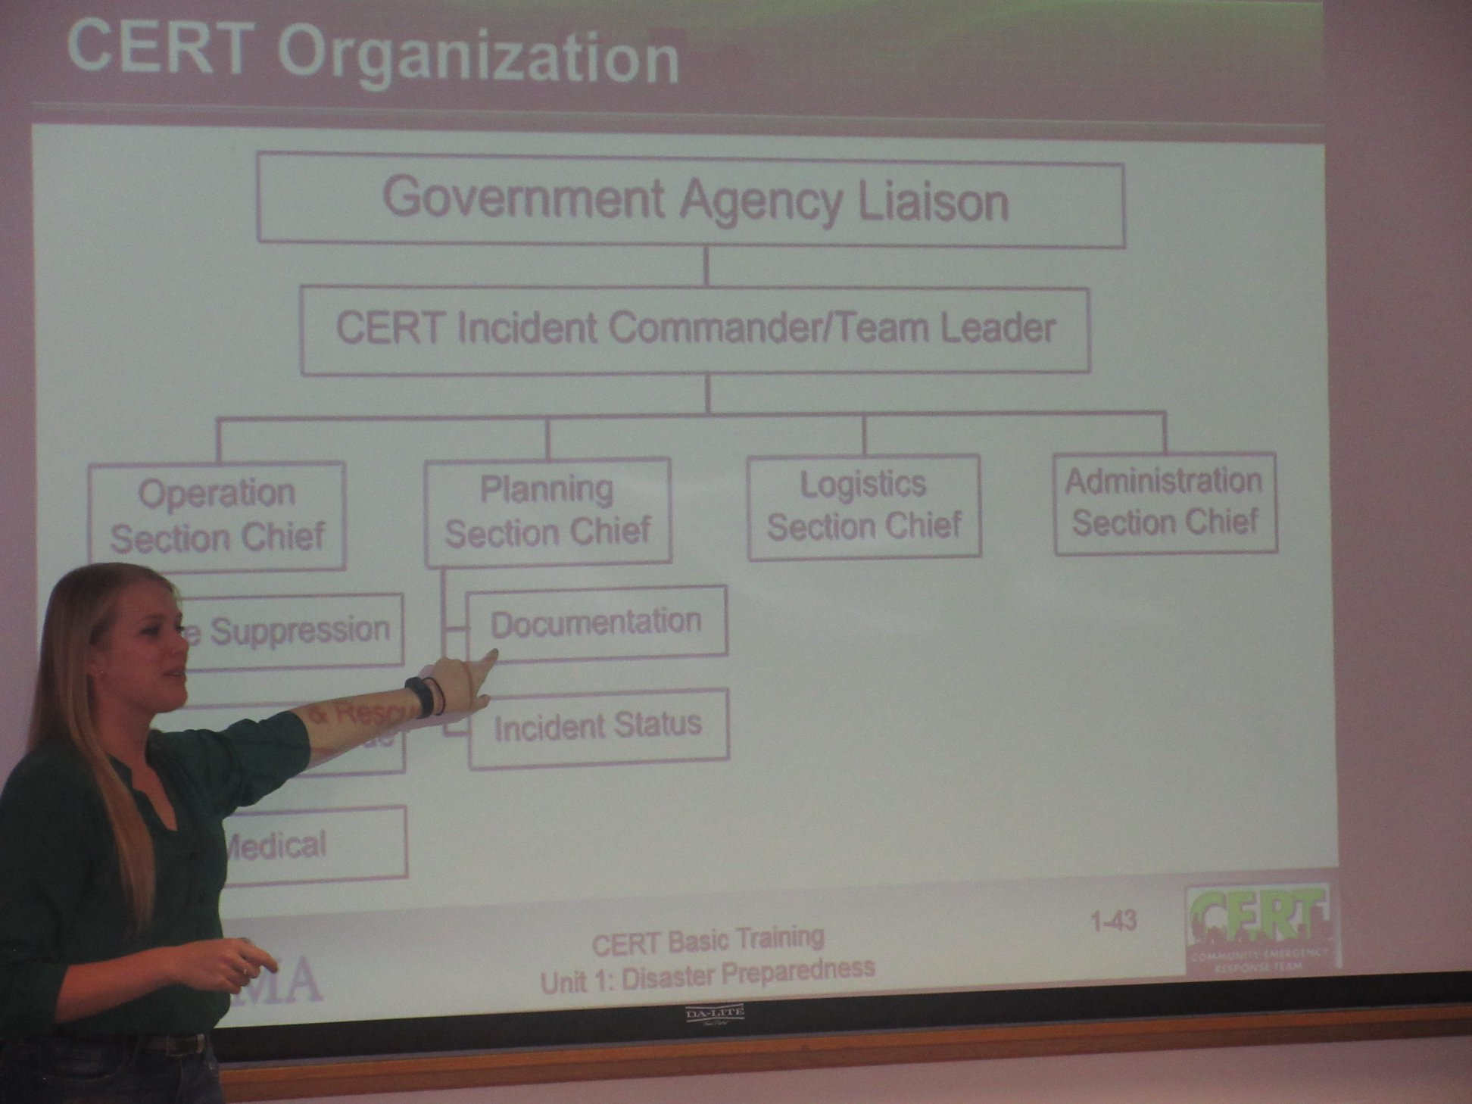

Slide 13
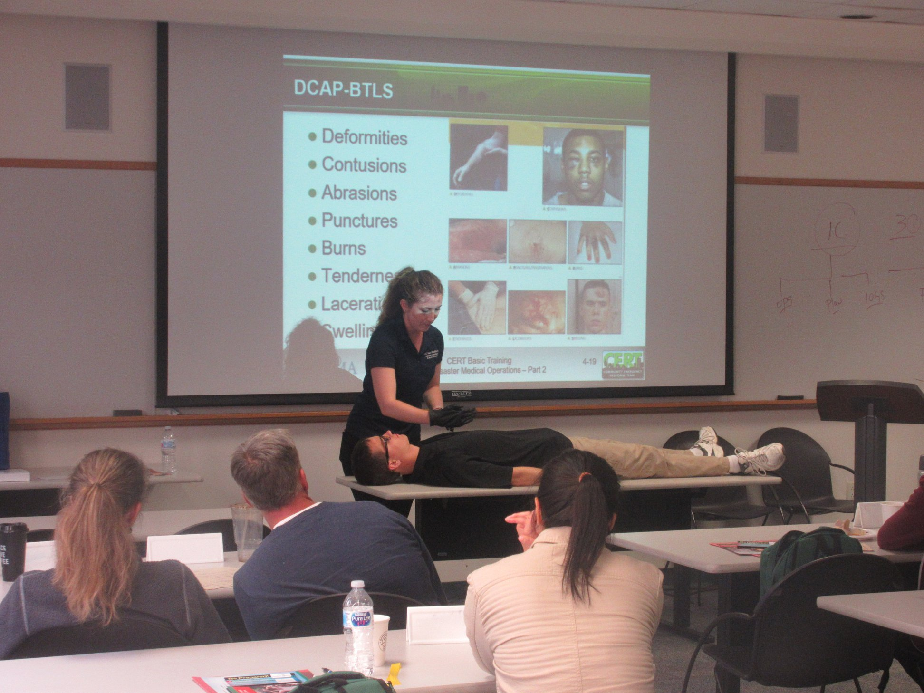

Slide 14
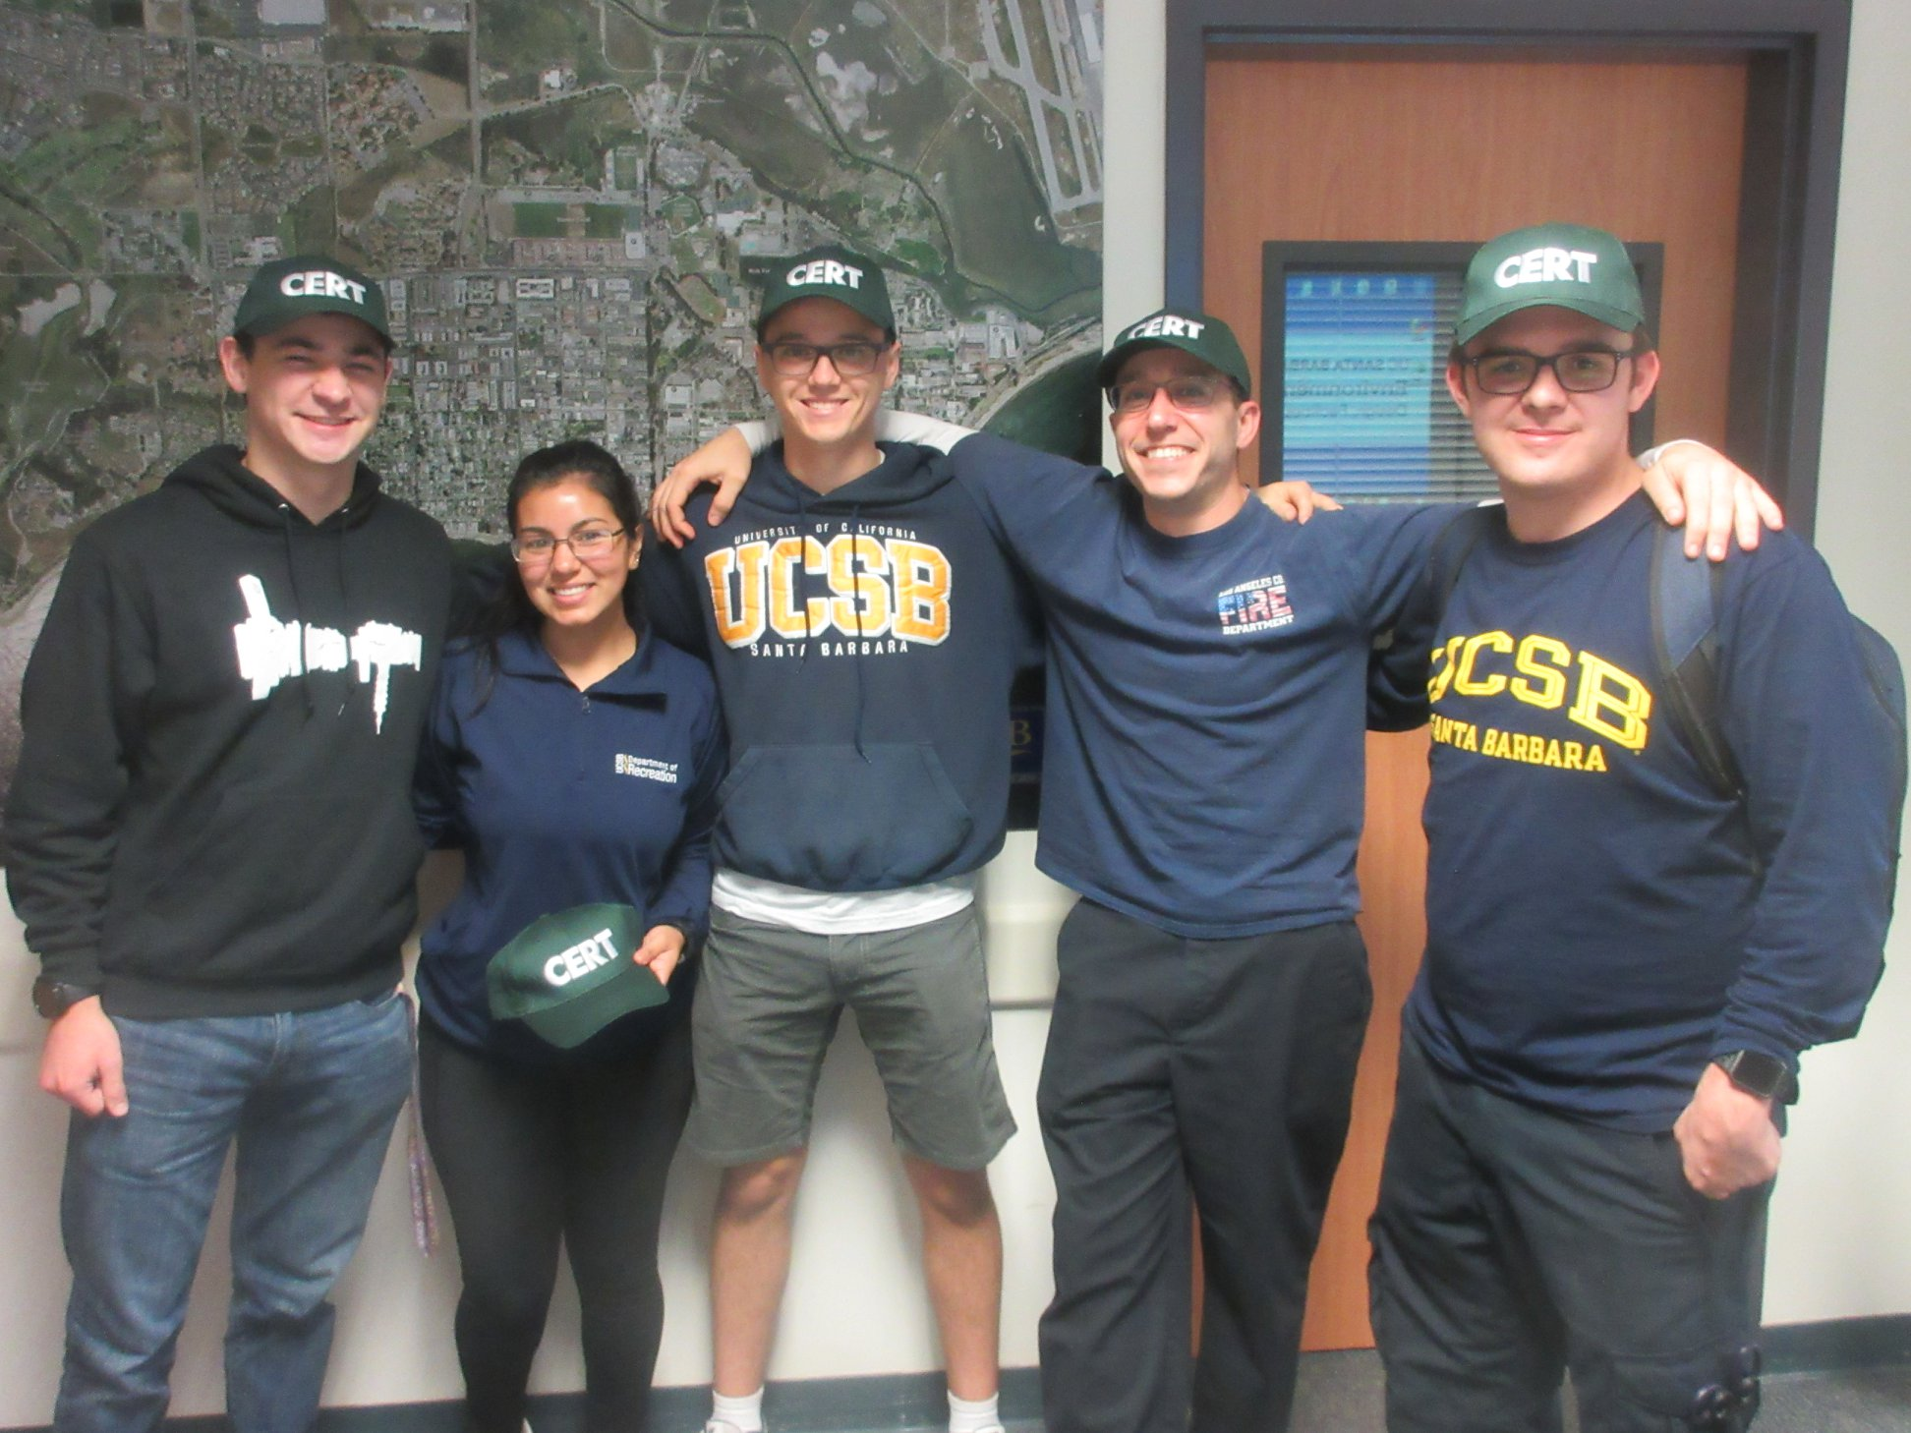

Slide 15
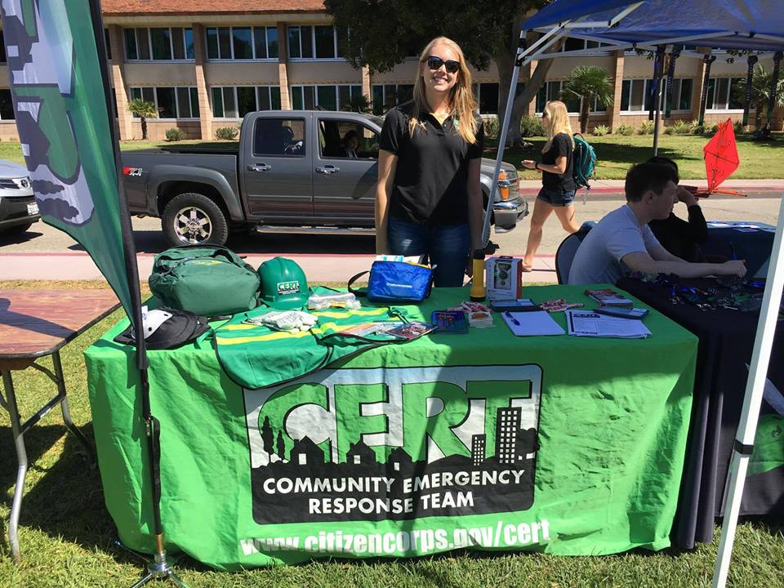
Getting the Word Out
Promotional Events
UC Santa Barbara Red Cross Club
Honors Program

Slide 16
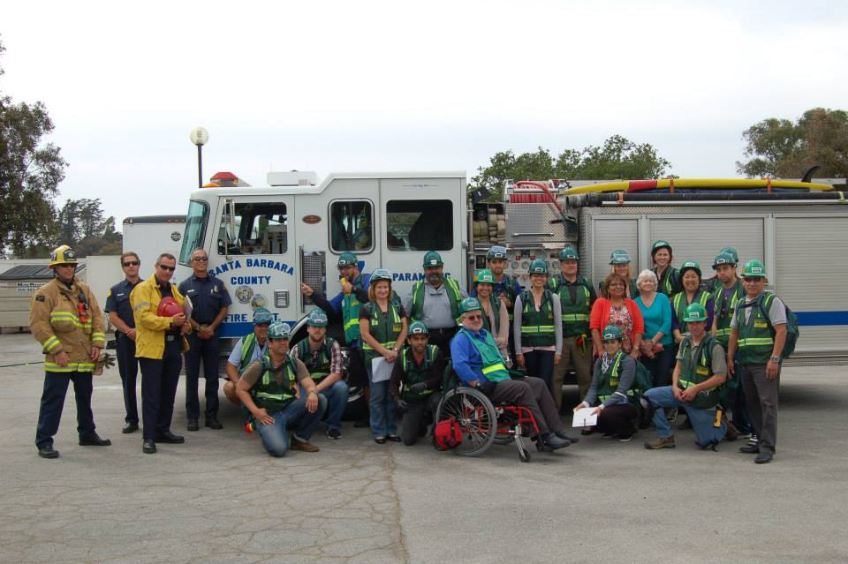
Staff and Faculty CERT
Two Classes per Year
Advanced CERT Program — One Class per Month
  Advanced CERT Learning vs. Refresher Training
Campuswide Annual Exercise

Slide 17
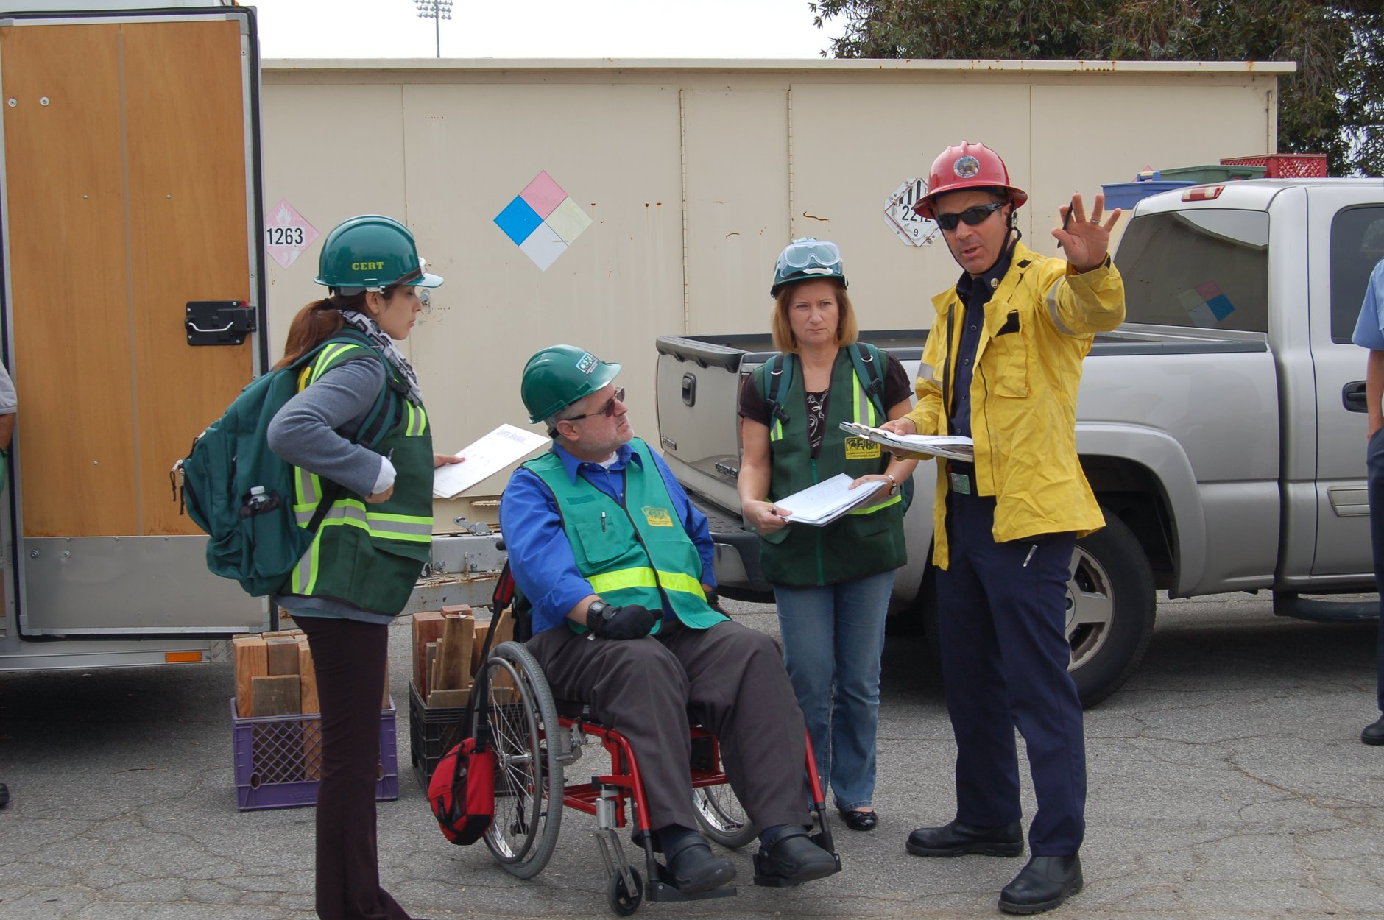

Slide 18
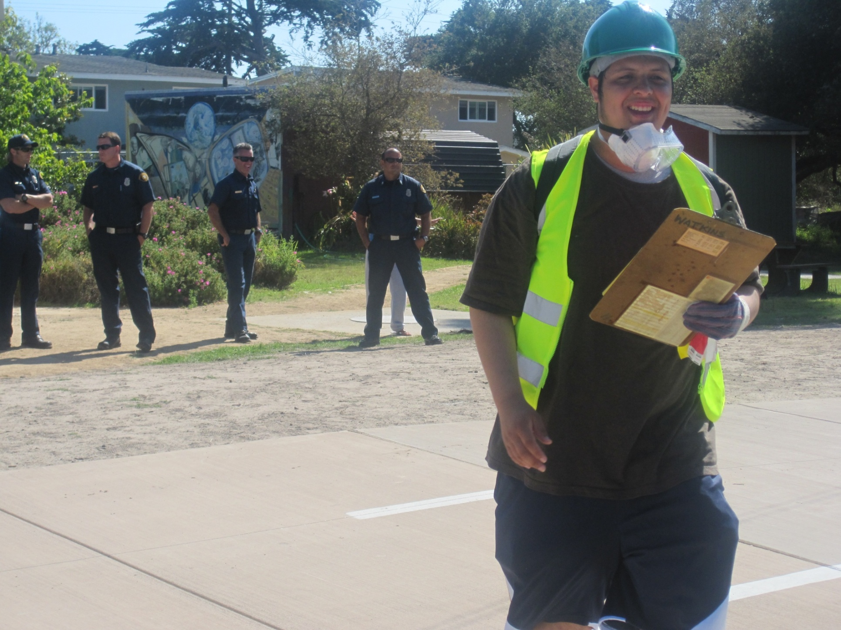
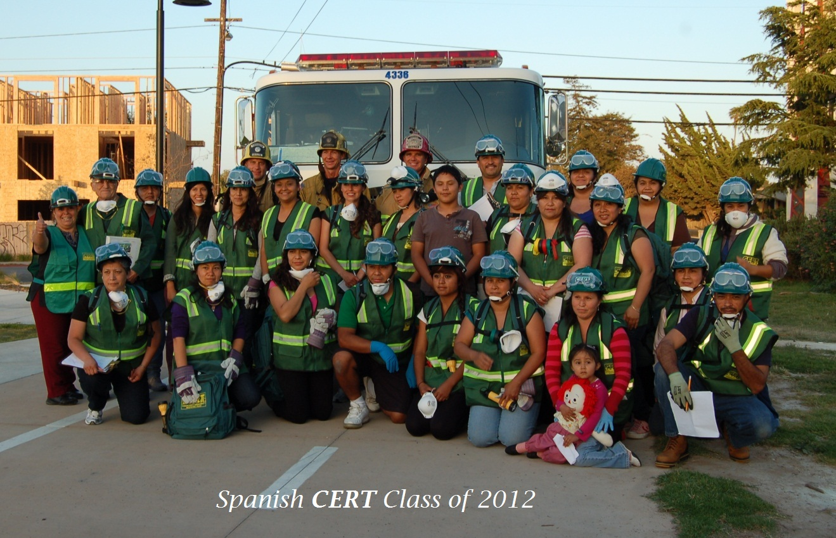
Community CERT
Teen CERT
Spanish CERT
Santa Barbara County CERT Committee

Slide 19
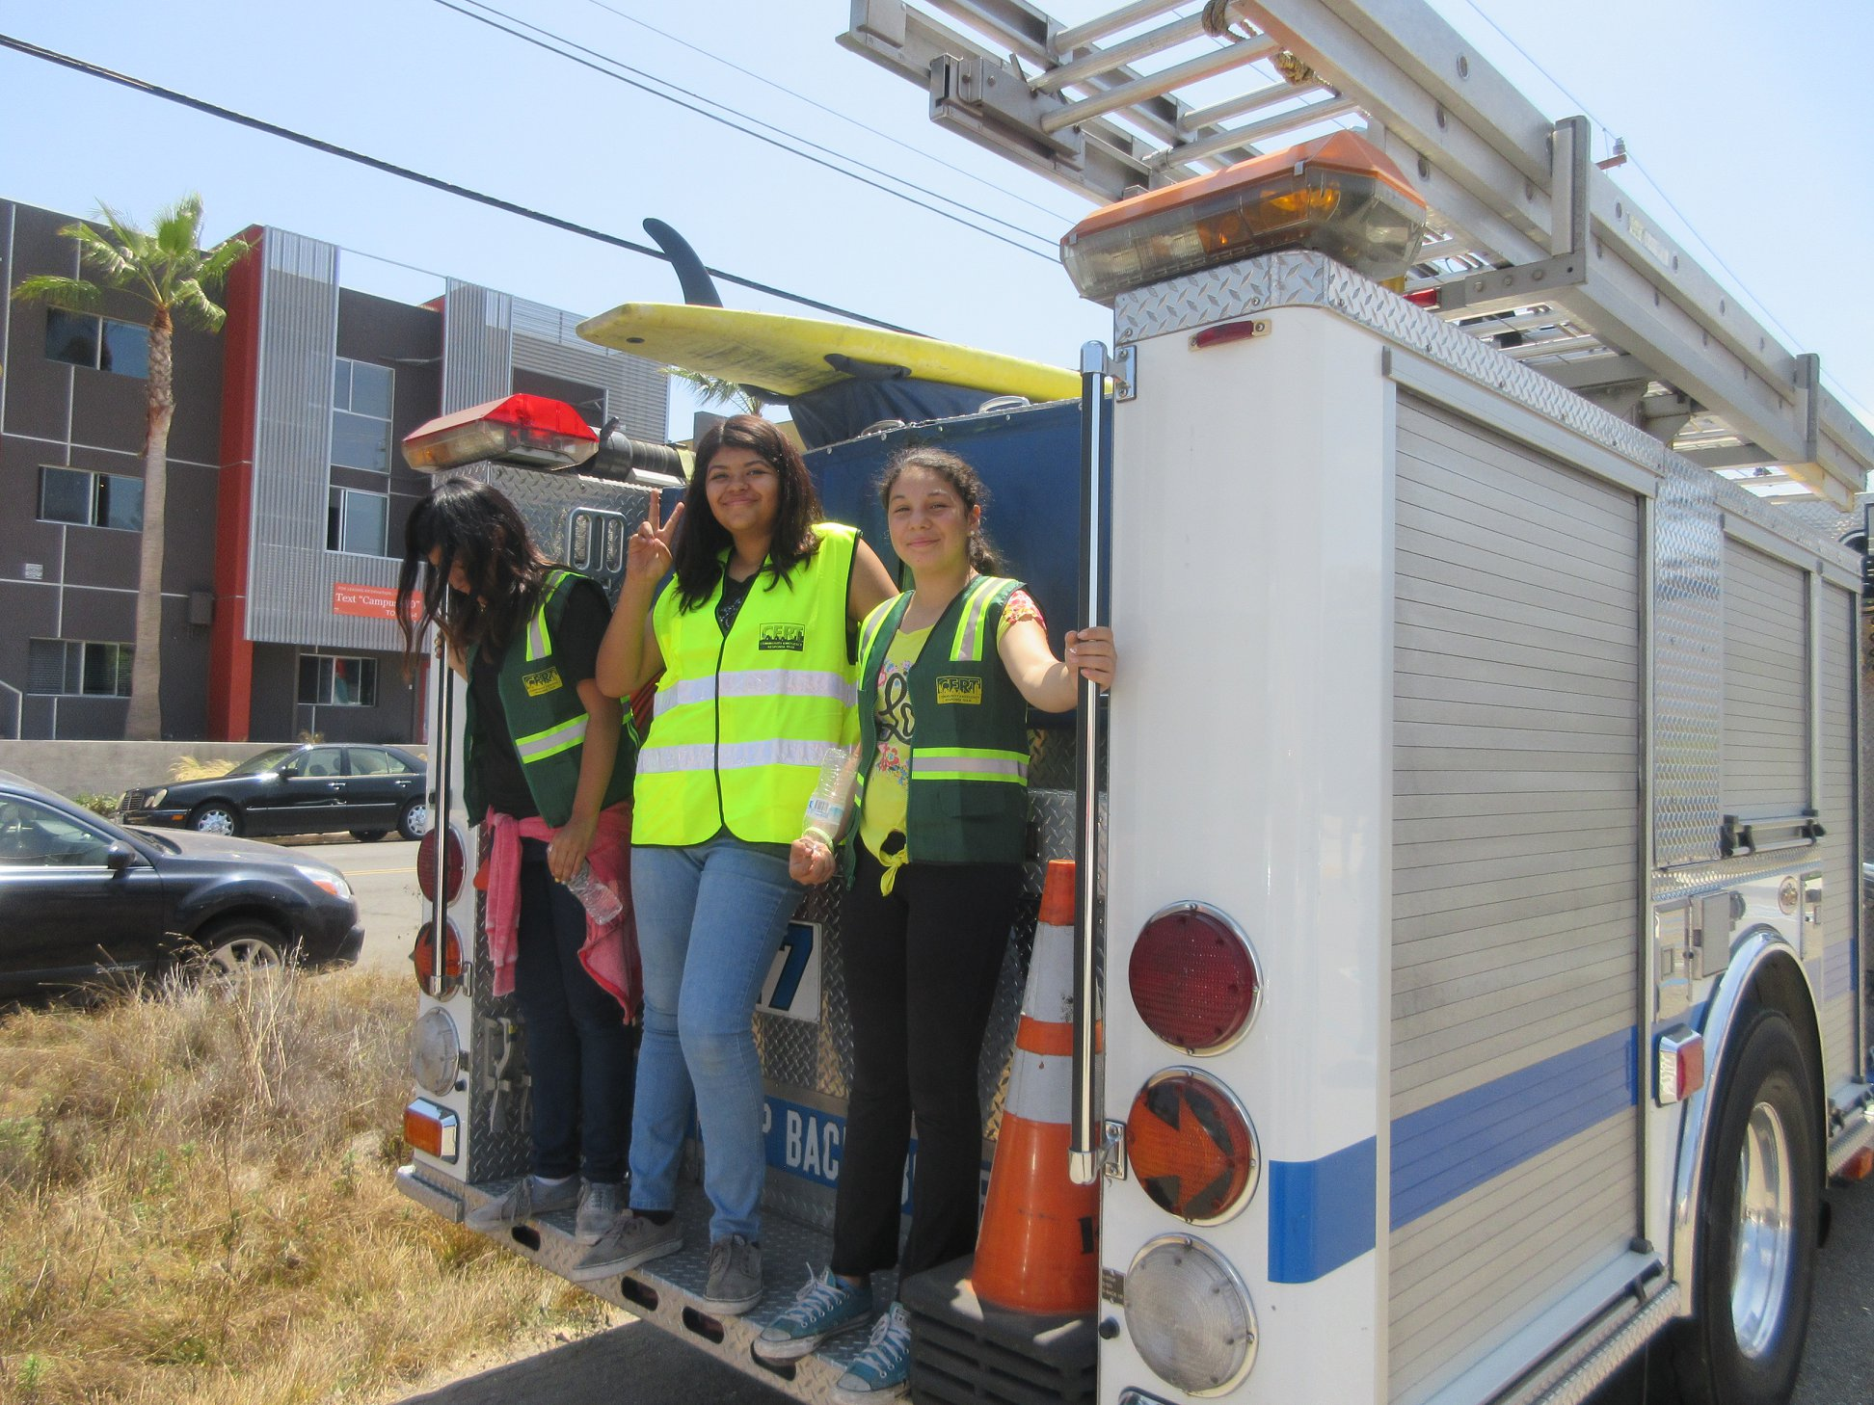

Slide 20
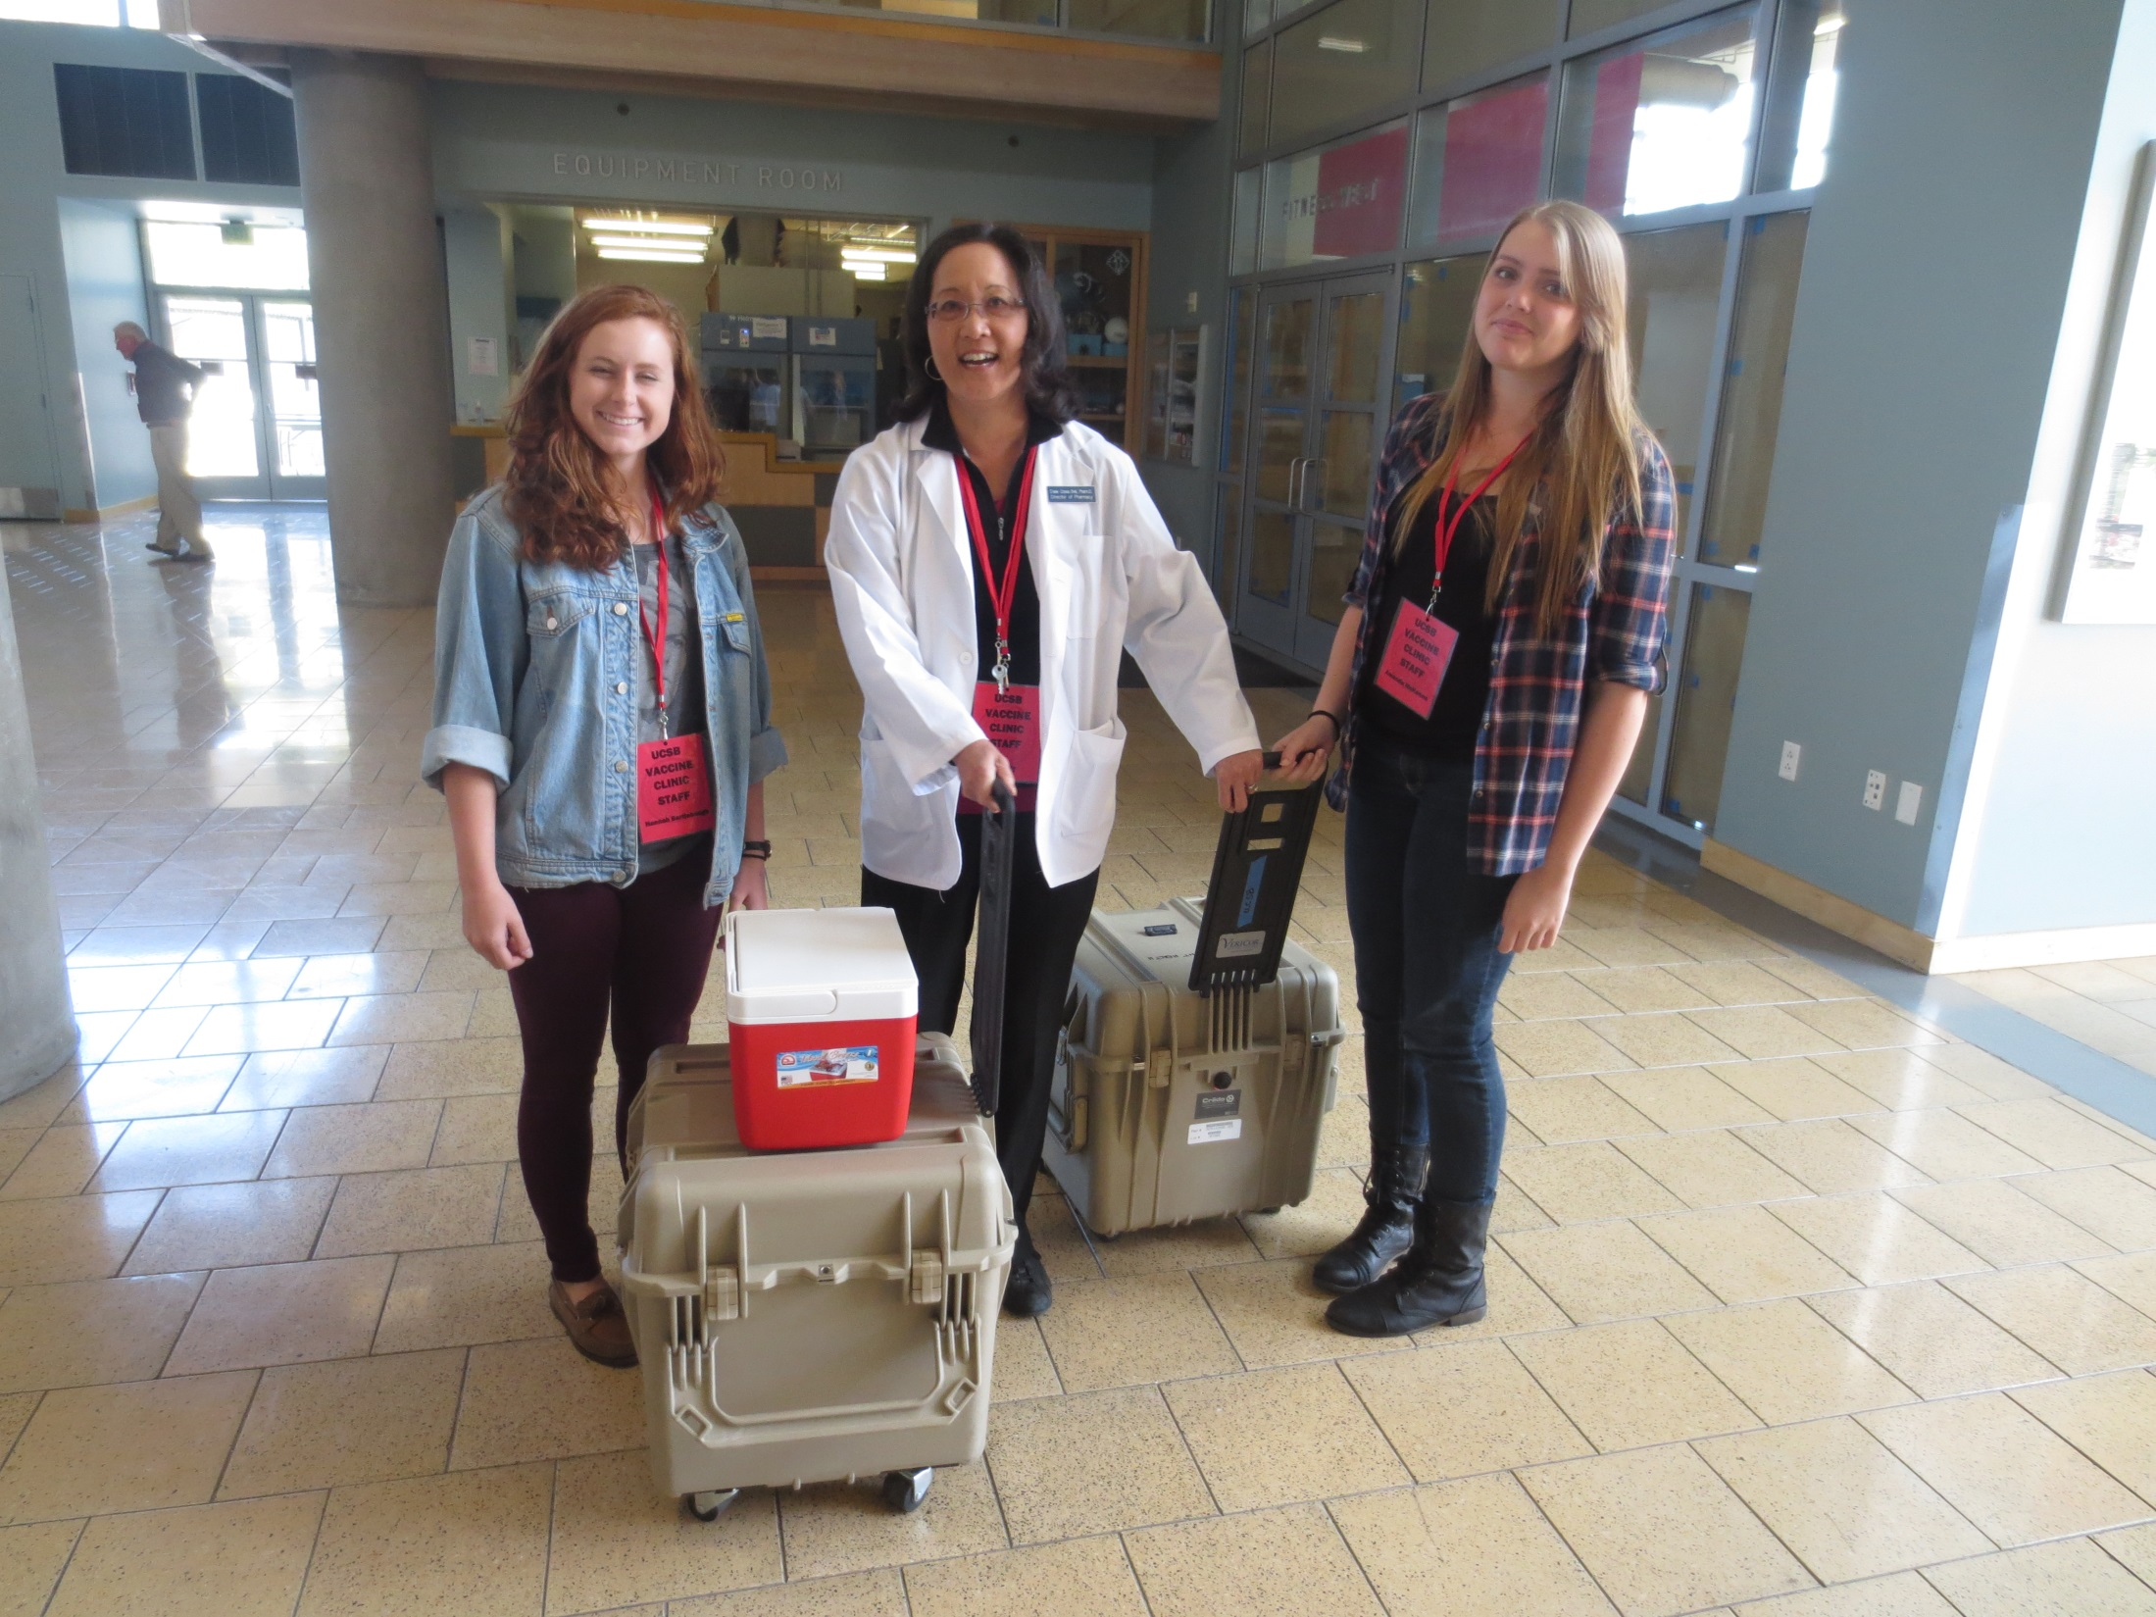
Events
Meningitis B Outbreak — 2013/2014
Refugio Beach Oil Spill — 2015
Thomas Fire — 2017
COVID-19

Slide 21
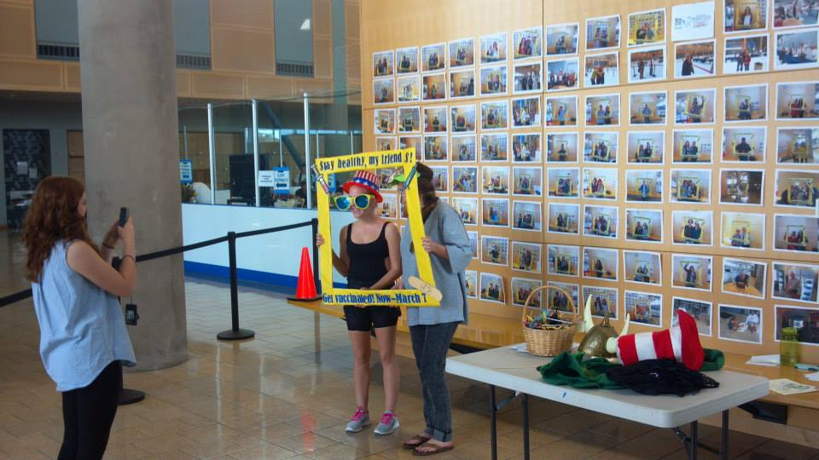

Slide 22
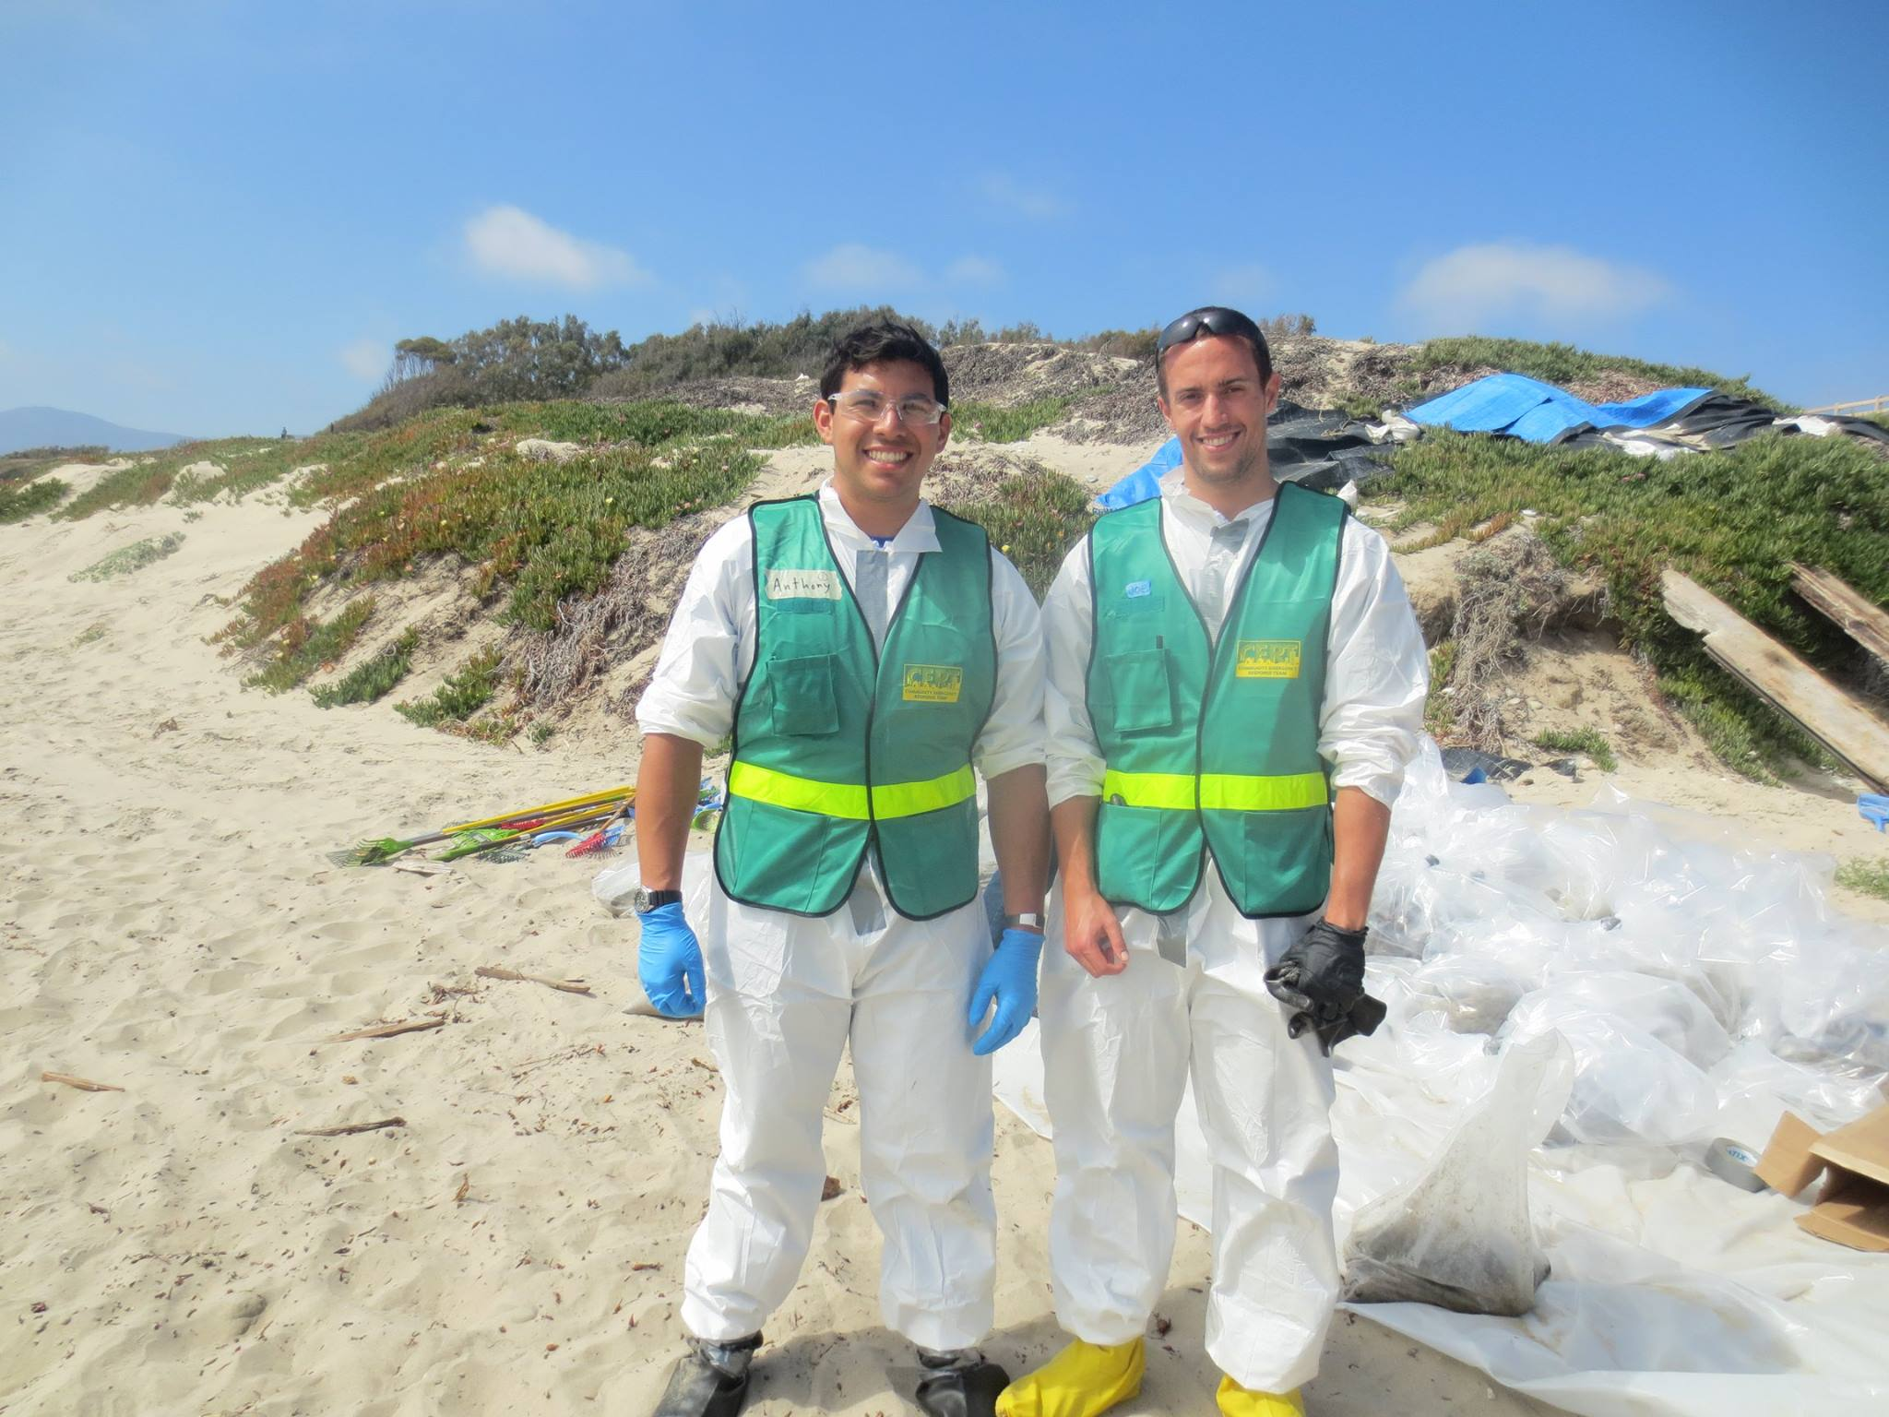

Slide 23
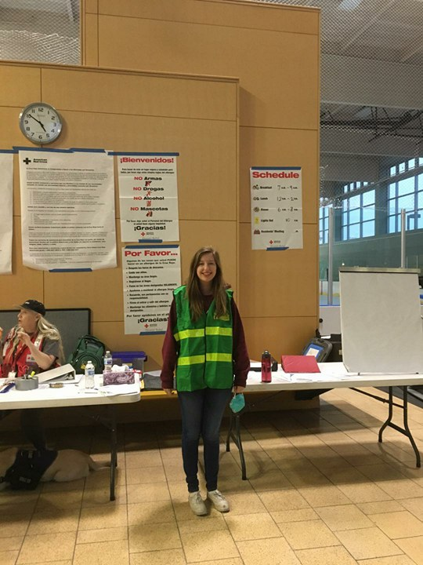
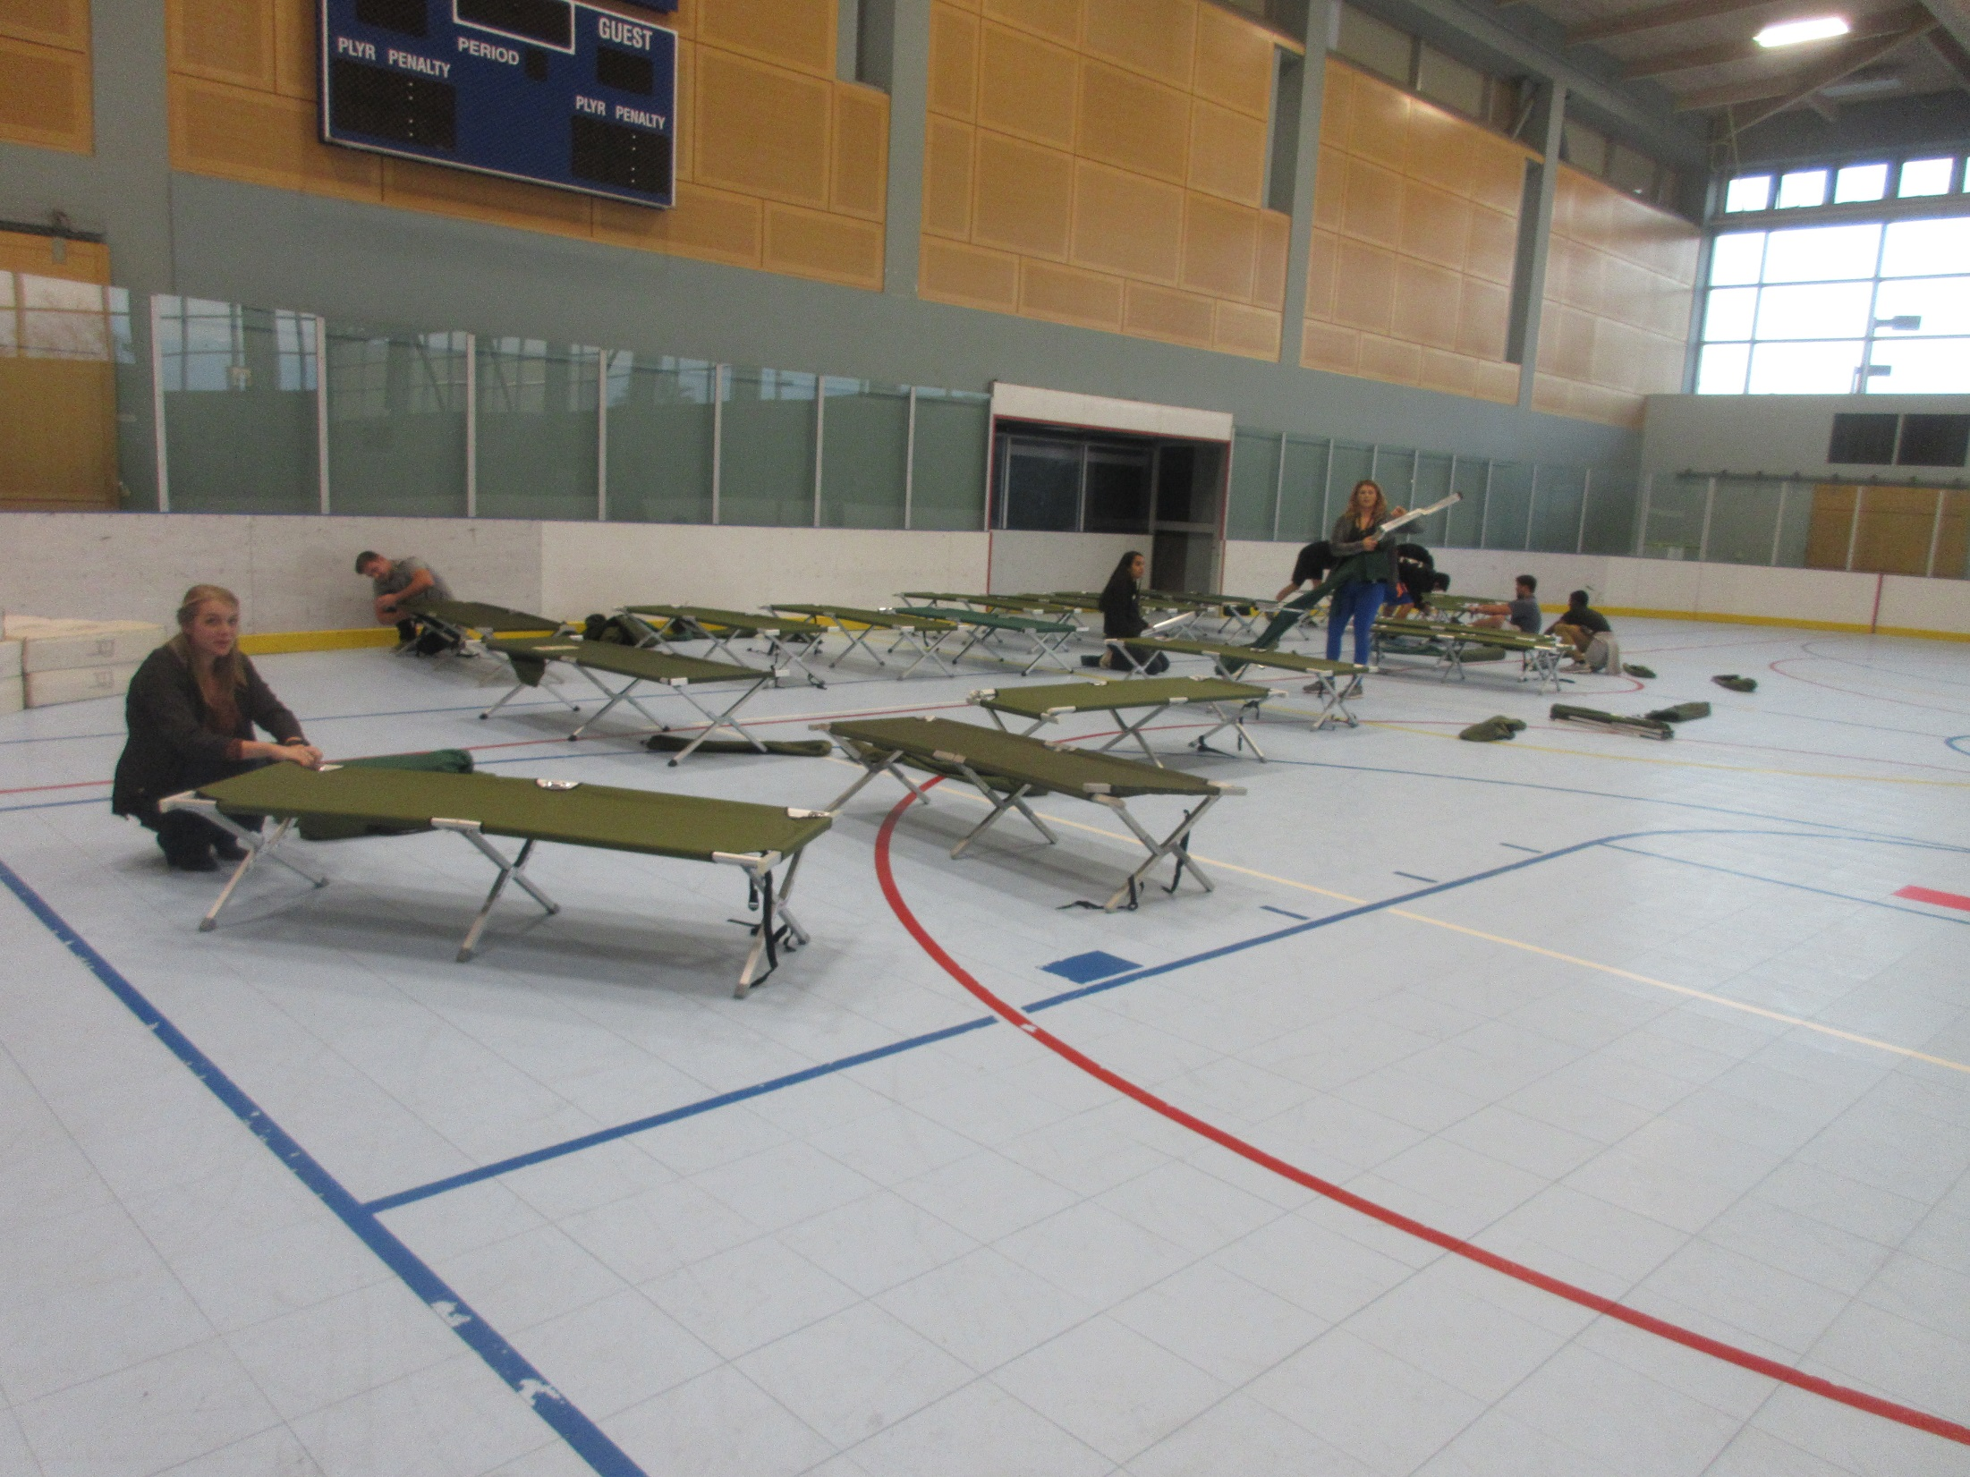

Slide 24
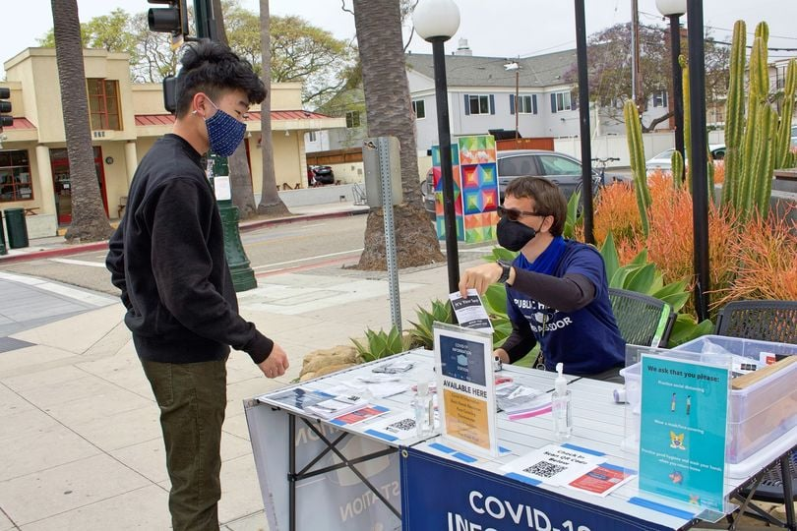

Slide 25
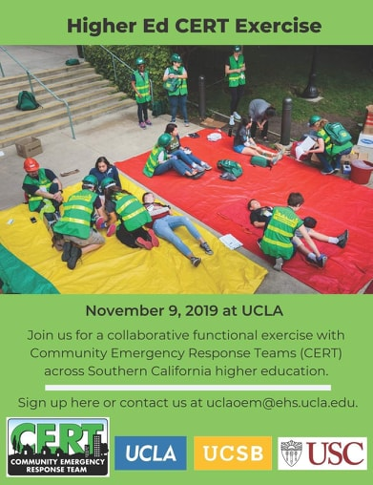
UCLA, USC, & UC Santa Barbara Drill

Slide 26
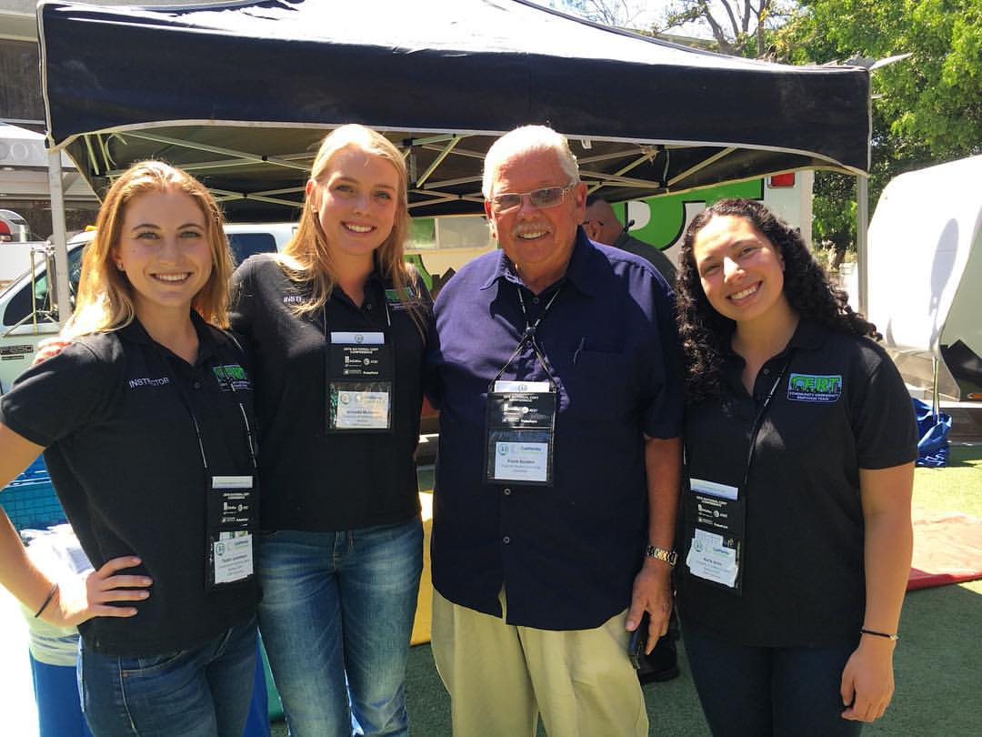
Summary
Student leadership to sustain the CERT program
Hoping to build relationships with other Campus CERT programs across the nation
Monitoring the students as they leave campus
- Are they staying involved in emergency preparedness?
- Building careers in Emergency Management?
Still developing the Campus CERT Response Plan

