Slide 1
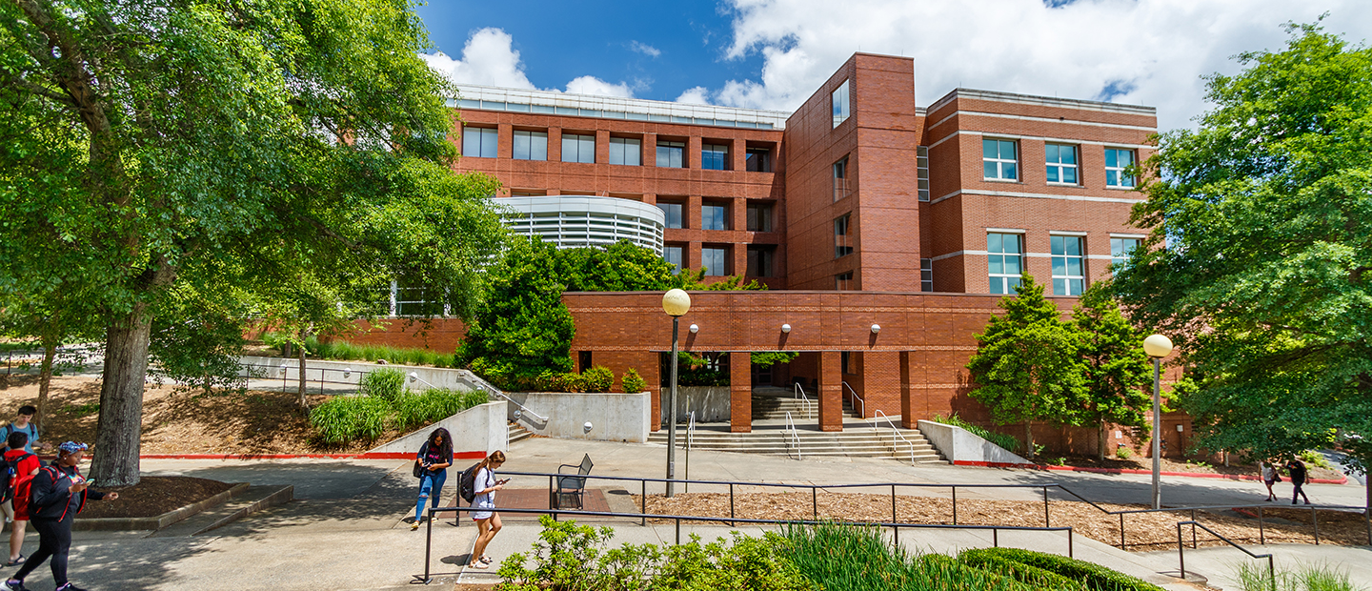
UNIVERSITY OF GEORGIA
BLEEDING CONTROL PROGRAM
Notes:
ALISON
Thank you, Madeline. As she mentioned, we are truly happy to showcase your training program in a future meeting – just reach out to us.
Now we’d like to turn things over to Steve Harris from the University of Georgia and his colleague Major Adam Fouche with the UGA Police Department to talk about their bleeding control program. Steve?

Slide 2
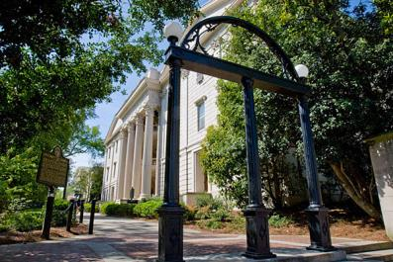
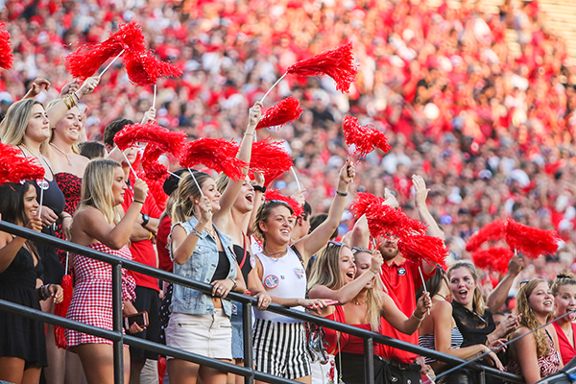
University of Georgia Profile
Athens, Georgia — population of 135,000
40,000 students/12,000 F/S
425+ buildings on 759 acres (main campus)
Nearly 42,000 acres statewide — land-grant institution
Sanford Stadium — 9th largest in U.S. (95,000)
Hosted several Olympic events in 1996
First state-chartered university in the nation — 1785
Office of Emergency Preparedness — independent office and reports to the VP for Finance/Administration

Slide 3
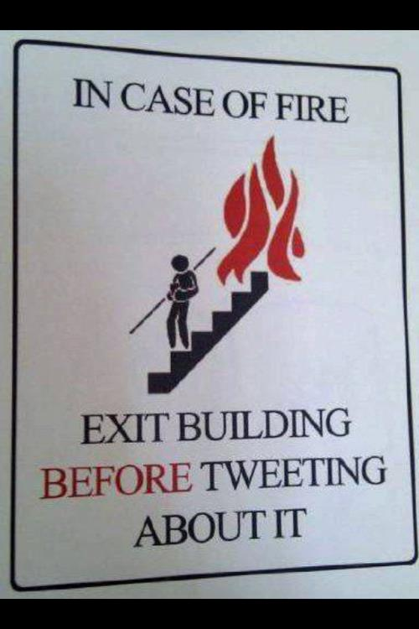
Unique Challenges in Higher Education
Campuses are open environments — basically small cities
Misconception that college campuses are immune to emergencies; students are especially “invincible”
Retraining of thousands of new students, staff, and faculty each year (10,000 rotate each year)
Large and primarily young population with limited life experiences with emergencies
All of which highlight the importance of emergency preparedness training for students, faculty, and staff on campus…

Slide 4
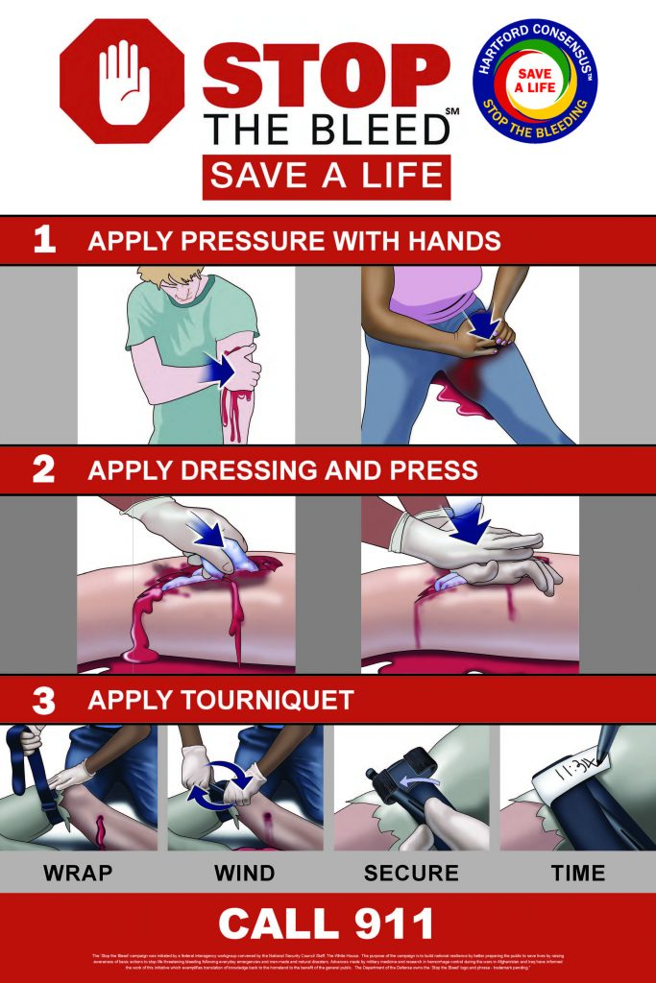
National “Stop the Bleed” Program
White House initiative from Hartford Consensus
Goal is to stop life-threatening bleeding
Empower individuals to act quickly to save lives
Adopted by K-12 schools, universities, businesses, public safety agencies, etc.
National Stop the Bleed Month in May each year
Similar programs First Aid for Severe Trauma (FAST — American Red Cross) and “You Are the Help Until Help Arrives” (Federal Emergency Management Agency)

Slide 5
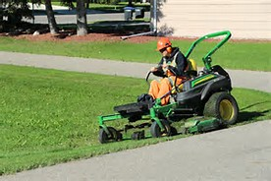
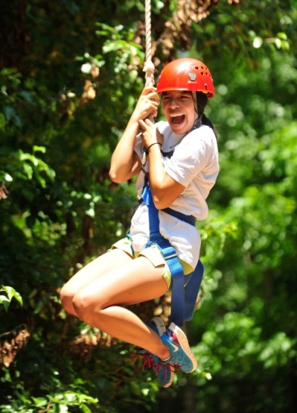
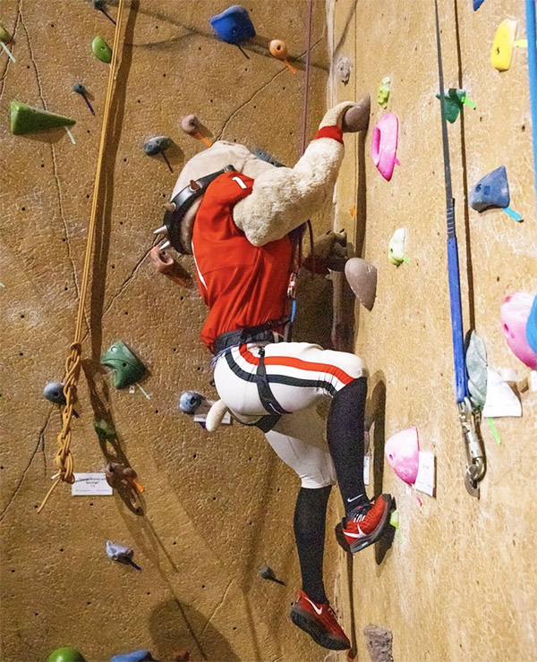
Why Implement at UGA?
Promote bystander intervention for
all-hazards use
Existing spirit of volunteerism — CPR/AED
Police already carrying tourniquets and kits
Integrated well with existing CERT and MRC programs
Extra training opportunity for building safety reps and AED Coordinators
Complemented our mass casualty planning efforts

Slide 6
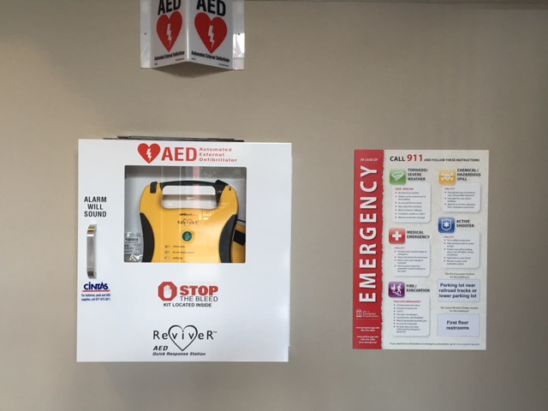
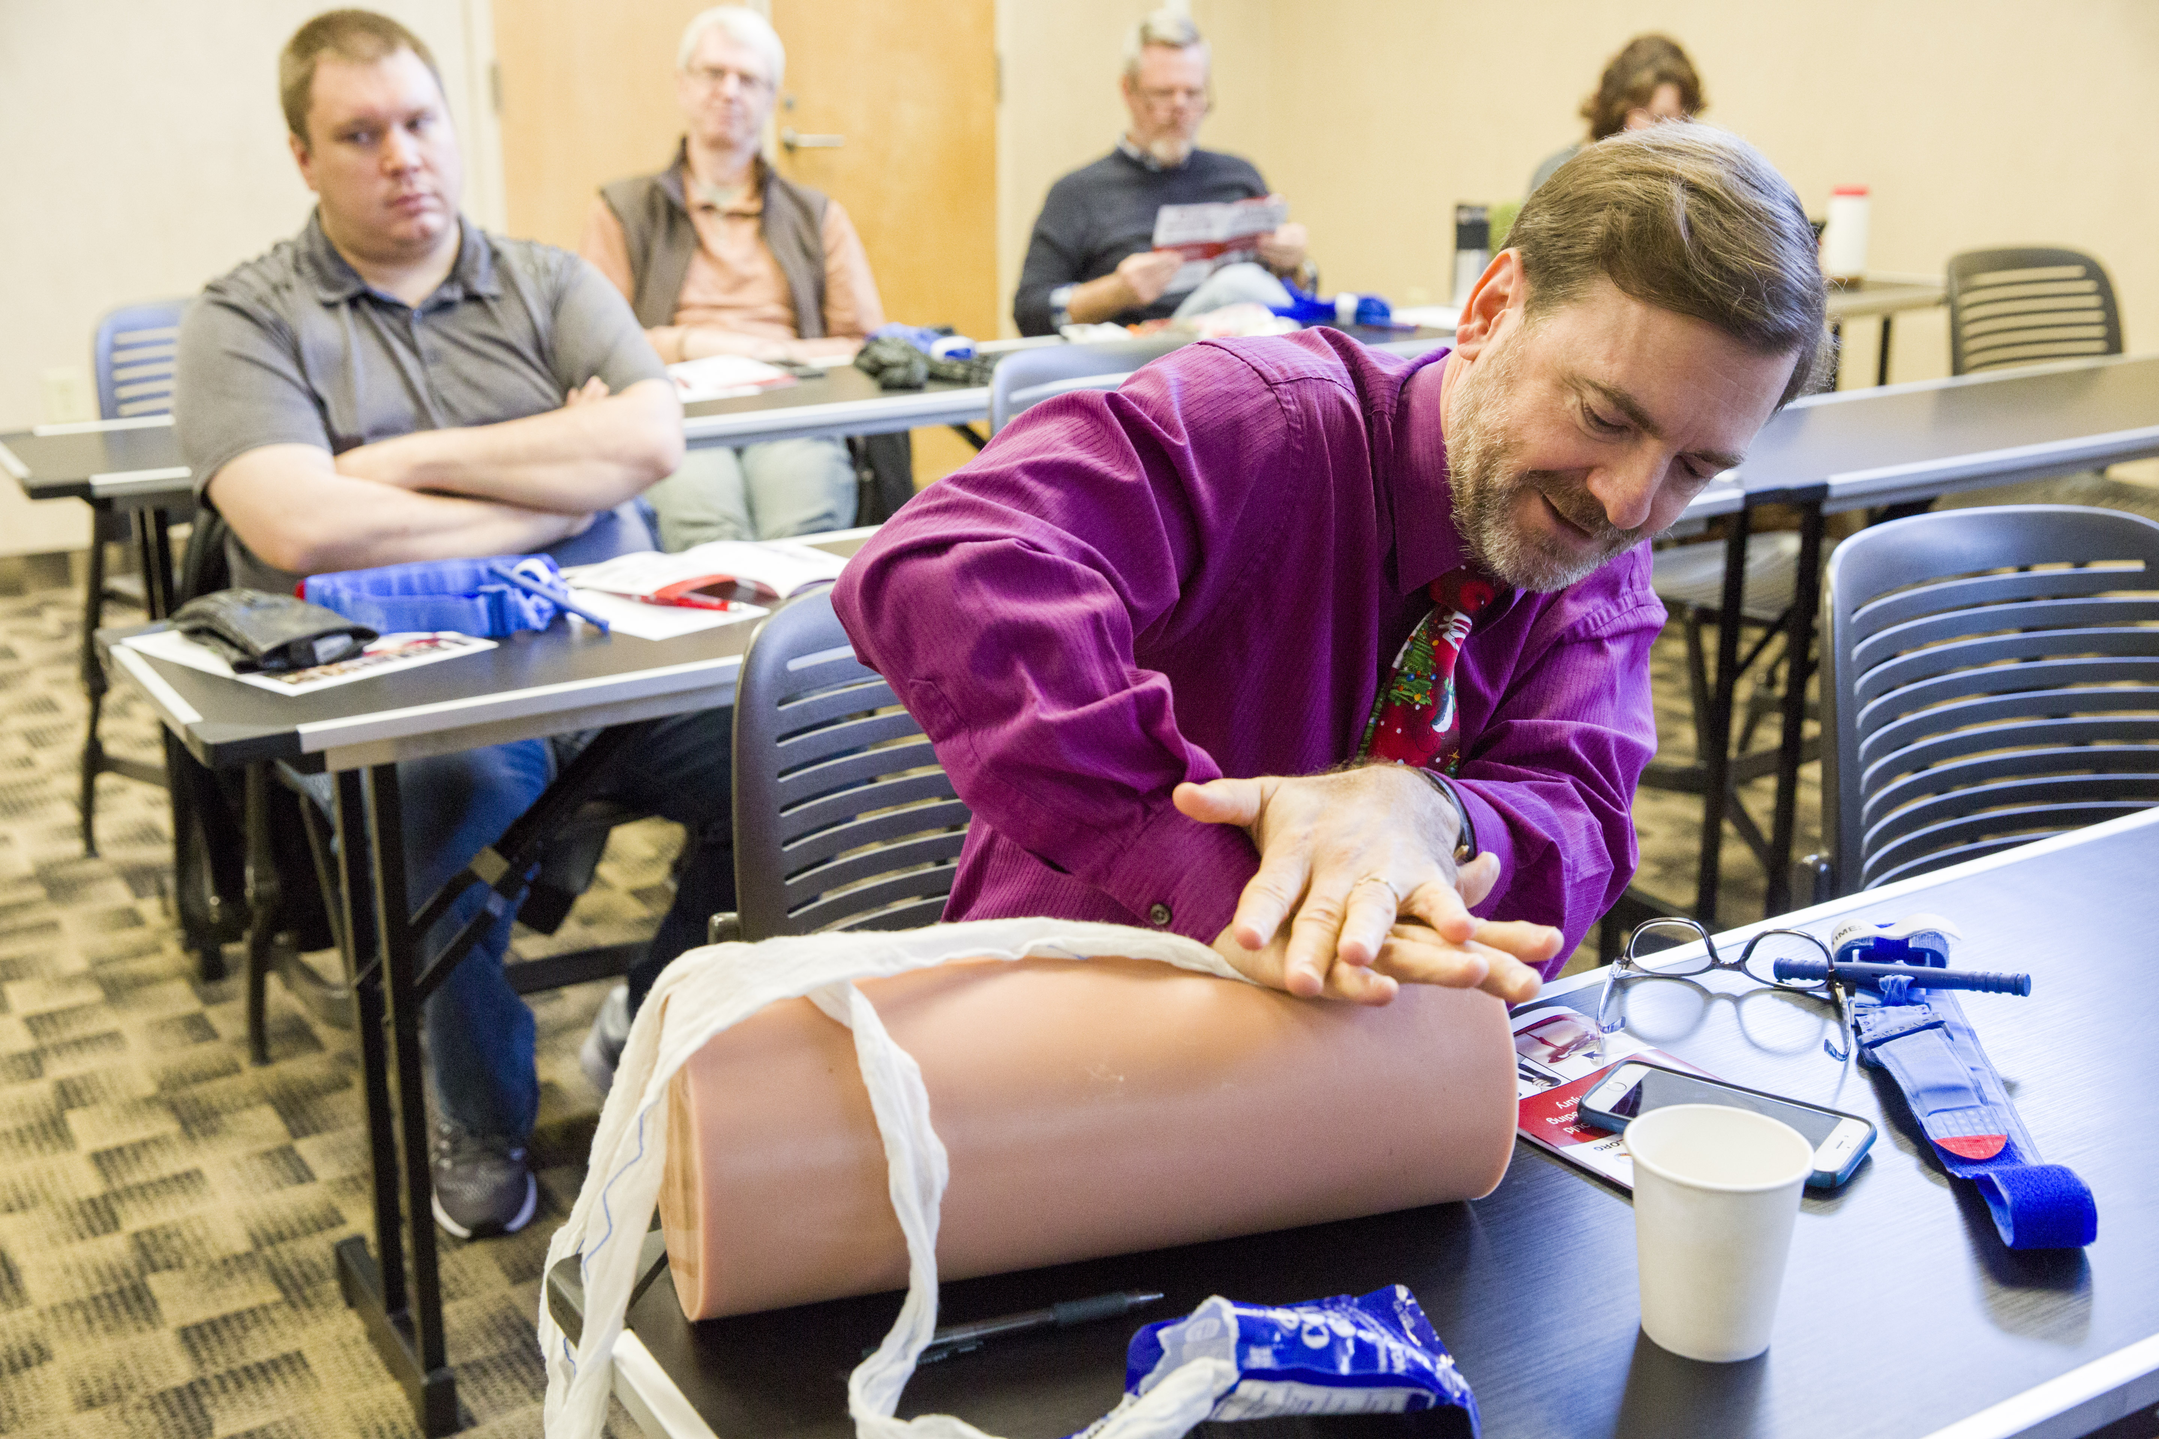
Training Overview
Campus AED/STB oversight committee
Public access kits in AED cabinets — 600+
In-house instructors for 1.5 hours class
Certification via bleedingcontrol.org
Include in faculty and staff professional development series
18-22 classes and 300+ participants each year
Training investment for equipment — $2,000

Slide 7
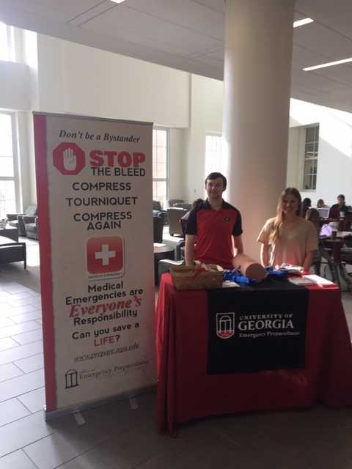
Communication Strategies
Student videos — 60 seconds — social media
Volunteer groups (MRC, CERT, Student Ambassadors, AED Coordinators, building reps)
Faculty/Staff Professional Development Series
Combine with other campus events to market — Bike/Pedestrian Safety, Health Center events, student orientation, student groups (Student Government Association)
Provide Lifesaver Awards for public recognition
Other campus partners — Risk Mgmt., Campus Recreation, police, EMS, hospitals
Participate in many community events off campus

Slide 8
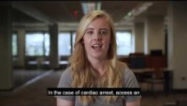
Notes:
https://www.youtube.com/watch?v=H8cXTxNO2jU&feature=youtu.be

Slide 9
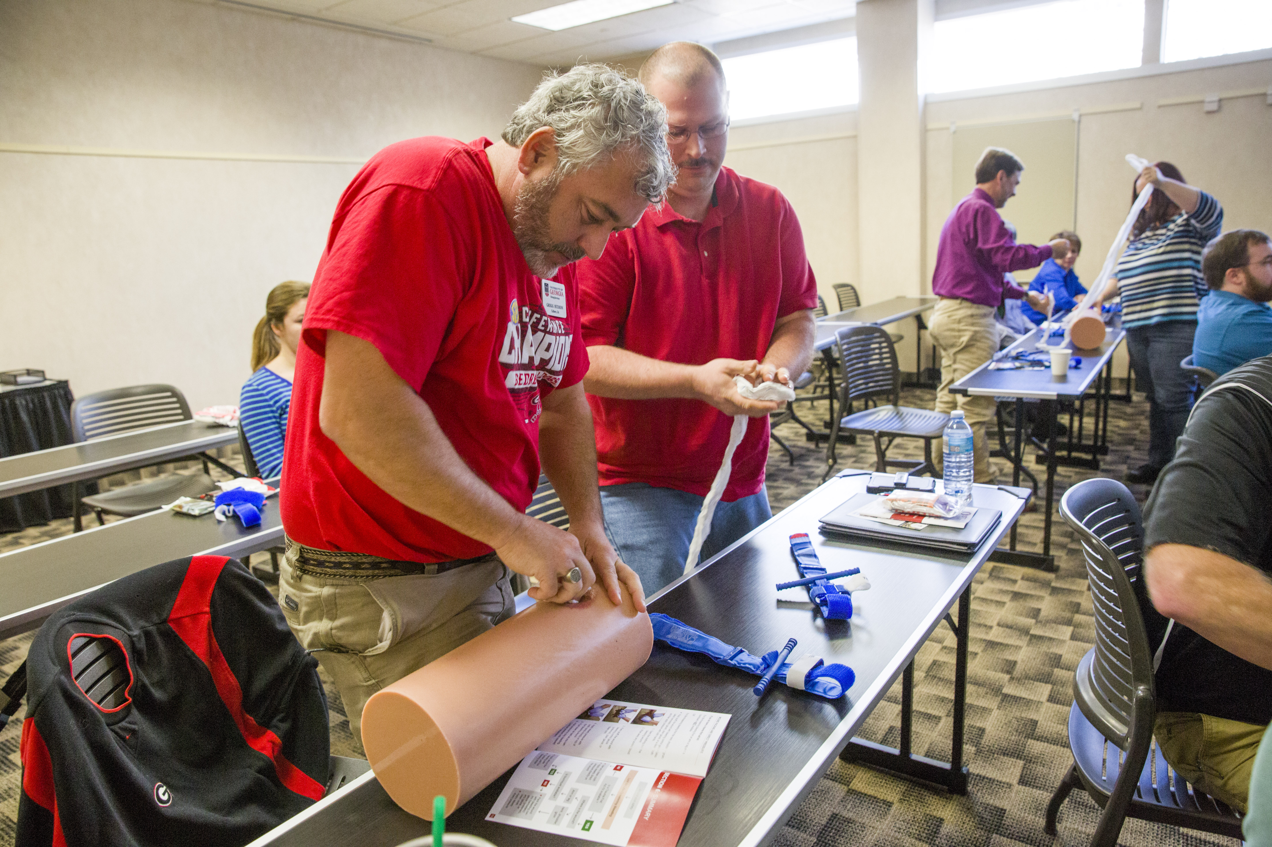
Lessons Learned
Completed a 5-year program review
Bleeding control kit incentives are preferred by participants
Campus and community partnerships have been of great value for marketing program
Positive feedback when included STB in CERT and MRC curriculum
Connection to campus mobile safety app
Modified training based on participant interest in purchasing/building own trauma kit
Recertification video/class needed due to perishable skills — coming soon

