Slide 1

Community Lifelines at the
University of North Carolina at Charlotte

Slide 2
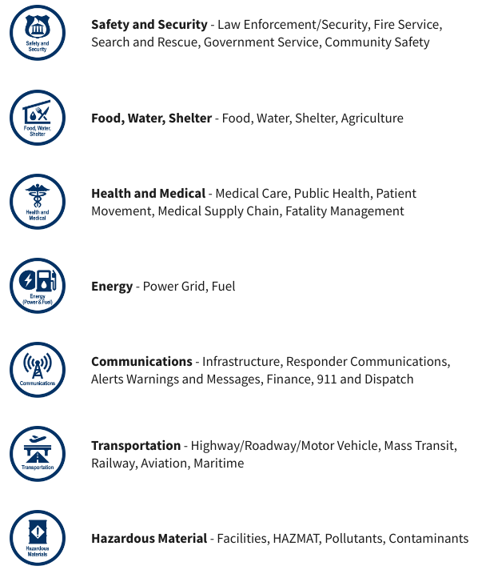
Current FEMA Lifelines
FEMA created Community Lifelines to reframe incident information, understand and communicate incident impacts using plain language, and promote unity of effort across the whole community to prioritize efforts to stabilize the lifelines during incident response.
FEMA Lifelines Link
Notes:
Share in chat:
Community Lifelines: https://www.fema.gov/emergency-managers/practitioners/lifelines

Slide 3
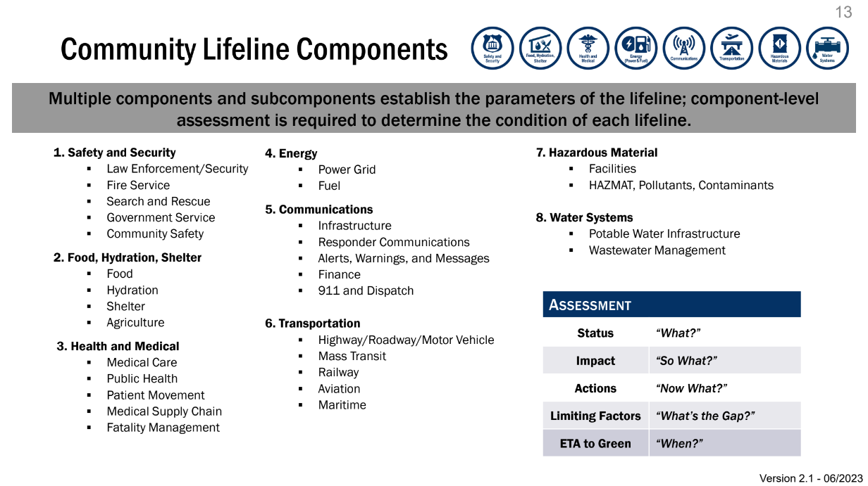

Slide 4
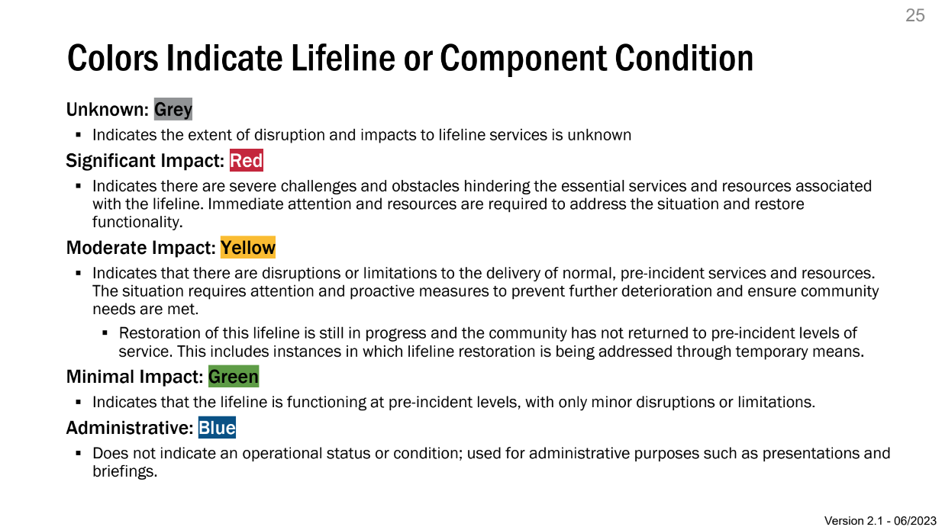

Slide 5

UNC Charlotte Lifelines

Slide 6
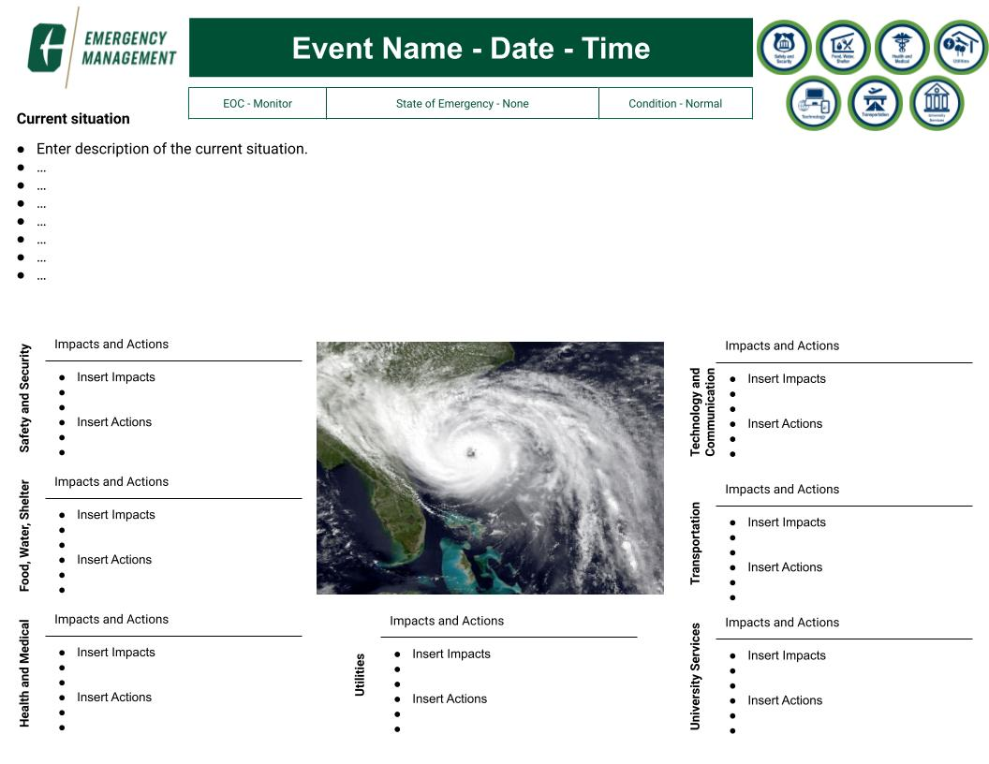
Lifelines
Reporting

