Slide 1
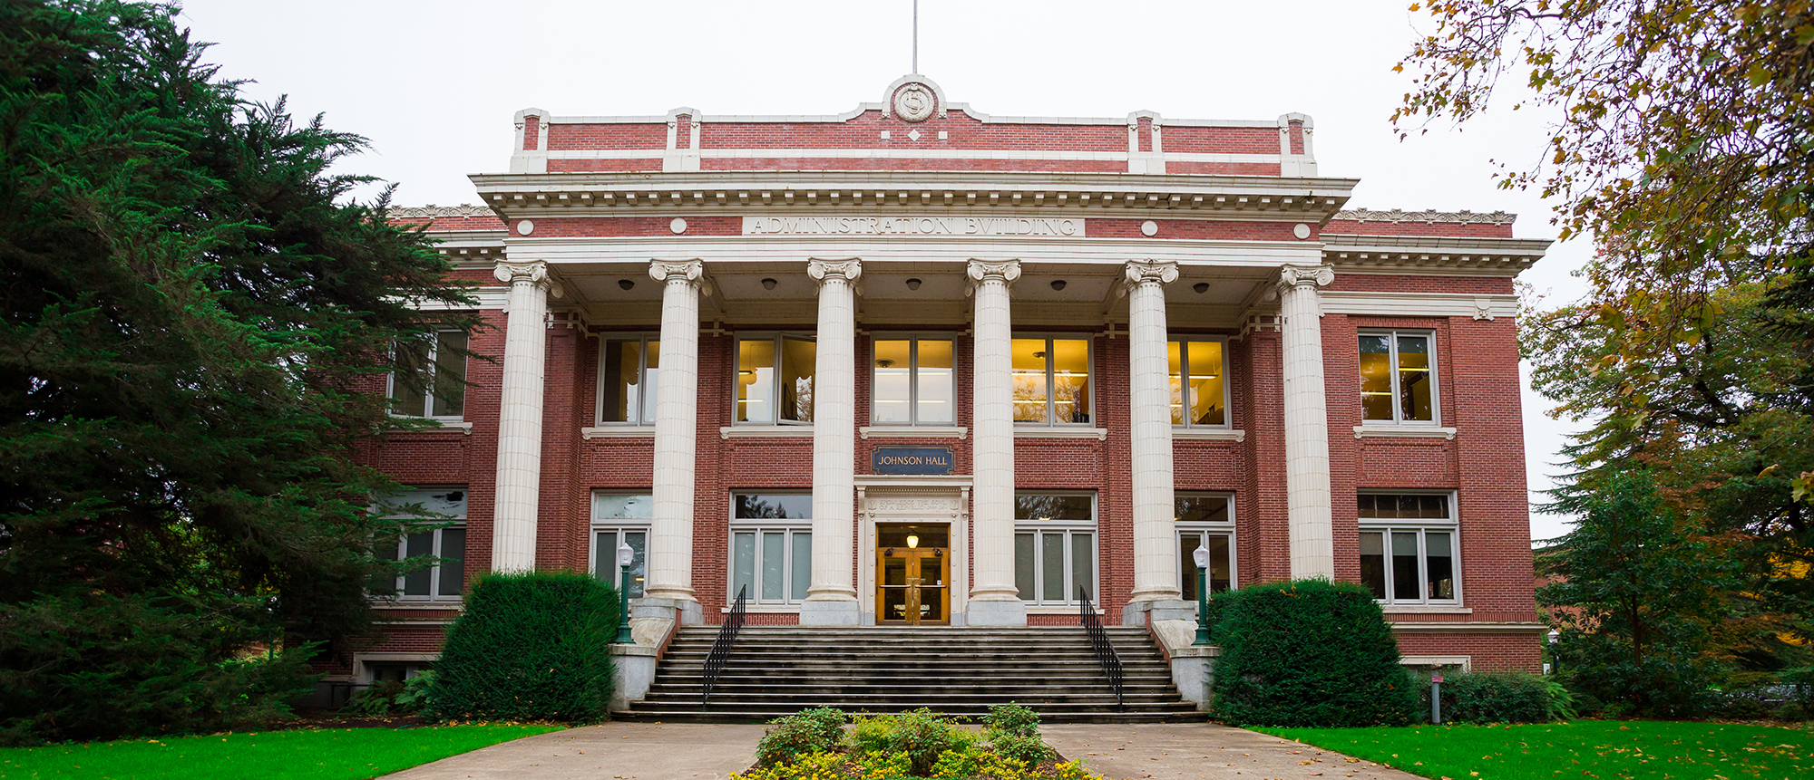
UNIVERSITY OF OREGON

Slide 2

Crisis Leadership Waves Concept
André Le Duc
Chief Resilience Officer – University of Oregon
The Great Wave off Kanagawa - Katsushika Hokusai

Slide 3
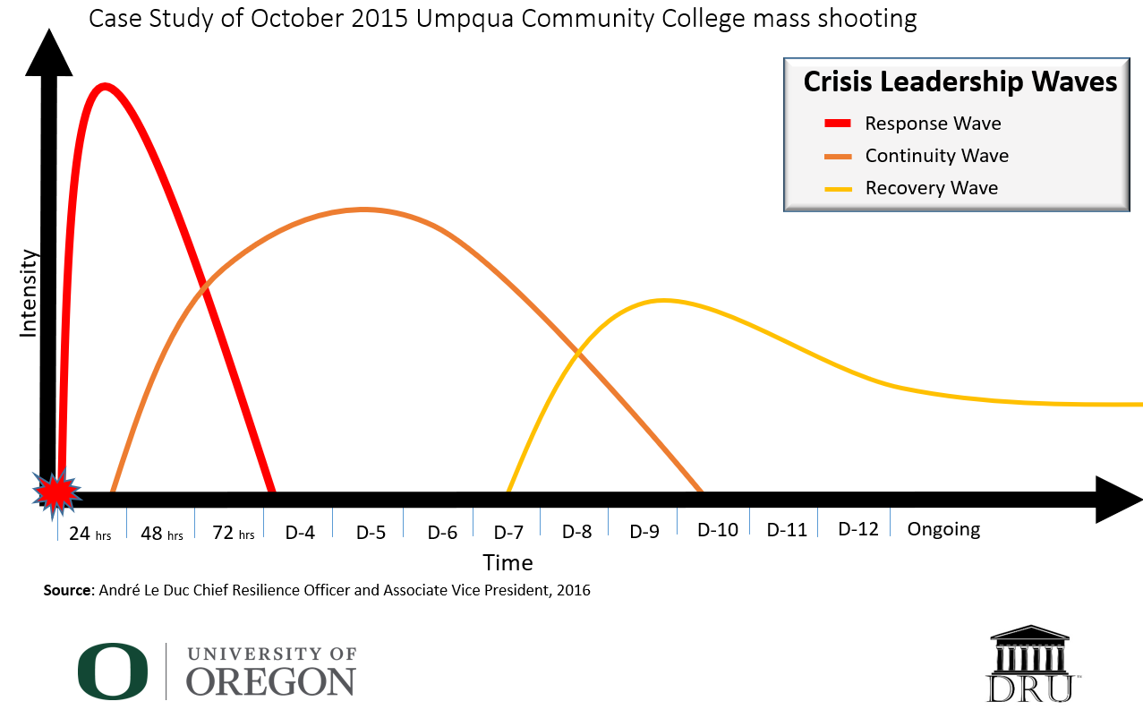
Understanding the Waves of a Crisis

Slide 4
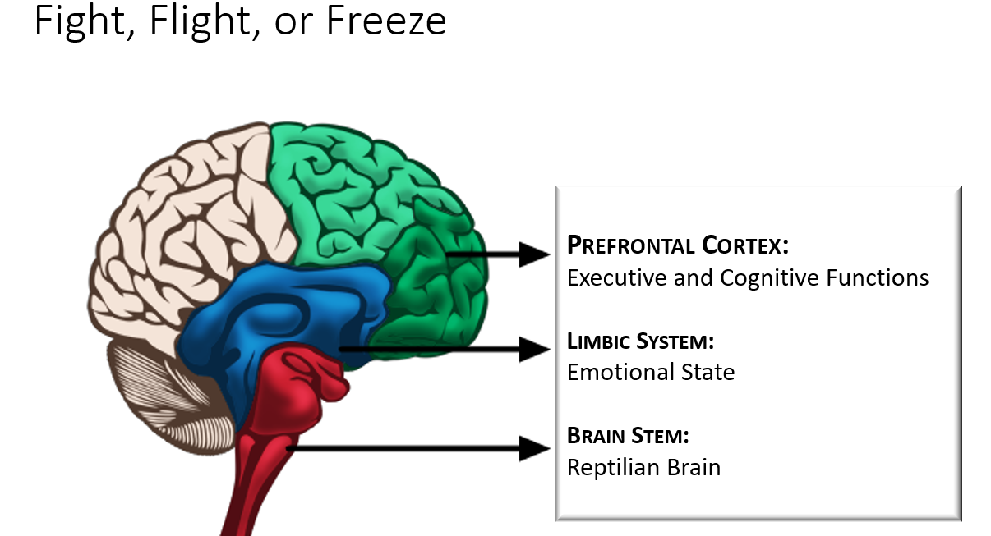
Understanding Our Brain and Stress

Slide 5
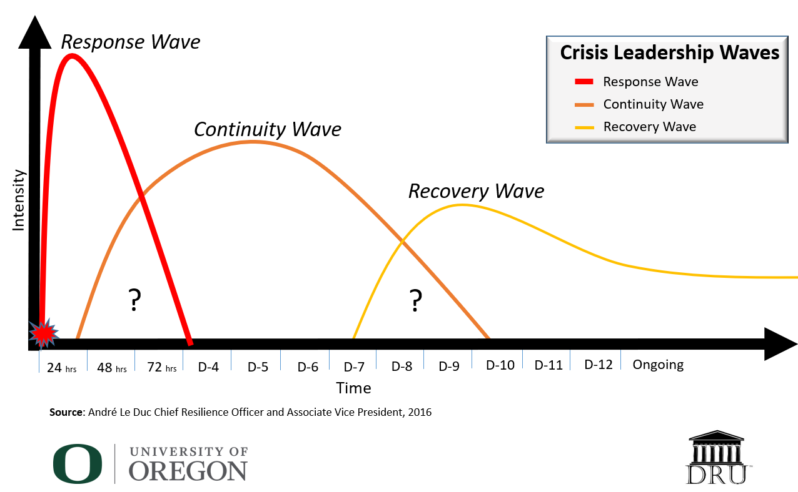
Do we have plans for transitions?

Slide 6
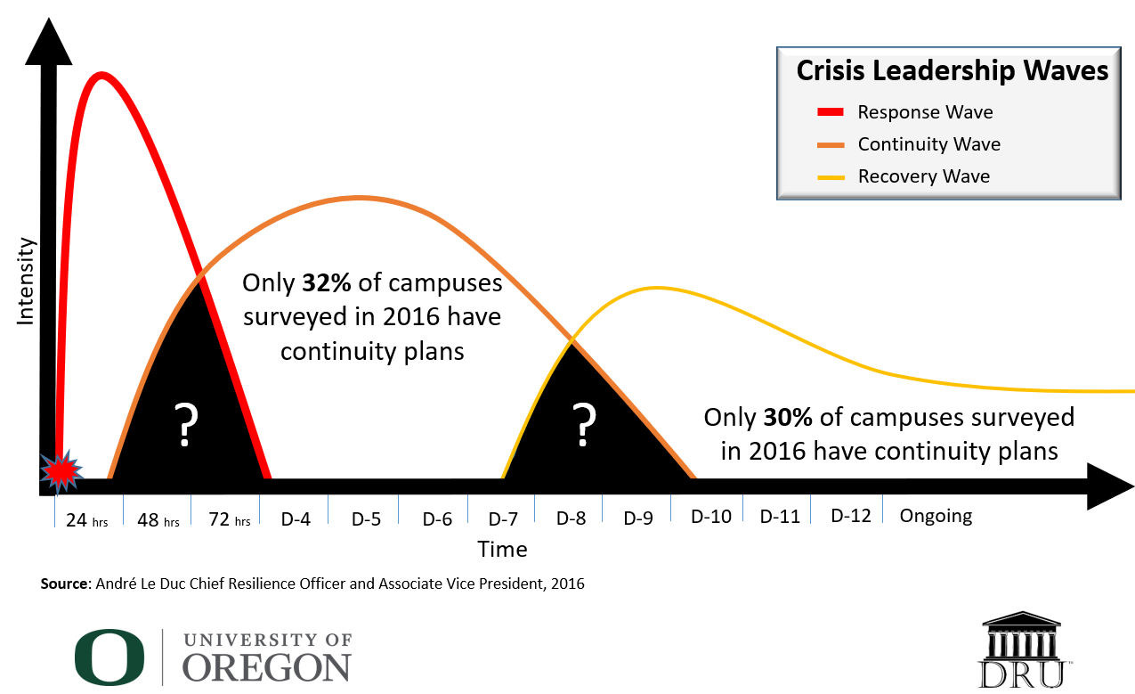
Where does mental health support fit?
Only 30% of campuses surveyed in 2016 have recovery plans

Slide 7
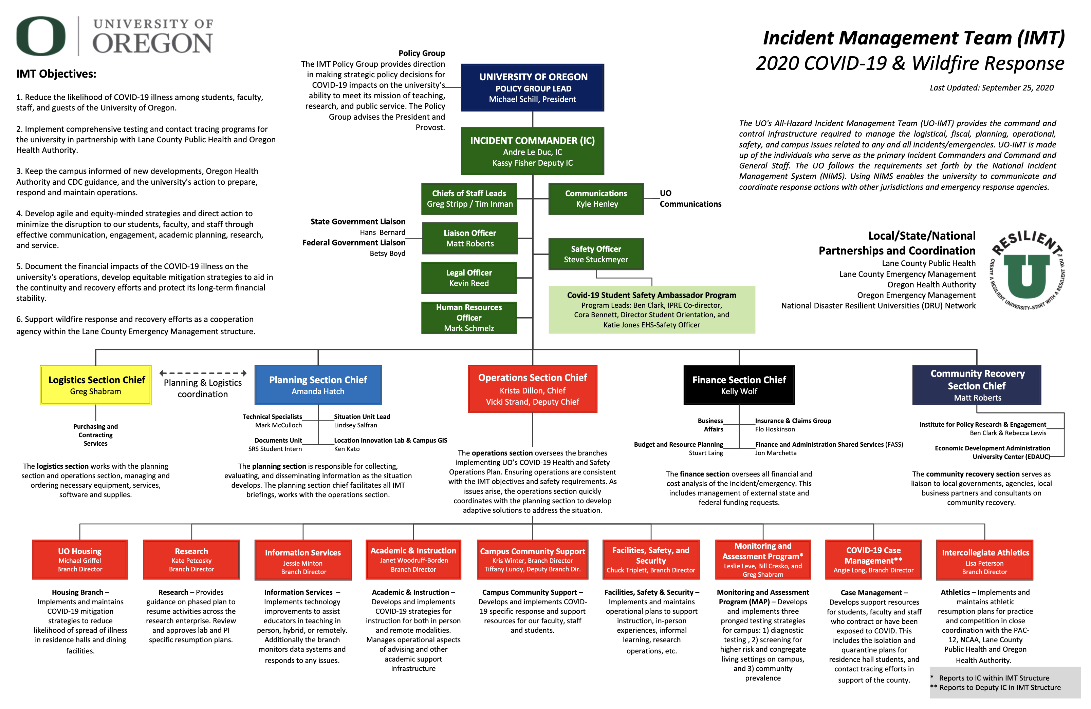

Slide 8

Program Highlights
Created in 2015 by then UC Davis Police Chief Matthew Carmichael of the UC Davis Police Department and Anita Ahuja from the California Victim Compensation Board with the first conference being hosted by UC Davis.
University of Oregon hosts three conferences pre pandemic
Leave No Victim Behind is now functioning as a non-profit and expanded the conference series in 2021 to include the topics of pandemic and civil unrest
Only international conference to bring together victim advocates, emergency managers, first responders, non-profits, district attorneys, and survivors to share real life experiences when responding to some of the most horrendous mass violence events that have occurred in history

